Slide 1
Destination: Secondary
In transit

Slide 2
My name is Ruby
I was once a tween too

Slide 3
My School
I went to Kingsdale
It’s not in Croydon but it’s a secondary school:
It’s mixed
It’s multi-racial
It’s massive
(400 children per entry form)

Slide 4
My thoughts while in transit
What if I arrive late?
What if I get lost?
Yeah, I can travel by myself!
What if I forget my homework?
What if I am not with my friends?
Yeah, I am officially older now! Moving to KS3!
Yeah, I’ll be able to access so many clubs!

Slide 5
With great powers come great responsibilities

Slide 6
STEP 1: Planning
Make a to-do list
Get uniform
Get zip-card
Sort out route to school
Get a bag
Get a pencil case
Download homework App (SMH)
Get a phone
Set an alarm to wake up on time
Think
Discipline
Safety
Wellbeing

Slide 7
STEP 2: TRAINING
Taster days
Summer school
Practice the route
Arrange to go with friends
Practice makes perfect

Slide 8
STEP 3: It’s a go, go, GO!
Getting your timetable
Meeting your teachers
Meeting the other children
Making new friends
Getting used to moving around
Joining after school clubs

Slide 9
Top tips

Slide 10
Remember what matters
Be punctual
Be in your uniform
Do your homework daily
And you will be running for gold!
Mr. Morrison and David Cameron

Slide 11
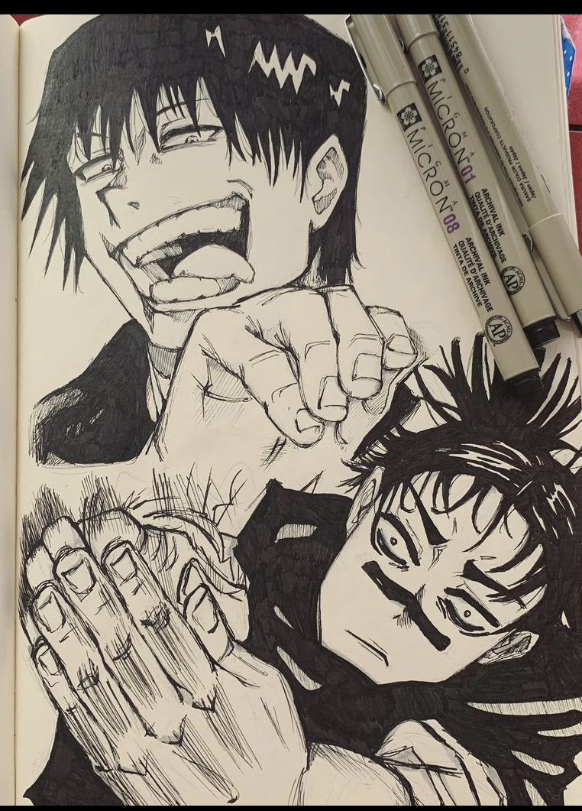
MY TOOL BOX
Meeting my best friend
Chilling listening to music
Drawing
Watching a movie
Stretching
Taekwondo
Taking a bath
Having a massage
Family time
Playing games

Slide 12
Your TOOL BOX
What is in your toolbox?

Slide 13

Moving up!
The transition to secondary school https://youtu.be/kFpVOIpeksk

