Slide 1
Helping children to cope with anxiety
Zoe Barkham Manlow
Croydon Council

Slide 2
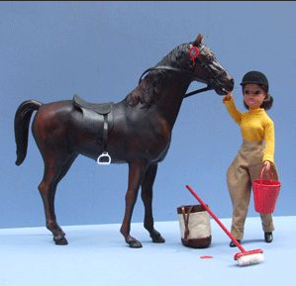
Down memory lane…
What made you happy when you were a child?
This might be your favourite toy, place, pair of shoes or song
What emotions is this memory giving you?
This exercise is helpful when thinking about how to help children
Notes:
The point of this exercise is to highlight the way that adults can lose sight of how it feels to be a child. Being able to see things from a child’s perspective is key to being able to identify and deal with their anxiety.
For example, an adult might respond to a falling-out between children by saying “just play with someone else.” However, this is a response designed to suit the adult (it helps them avoid having to spend time on what feels like a trivial problem). It does not help the child to deal with the situation, or to develop the skills they need to cope with conflict, or to manage their distress.
Thinking ourselves into the child’s world, seeing him or her as an individual, is the biggest part of being able to support them.

Slide 3
Your “frame of reference”
It’s important to be able to think ourselves into the mind of a child
We need to enter their reality so they believe we understand them
We are shaped by our own experiences and we need to acknowledge them
Feel free to ask questions as we go along, but it’s okay if you’d rather just listen
Notes:
Our own experiences shape our reactions and our attitudes. These experiences might have been positive ones – for example, if our parents behaved in a way we liked, we might well copy it with our own children.
However, negative experiences may have the opposite effect. This is important when we remember that we might not recognise that things we went through were not okay.
For instance, as a child we might have just accepted that being beaten or shouted at was a normal part of life, and then go on to repeat those behaviours with our own families.

Slide 4
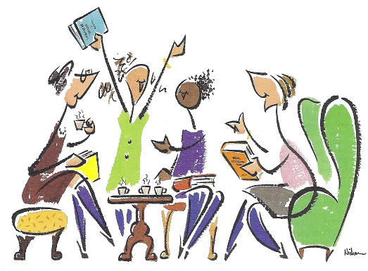
What we’ll be talking about:
The brain, how it develops, and how it affects behaviour
What anxiety is and what it’s for
Guiding principles for working on resilience
Practical ideas for use at home

Slide 5
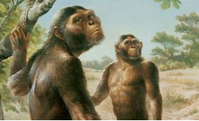
The key points
All behaviours are forms of communication
People of all ages will do anything to avoid anxiety
We often don’t realise this is what we are doing
Biologically, we are still a prey animal
Notes:
Behaviour is often a clue to what is really going on in a child’s mind. They may develop very clever coping strategies to avoid situations that frighten them but these solutions may cause problems themselves.
For instance, some children may learn that by misbehaving in a lesson that worries them, they can get sent outside and thus avoid having to do work that scares them.
Our anxiety is something we may not recognise but it can affect all aspects of our lives. How much effort do we put into not booking that dentists’ appointment?!
Adults’ emotional reactions can:
Exacerbate or reduce the anxiety being felt by the child (and perhaps other adults)
Affect how they manage their own wellbeing (perhaps by taking problems home with them, feeling guilty for always being cross)

Slide 6
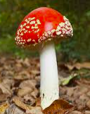
Evolution and mental health
Human beings needed to adapt to challenging environments
Changes were too fast for the adaptations to be fixed biologically
Instead, we had to learn as a group from other people we trust – this means we learned to understand other people’s feelings
This trusting relationship for children is called containment and leads to attachment
We have to trust before we can learn
Notes:
In our earliest days, we had to be able to rely on other people – to read their body language and expressions, to make a judgement on whether we would be safe with them. For example, we had to trust when another person told us something like a mushroom was edible. We still have this need today. For instance, we choose which news source we trust and therefore believe.

Slide 7
Containment
The infant experiences overwhelming distress (hunger, fear, discomfort)
The caregiver understands this distress and can bear it herself*
She communicates this understanding with her response, through both words and non-verbal signals
The infant is reassured and anxiety is reduced by this understanding
Hormones cause both stress and soothing reactions
* It can be a man too!
Notes:
By picking up a crying baby, feeding it, cuddling it and so on, the carer shows that its distress has been understood and that another human being can support this distress.
The baby’s distress causes the release of stress hormones and more hormones are produced when the baby is soothed.

Slide 8
The care and containment comes from a reliable, trustworthy source
The caregiver’s response teaches the child about themselves – feeling hungry results in being fed
The child begins to learn about understanding their own and other people’s feelings
The caregivers become the “secure base” to which the infant is attached
Notes:
However, if care is not given, the baby is being taught that its distress is not recognised and it does not learn about how to interact in a healthy way. It does not develop that secure base from which it can explore life safely.
If care does not come, stress hormones are not reduced. These can eventually affect the development of the child’s brain.

Slide 9
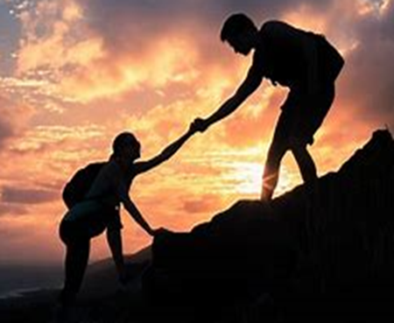
Attachment provides contact with the secure base, allowing the child to feel safe and secure
Families are the root of attachment for most children
Schools, settings and their staff can all become secure bases for children – especially those who lack attachment in their family life
With a secure base, the child can explore life safely

Slide 10
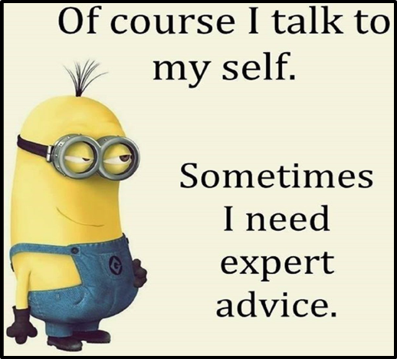
The importance of language
Words help the child to translate fear into thoughts
This helps the child to explore their fear and to find solutions, with the help of supportive adults to offer containment
It means we can describe what we are feeling
Without this, the fear and uncertainty become overwhelming
Notes:
If we can’t explain or describe how we are feeling, we can’t seek help. Fear and anxiety are left to grow.
It’s important to give children a wide emotional vocabulary, and to teach them that it’s okay to talk about feelings.

Slide 11
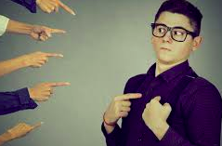
Splitting and projecting
Strong feelings are too much for us so we split them off
They can then be projected onto other people who can “feel” them for us

Slide 12
A child who is bullied may scare others in order to make them feel the fear and anger the child cannot bear
The child who laughs at others for getting something wrong may have been very scared about not knowing the answer themselves
Children who feel ashamed of their own lack of skill may mock other children to make themselves feel superior
A child who picks on another child for sharing one of their traits may be punishing the problem in the shape of the other person
We all do this, even as adults….
Notes:
For example, if we see someone who seems to be more successful or attractive than us, we might try to find something negative about them to make ourselves feel better.

Slide 13
What can be done?
Ask yourself “what is the behaviour trying to tell me?”
Remember that the anxiety and fear may make it hard for the child to express what is going on (more on this later!)
Respond with patience, consistency and kindness
Do not add to the child’s fear – we all remember scary teachers but for the wrong reasons!
Notes:
Be kind to yourself. We are all only human. We don’t always get it right. Be patient and just try again next time.

Slide 14
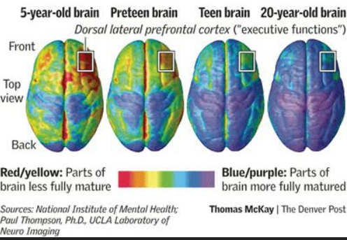
What on earth are they thinking?
Notes:
This infographic shows how the areas of our brain that are responsible for “executive functions” do not fully develop until we are in our 20s.
Executive functions are things like decision making, empathy, managing risk, planning and so on.
This is why we can’t expect children and teenagers to think clearly about their actions – their brain is not fully wired up to allow them to be rational about how they behave or react.
This is why teenagers have been described as being like a Ferrari with no brakes!

Slide 15
The amygdala – part of your “lizard brain”
Linked to survival responses – “fright, flight, freeze, food and fornication”
Triggers an uncontrollable and unthinking physiological response
Can’t tell the difference between real or perceived threats
Strong links to stored memories
Notes:
The amygdala (we have a left and right one) are small structures in the brain. They learn and store information based on emotional events, using memories as a reference for whether something is a threat or not. It doesn’t distinguish between real or imagined danger.
The amygdala causes physical reactions to shock or fright by sending hormonal messages to the hippocampus. These reactions include:
Faster heart rate (gets blood to muscles)
Nausea (halts digestion to divert energy for fright/flight)
Dry mouth (water diverted to the blood)
Red face (blood to surface of skin)
Shaking (adrenaline and tension)
- all physical reactions aimed at escaping from danger, whether this actually exists or not (they also cause after-effects such as tiredness, headache etc.)
People with a damaged or missing amygdala often don’t feel fear even in extreme situations.

Slide 16
The brain and hormones
Some stress is useful – it stimulates us and helps us to learn
The fright/flight response is controlled by stress hormones released by the brain
Being soothed produces calming, feel-good hormones
However, high levels of stress hormones that are not reduced by care can affect the development of the brain – stress becomes “hard wired”

Slide 17
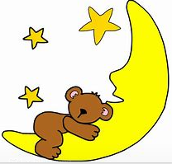
Other brain issues for children
The amygdala is not fully mature or connected
The hippocampus, which controls memory, is not fully developed
The neurons related to empathy and compassion are changing
A brain chemical called dopamine increases at puberty, which means the brain becomes hyperactive
Technology can stimulate the brain and reduce the quality of sleep
Notes:
These are all reasons why we can’t expect children to behave in the same way as adults.
This is why we started with the exercise reminding us how important it is to see things from the child’s perspective.

Slide 18
How we can help
Help children explore the causes of their anxiety, and identify ways to defuse things
Remember that the “flight-fright” response is often irrational
Replace stressful mental images with positive ones
Challenge unhelpful versions of the “truth”

Slide 19
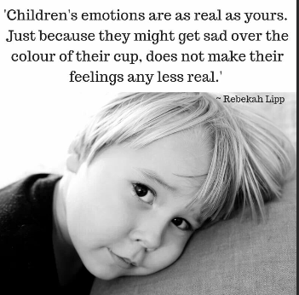
Beneath every behaviour is a feeling. And beneath every feeling is a need. And when we meet that need rather than focus on the behaviour, we begin to deal with the cause not the symptom.
Ashleigh Warner, psychologist

Slide 20
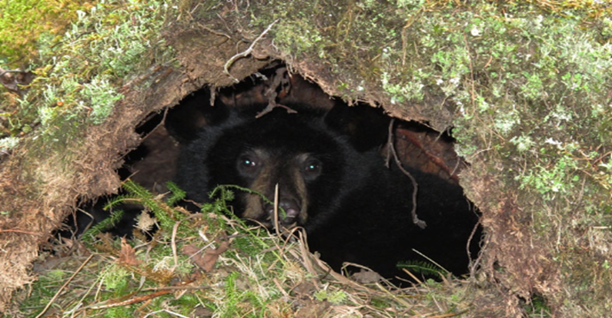
Pareidolia and the power of pictures
Human brains work on images rather than words
New born babies are attracted to things that look like faces
Our lizard brain links images to memories and emotions, and this reinforces our “truth”
Is it a shadow, or a bear?
Notes:
It is because of this reliance on images that we can’t understand foreign languages until we learn to associate the sound with the image.
The amygdala basically uses memories to create a “reference library” to check if a situation is dangerous, but it always assumes that danger is present. This is why, if you go into your bedroom and see your dressing gown hanging in an unfamiliar place, you might jump out of your skin thinking it’s someone standing there. The amygdala has registered a person-shaped presence, and only thinks it’s a dressing gown rather than a burglar later. Children have this reaction, without adult experience to help rationalise the situation.
If the amygdala is damaged, people often lose their sense of fear as they have no memory of why something is frightening.
If you go into a cave and see a shadow that looks like a bear, you can think “that’s a bear!” and run out again. Or you can think “that’s just a shadow” and stay there. Overall you are safer running out as it might indeed be a bear…whereas staying means you are possibly going to get eaten.

Slide 21
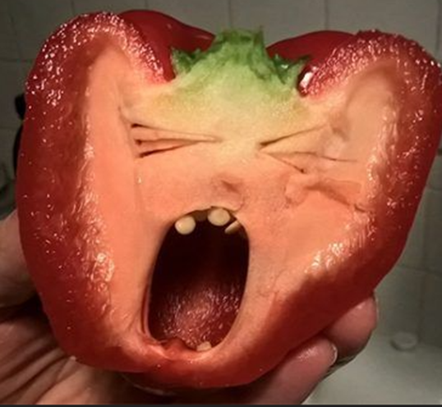
Notes:
These are all examples of how we see “pictures” that aren’t really there – to illustrate how our brains are programmed to see things that might keep us safe. We are especially drawn to things that look like faces.

Slide 22
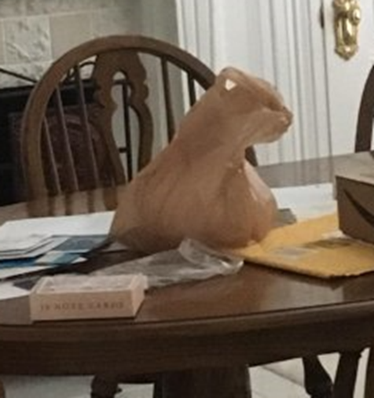
Notes:
The plastic bag cat

Slide 23
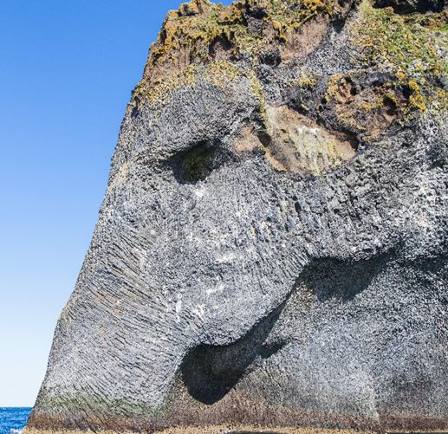
Notes:
Elephant Rock, Iceland

Slide 24
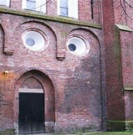
Notes:
An alarmed-looking building

Slide 25
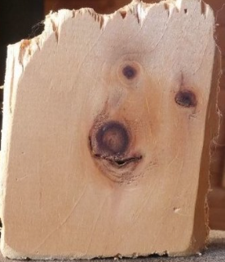
Notes:
Dog or polar bear?!

Slide 26
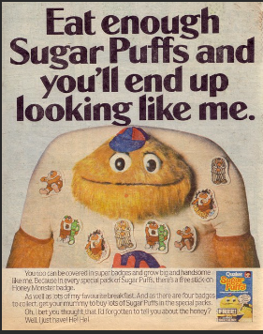
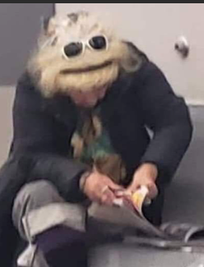
Notes:
My personal favourite

Slide 27
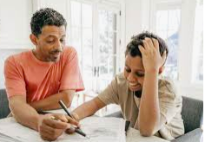
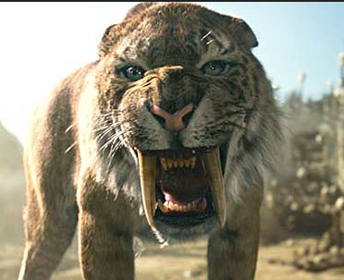
The impact of this in real life
You see….
The amygdala sees…
Notes:
The amygdala is responding to the threat it perceives, not the situation as it actually is.
This is why a child might react in a way that seems completely out of proportion. The amygdala is responding to a stored memory.
I worked with a young woman who had been taken into care after a terrible childhood. Her new carers brought her PE kit to school the day she forgot it and it caused her to have a huge meltdown. Nobody could work out why, until someone realised it was because in this girl’s world, adults were abusive and cruel. To her, an adult being kind was completely terrifying as she had never experienced it before.

Slide 28
Working with the brain to make things better

Slide 29
The self-talk cycle (with thanks to the Pacific Institute)
Someone we believe gives us information about ourselves
This becomes our “truth”, stored subconsciously
We cannot bear the unconscious anxiety when we move
away from our “truth”
We go out of our way to make things “true” again -
behaviour becomes a solution
Notes:
We get information about ourselves from people we trust and believe (like we did with toadstools).
Unfortunately these people may give us negative ideas about ourselves which can then go on to cause us problems. We need to concentrate on using positive language which helps build a child’s resilience to life’s ups and downs.

Slide 30
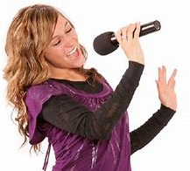
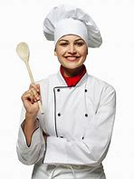
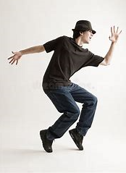
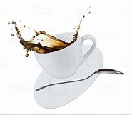
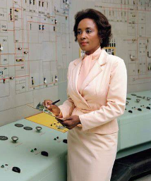
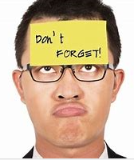
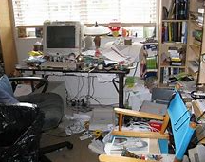
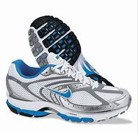
Who gave you your “truth”?
Why did you believe them?
Notes:
Are you a bad singer, dancer, cook?
Are you clumsy and accident prone?
Are you bad at science or sport?
Are you forgetful or untidy?
Why do you think this? Who told you this about yourself? Most importantly, is it true?
How does the belief you hold about yourself affect the things you do and how you feel?
Are you saying the same sort of thing to your child? For example, are you helping them to become anxious and to feel they don’t have any control over events?

Slide 31
Practical ideas for use at home and at school (they also work for grownups!)

Slide 32
“Your room is always messy.”
Mum says I’m a messy person. Mum must be right.
Messy people don’t put their pants in the laundry basket.
My room is a mess. Pants all over the place.
See? Mum was right!
“You’re usually much tidier than this.”
Mum says I’m a tidy person. Mum must be right.
Tidy people put their pants in the laundry basket.
My room’s tidy again. Everything’s been put away.
See? Mum was right!
Notes:
Changing the way we talk to our children is perhaps one of the easiest and most effective ways we can help them to form positive images and to develop strong self-esteem.

Slide 33
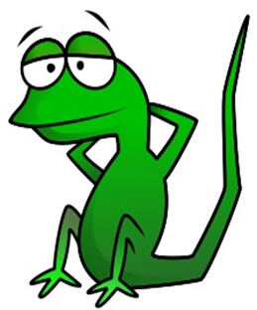
Creating a new truth – tricking the lizard
You always get nervous about tests, don’t you?
You never stop talking when we are trying to learn
You always make so much fuss about the lockdown
You are a calm person. It’s not like you to worry too much
You know that talking is not okay. I see you as an attentive person
Being scared is okay but I see you as a thoughtful person
That’s Not Like You/I See You As… key phrases to use and repeat
Notes:
These are ideas for re-phrasing the way we talk to our children. We can still put the message over, but in a way that forms a positive memory for the amygdala to call on.
That way, positive behaviour becomes the “truth”.
“.”

Slide 34
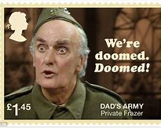
Is your child learning your self-talk?
Take a moment to think about your own reactions to stress
Are you too optimistic?
Or are you a negative fortune teller?
Could changing your reactions help your child?
Notes:
We learn our reactions from our own families. These can become habit, and it may be useful to think about them and to change the attitudes we don’t think are helpful.

Slide 35
Statement Cards
Get ideas and information from advice/support charity websites
Print these off on small cards and leave for your child to take and carry around
Or help your children write and create their own
Children can also make cases/boxes for storing the cards

Slide 36
Suggestions for anxiety cards
Everyone feels scared sometimes
It will all be okay in the end
You will feel better again
You are not alone
Mistakes are the best way to learn
We can find a way around this
There is always someone who can help
You have strengths and skills
You don’t have to be like everyone else
You can always control the way that you react
This is only temporary and things will get better

Slide 37
Hope for the best, prepare for the worst
Say the unsayable – “What’s the worst thing that can happen?”
Help your child to have a realistic perspective and gain a sense of control
Explore how it will feel if something less good happens
Then make a plan for dealing with the situation
If you don’t explore the possibilities, you can’t plan for them
Notes:
We have a strange superstition about voicing our worse fears, as if this will make them come true. However we do need to speak about them, as this can very often reduce anxiety and help us to see things in a better light. As the slide says, we can’t plan for things we don’t explore.
Helping children to plan and to decide on their strategy in advance makes them feel much more in control.

Slide 38
Notes:
Helping your child to distinguish between the things they can control and the things they can’t is very important.
This gives a base for then thinking about solutions and strategies. It also means it’s okay for them to accept that sometimes we can’t do anything except work out how to cope.

Slide 39
“I’m so sad I’m not seeing my friends any more”
It’s really hard not to see people we love. It would make me sad too. Let’s try to think of ways you can keep in touch. Maybe you can all keep a diary so you can show each other everything you’ve done when you see them again?
“I’m scared I’ll get the virus and give it to my mum”
Let’s look up advice about the things we can do to help mum stay safe. It’s great you want to be responsible, that’s really grown up. I’m proud of you.
“I won’t learn anything for ages and everyone else will know more than me”
Everyone will be learning different things while they are out of school. Let’s make a list of all the things you have already done. Then we can look at where you might need a bit more help.
Remember, the fears are the child‘s “truth.” Dismissing them won’t help.

Slide 40
These responses:
Show respect for the child’s feelings
Reassure the child that these feelings are normal and okay
Are realistic and honest
Offer practical, optimistic solutions
Make the child feel they are in control
It’s really hard not to see people we love
Let’s try to think of ways you can keep in touch
It would make me sad too
It’s great you want to be responsible, that’s really grown up
We can look at where you might need a bit more help

Slide 41
Solution-focussed thinking
“If you had a magic wand…?” can be a helpful question
Identify small, practical steps that can be taken
The steps won’t address the underlying problem but will help alleviate the “symptomatic” behaviours or worries
Use a thermometer scale to assess change

Slide 42
10 - The day after the magic wand has worked
(I did my SATS without getting upset)
9 – I have a plan for dealing with any problems that might come up
5 – I’ve done 30 minutes’ revision every day
3 – dad’s agreed not to nag me about revising
2 – I’ve talked to my teacher about how I’m feeling
0 – how things are with the problem
(I’m really scared about SATS)
(With thanks to Brief Solutions)
Notes:
This can be adapted to any sort of problem that can’t be removed entirely (in other words, things the child has to find a solution for – tests, family breakdown, illness, etc).
It can help to keep the thermometer picture and to look at it after the problem has passed. This can show children how many things which seem huge at the time pass and we forget about them, but it also illustrates how we can learn from experience and deal with things better next time. You can also discuss the things that didn’t go so well, and think about how they could be improved.

Slide 43
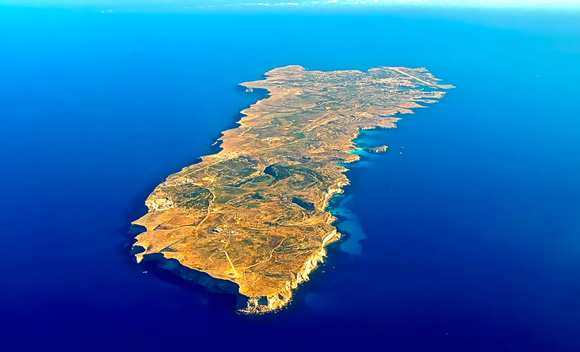
The Three Islands
The Island of things that are okay sometimes
The Island of things I love
The Island of things I can’t bear
Notes:
The child or young person draws three islands
On the first, they can draw or write all the things that are good in their life. This can be anything – friends, family, pets, TV shows, favourite subject at school
On the second, they draw or write the things that are okay sometimes – their brother when he’s not playing bad music, PE when it’s not raining, their mum when she’s not moaning
On the third they draw/write the things they wish were not in their life – being diabetic, their dad’s new girlfriend, the bully on the school bus. They can draw sharks, barbed wire etc to keep these things on the “bad” island
They can also draw a bridge between the islands, and use this to explore what needs to happen to shift things on to the “good” island – help mum with cooking so she’s not so tired and grumpy, tell dad they’d like more time with him by himself

Slide 44
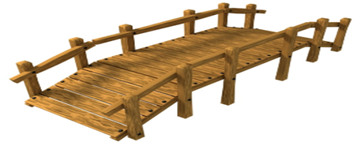
Add a bridge to move between the islands
Learning’s okay sometimes except when it’s maths
I can’t bear feeling so anxious
What is it about maths that worries you? What would happen if you had a magic wand?
What would make things more manageable? What strengths do you have that can help?

Slide 45
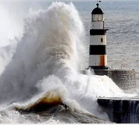
Who was your lighthouse when you were a child?
How can you be one now you are the grown-up?
Notes:
A lighthouse – someone who steers us, gives us someone to look up to, makes us feel safe.
Many children who live through trauma say that there was one adult who helped them survive. It is often someone unexpected, like a friendly lollipop man or a dinner lady who gives them extra food. We can be a lighthouse through our actions and the way we speak to our children.

Slide 46
How to be a lighthouse (without getting wet)
Tune in to your children – show you’ve noticed how they are feeling
Meet them where they are – acknowledge their emotions and allow them to be named
Use your voice, language and body to show you understand
Maintain eye contact
Using the names of feelings
Checking in during the day
Treat each child as an individual
Sit at the child’s level, or walk with them if they want to

Slide 47
Be empathetic
Acknowledge feelings as they are - don’t try to change them
Help the child to make sense of the emotions they are experiencing
Use containing techniques (physical and emotional)
I can see that this is making you really sad
It’s okay to be angry
That would make me scared, too
Let’s have a cuddle while we let the feelings get smaller
How can I help you?

Slide 48
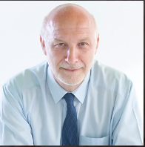
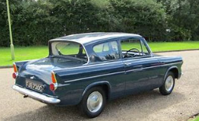
“Peter, that’s a wonderful car”
Notes:
Peter Fonagy is a psychoanalyst, and the chief executive of the Anna Freud Centre. On a recent radio programme he told this story to illustrate how important it is to see the person behind the problem or situation.
He was in therapy as a young man, talking about many significant issues in his life, including his experience as a refugee and being alone in England without his family. He was very depressed and angry.
One day he arrived for his therapy appointment buzzing with excitement because he’d bought a Ford Anglia, his first car.
His therapist didn’t try to drag him into her world. Instead she entered his, by saying “Peter, that’s a wonderful car” - making him feel she saw him as an individual, that she “held him in mind” as a person, and that he mattered as more than just a case.
(Radio 4, The Life Scientific)

Slide 49
Other sources of help and support
The Anna Freud Centre – www.annafreud.org
Young Minds - https://youngminds.org.uk/
Papyrus (young people’s suicide prevention) https://papyrus-uk.org/
Croydon Drop In - https://croydondropin.org.uk/
Off the Record (young carers) - https://www.talkofftherecord.org/

