Slide 1
Welcome to Year 6’s Celebration Assembly

Slide 2
Over the past week, we have seen some exceptional work from our Year 6s. From great reading comprehensions to creative artwork, we have really been impressed.

Slide 3
Take a look at some of the fantastic work that we have been sent…

Slide 6
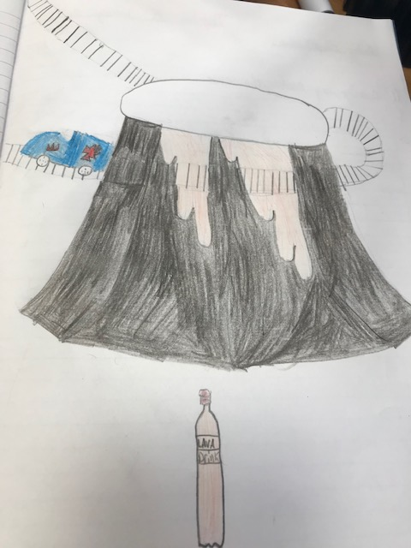
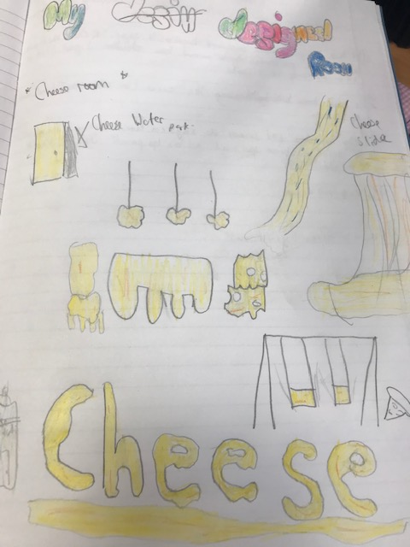
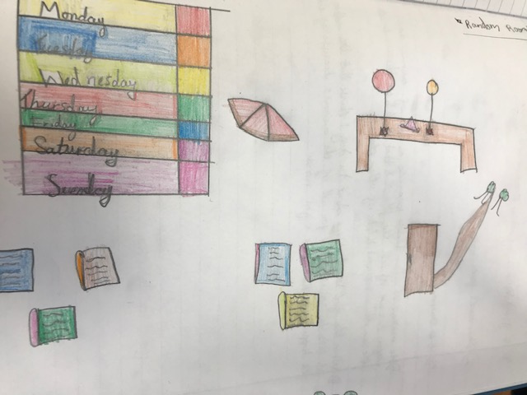

Slide 7
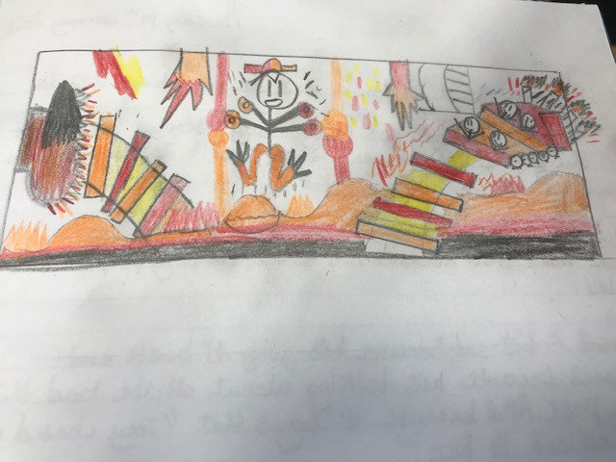
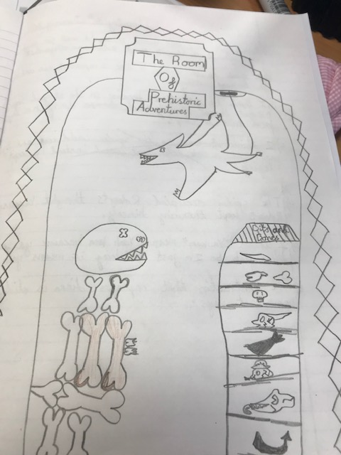

Slide 8
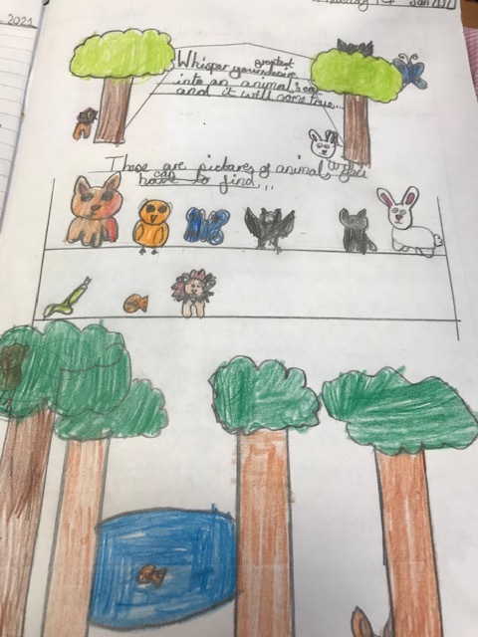
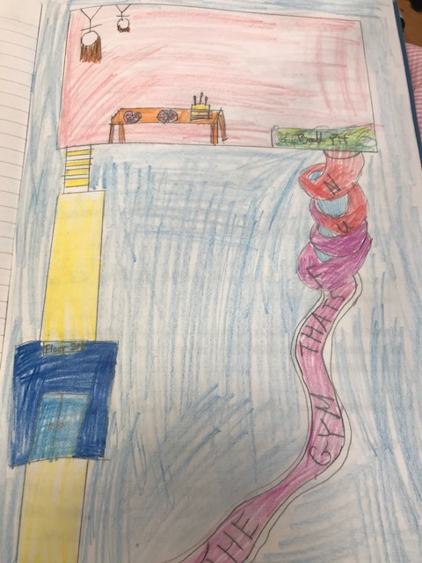

Slide 9
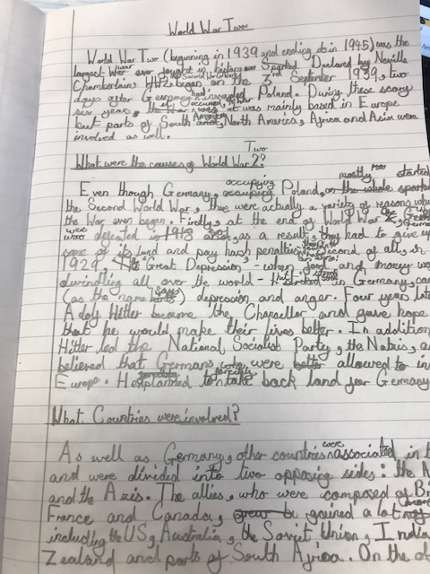
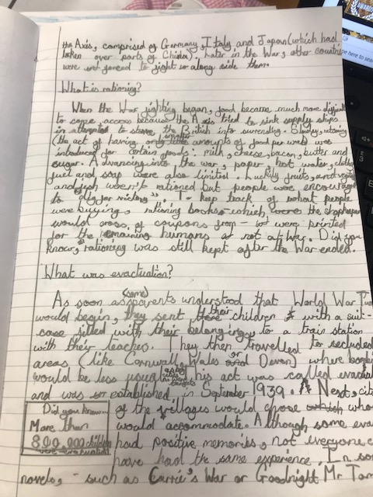

Slide 10
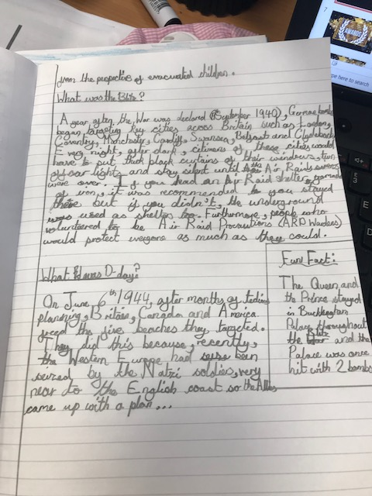
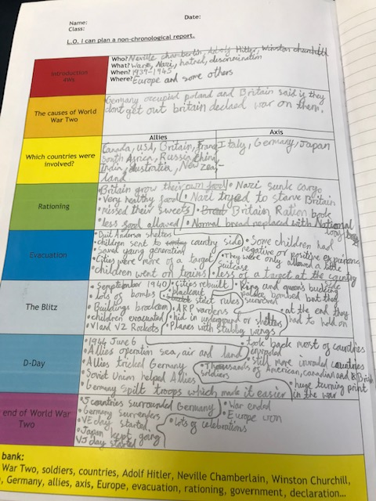

Slide 11
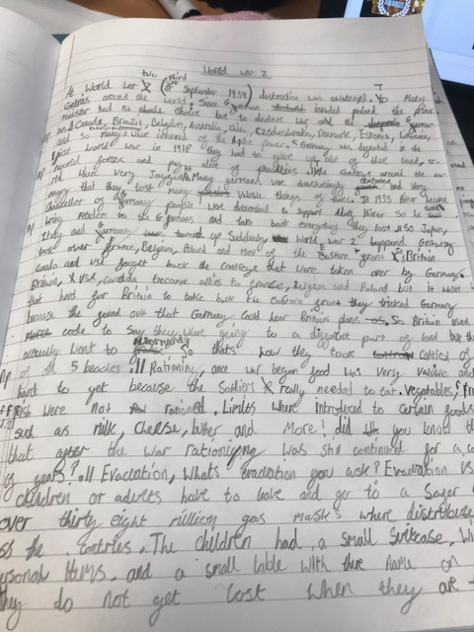
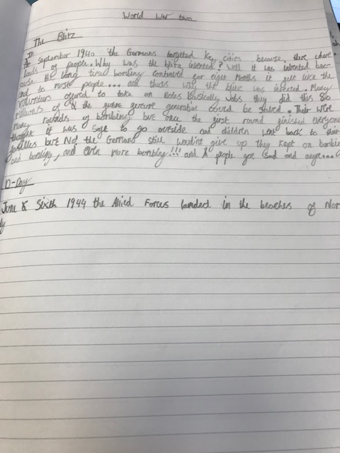
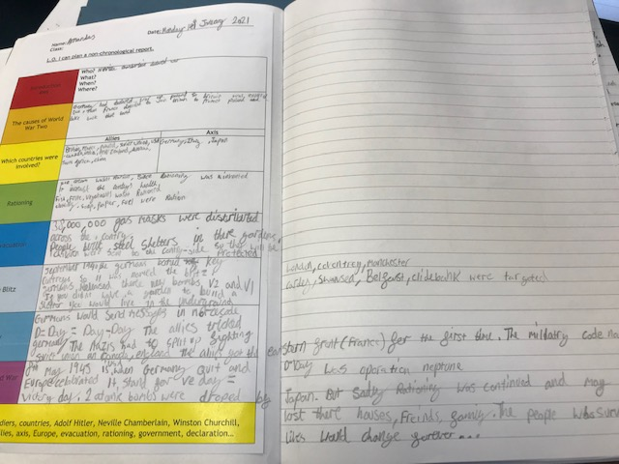

Slide 14
Congratulations
This certificate is presented to
for
Armandas
For your commitment to your learning this week.
Signed: The Year 6 Team Date: 15th January 2021

Slide 15
Congratulations
This certificate is presented to
for
Keona
For your contributions to class discussion!
Signed: The Year 6 Team Date: 8th January 2021

Slide 16
Congratulations
This certificate is presented to
for
Mollie
Taking the time to respond courteously to posts on Google Classroom and to adult’s feedback.
Signed: The Year 6 Team Date: 15th January 2021

Slide 17
Congratulations
This certificate is presented to
Taylor
for
For persevering with your learning, even when you have found things tricky! Well done!
Signed: The Year 6 Team Date: 15th January 2021

Slide 18
Congratulations
This certificate is presented to
for
Lucy
Your incredible song. Your lyrics were truly inspirational.
Signed: The Year 6 Team Date: 15th January 2021

Slide 19
Congratulations
This certificate is presented to
for
George
For your commitment to your learning. Well done!
Signed: The Year 6 Team Date: 15th January 2021

