Slide 1
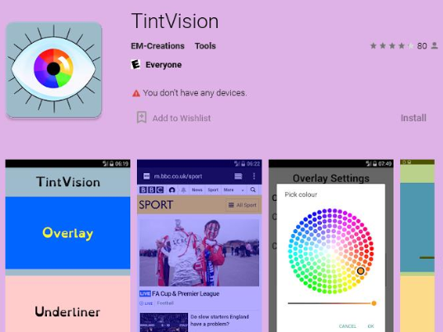
Help for Dyslexia/Visual&Literacy difficulties
How to change the tint on your android phone so that you can access all lessons.
Android Phones – Download the free app Tint Vision – Apply the colour you need

Slide 2
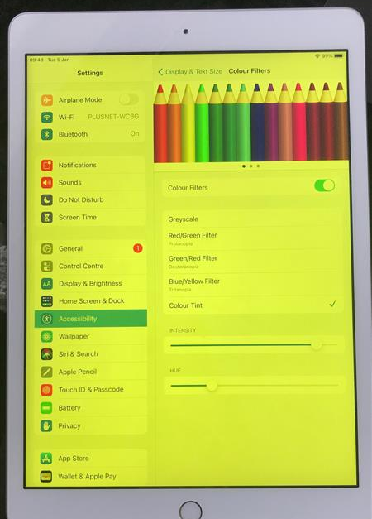
Help for Dyslexia
How to change the tint on your iPhone or iPad so that you can access all lessons.
iPad and iPhones –
Settings > Accessibility > Display Text & Size > Colour Filters > Slide to ON and pick the colour you need by sliding the intensity and hue.
Intensity
Hue

Slide 3
If you are using a phone, a laptop or a desktop:
Go to the aurelitec website and download a free
ColorVeil Color filters over your screen. This will help with reducing eye strain, help with Dyslexia and Visual Stress.
https://www.aurelitec.com/colorveil/windows/

Slide 4
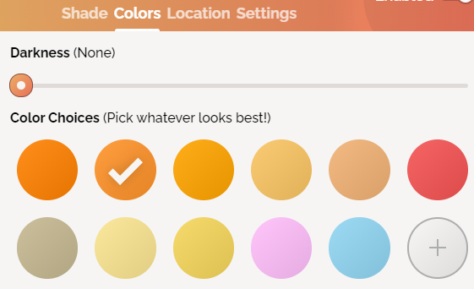
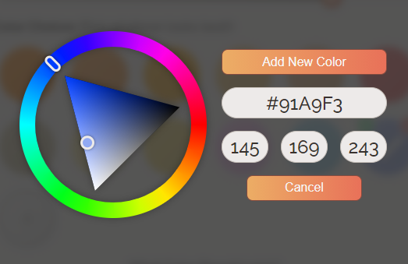
Help for Dyslexia
This is a how to guide: How to change the tint on your laptop so that you can access all lessons.
Laptops – Open Google Chrome > type screen shader > click the link and add to chrome > click add extension > sign in to Microsoft Teams through Chrome browser > press the jigsaw piece on the toolbar for extensions (1) > select screen shader > select colours and pick the colour you need (2) > if you need a colour not available click the + button and select the right colour on the wheel and press add colour (3) > finally to adjust the shade of your colour select shade and drag the slider (4).

