Slide 2
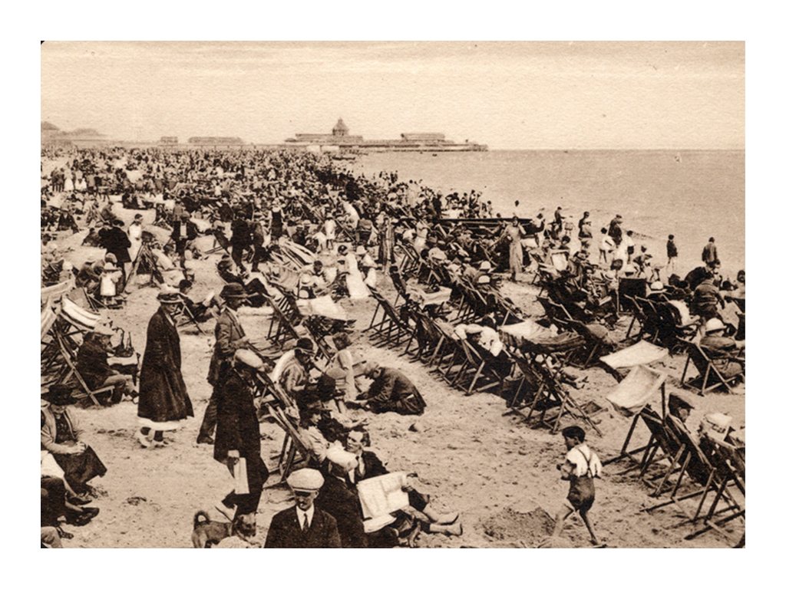
1850s

Slide 3
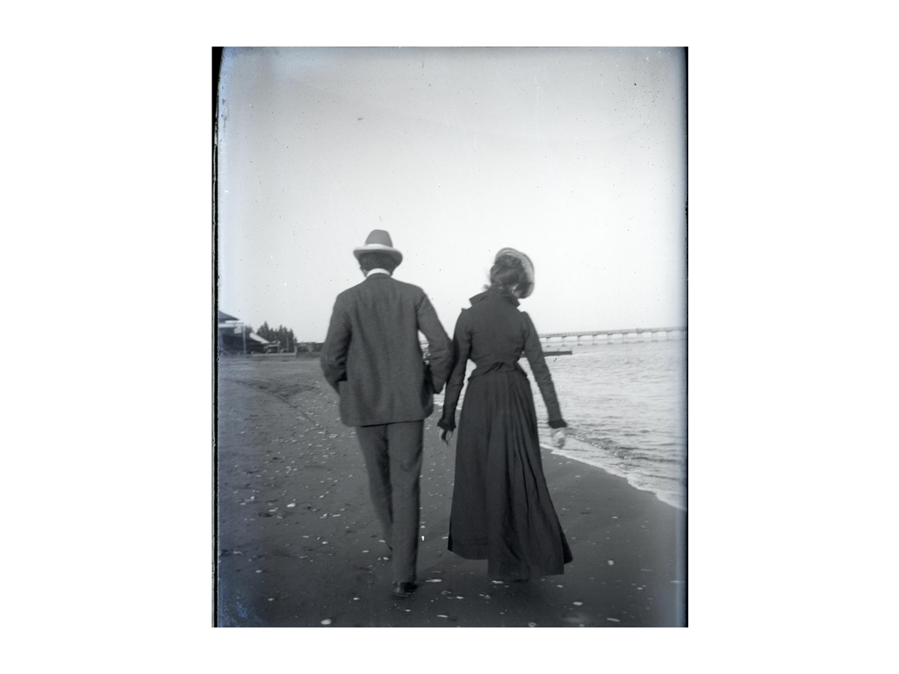
1900s
Photo courtesy of Claremont Colleges Digital Library (@flickr.com) - granted under creative commons licence - attribution

Slide 4
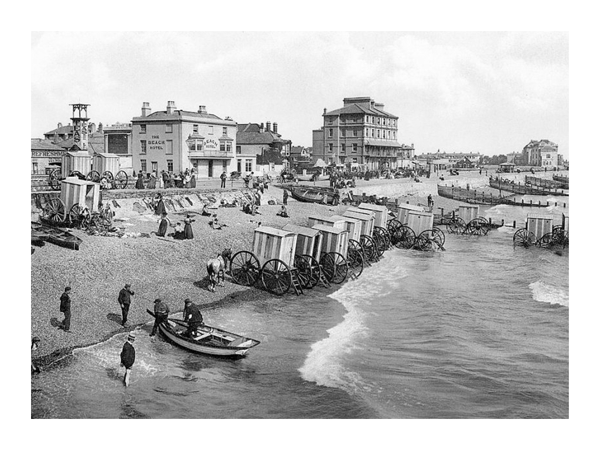
1900s

Slide 5
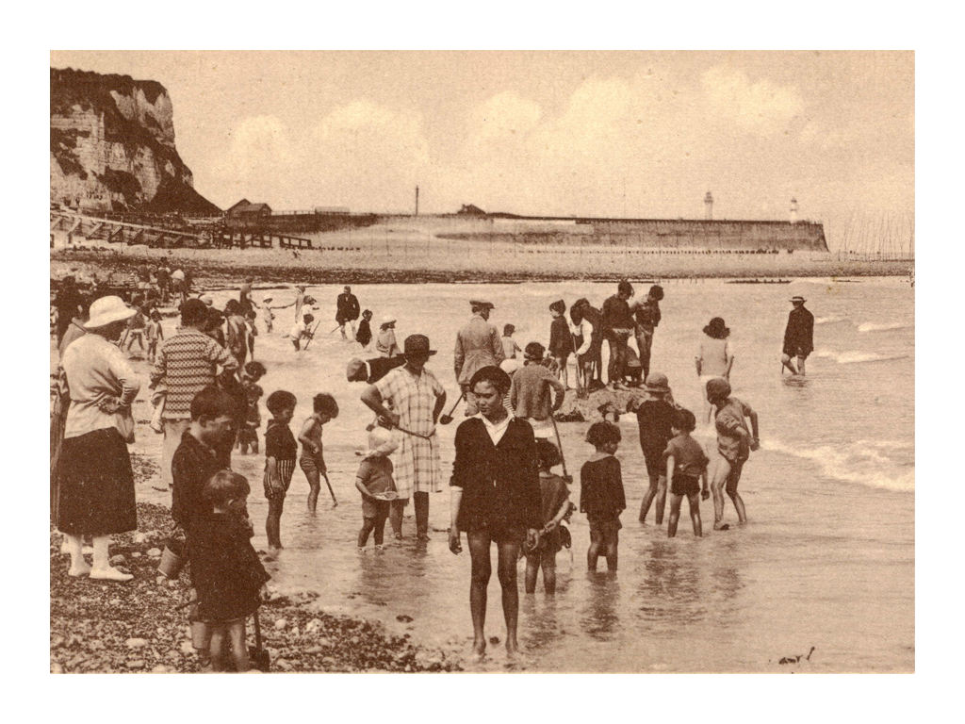
1920s
Photo courtesy of pellethepoet (@flickr.com) - granted under creative commons licence - attribution

Slide 6
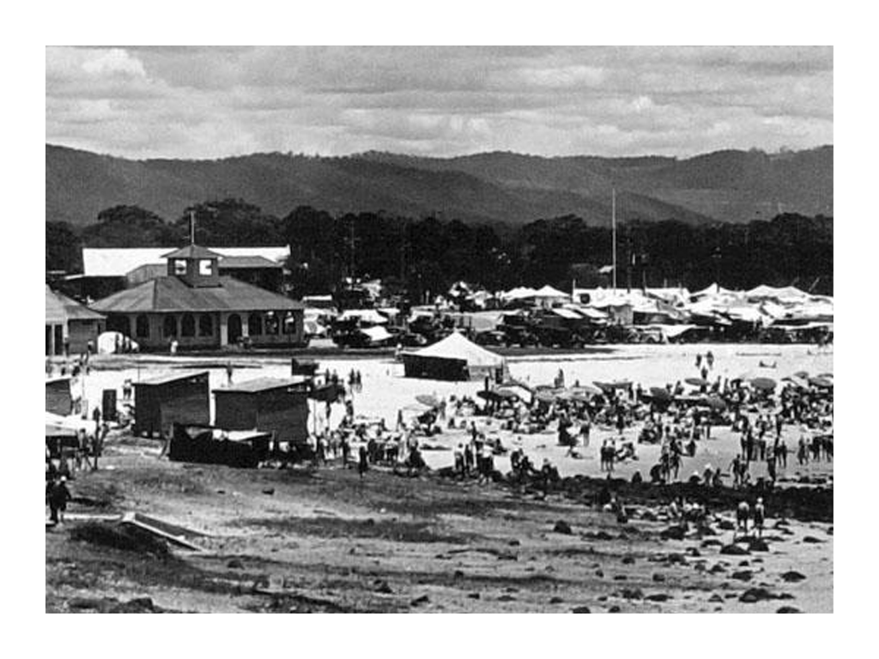
1940s
Photo courtesy of Queensland State Archives (@flickr.com) - granted under creative commons licence - attribution

Slide 7
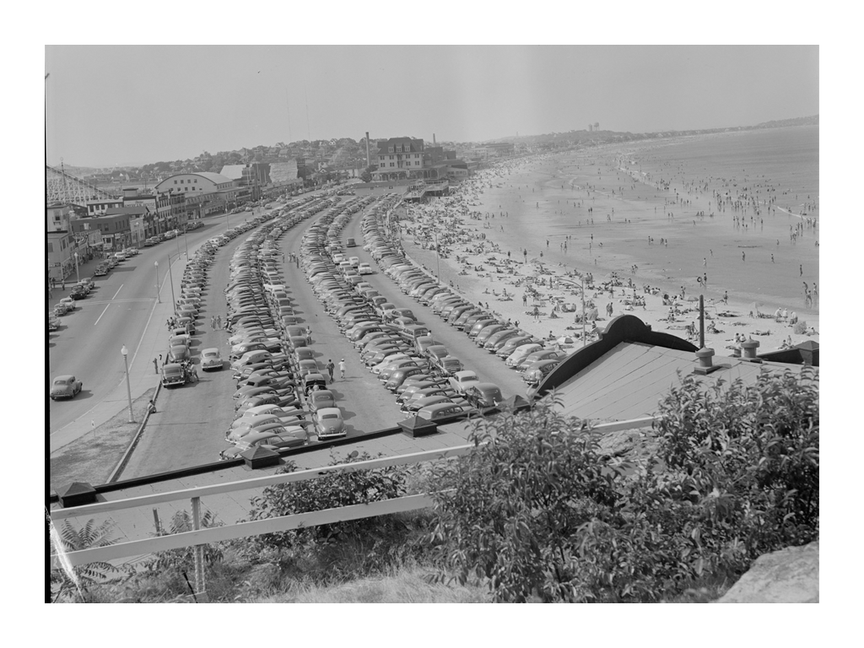
1940s
Photo courtesy of Boston Public Library (@flickr.com) - granted under creative commons licence - attribution

Slide 8
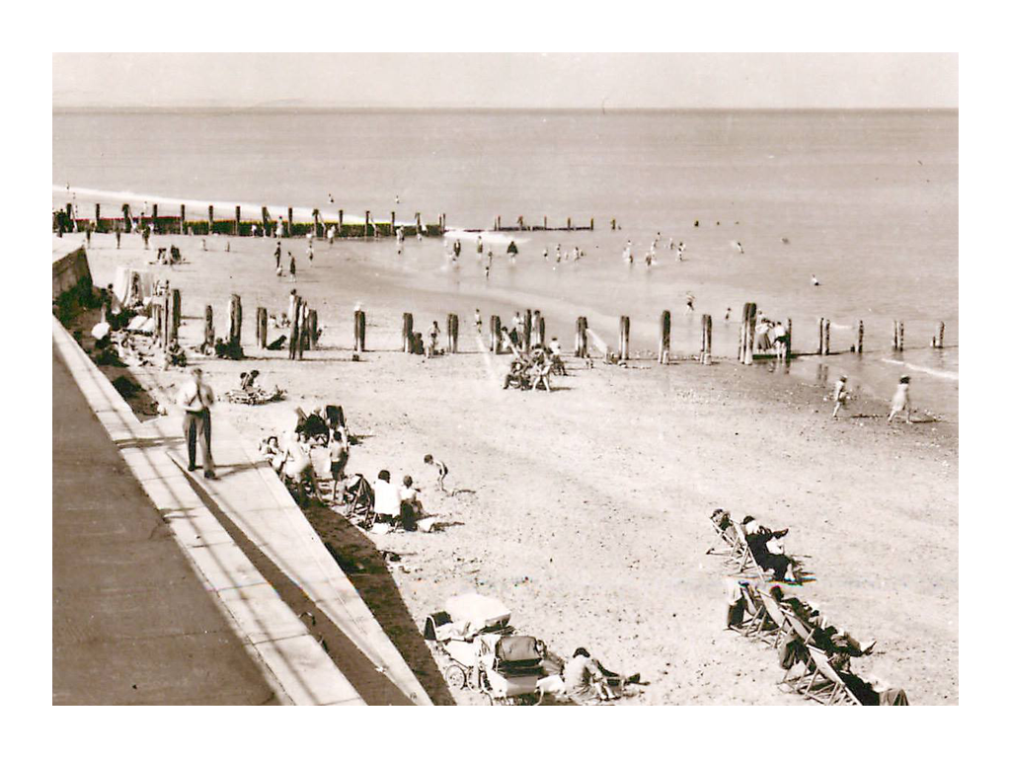
1940s
Photo courtesy of Bradford Timeline (@flickr.com) - granted under creative commons licence - attribution

Slide 9
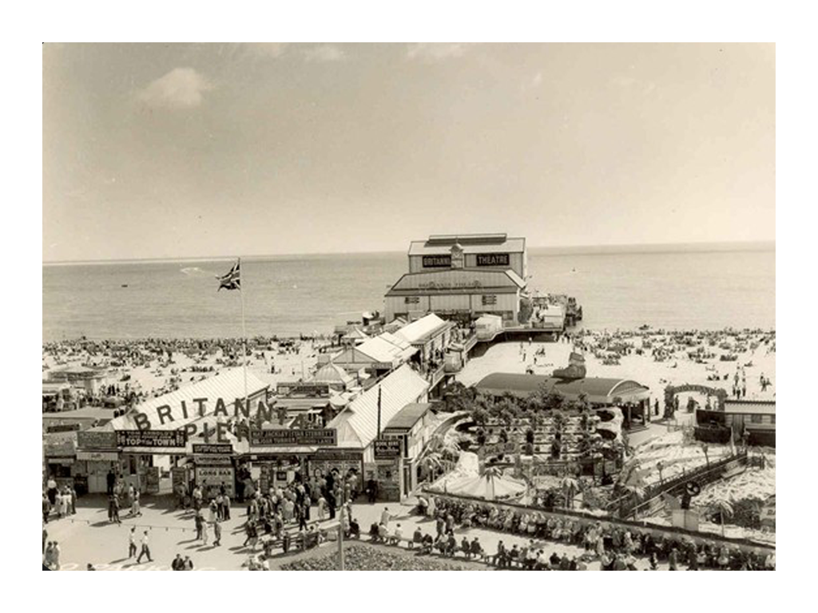
1950s

Slide 10
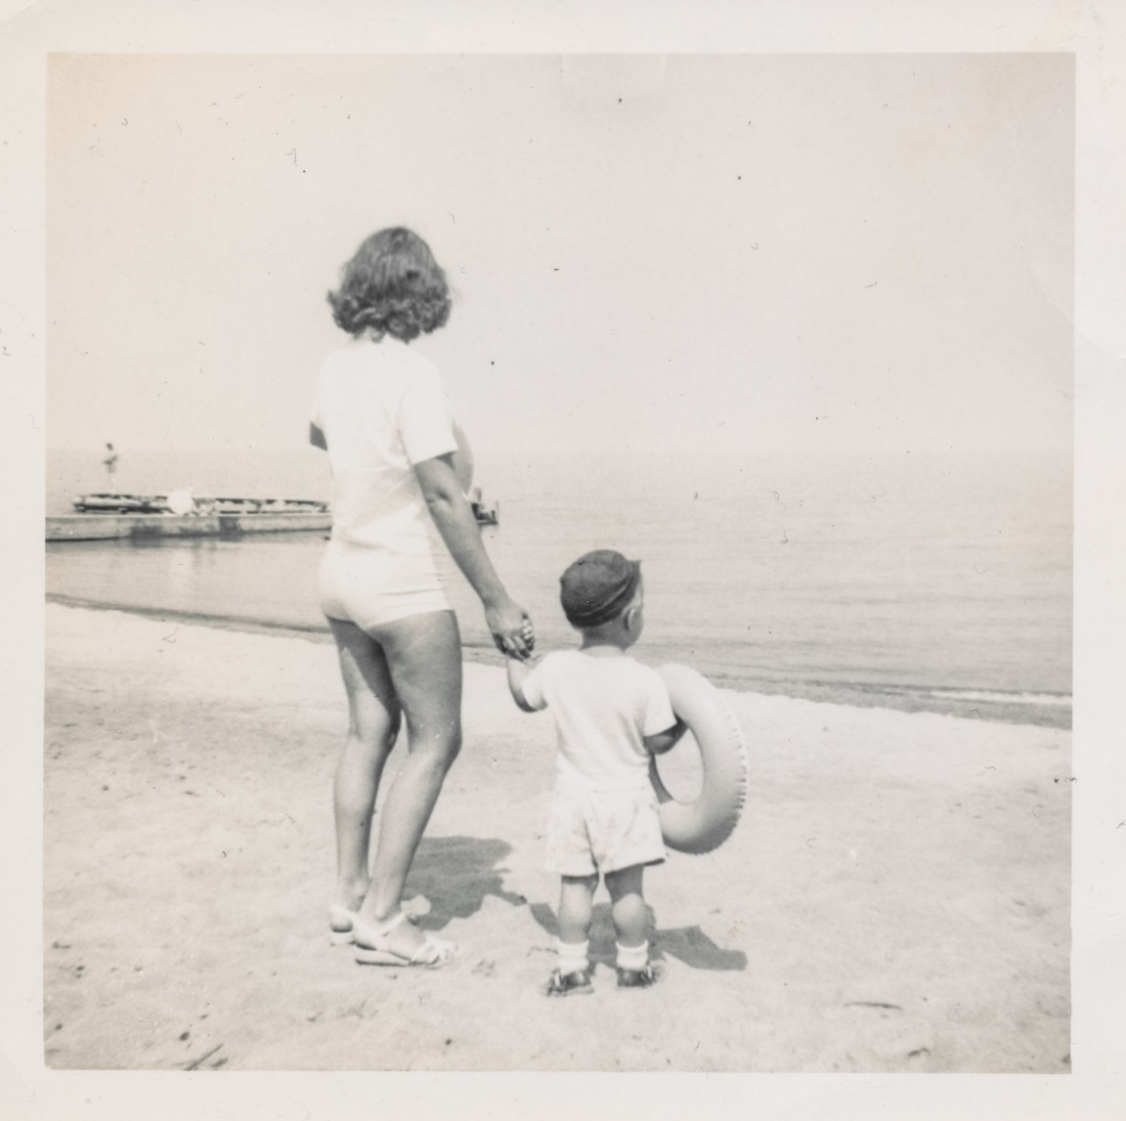
1950s
Photo courtesy of simpleinsomnia(@flickr.com) - granted under creative commons licence - attribution

Slide 11
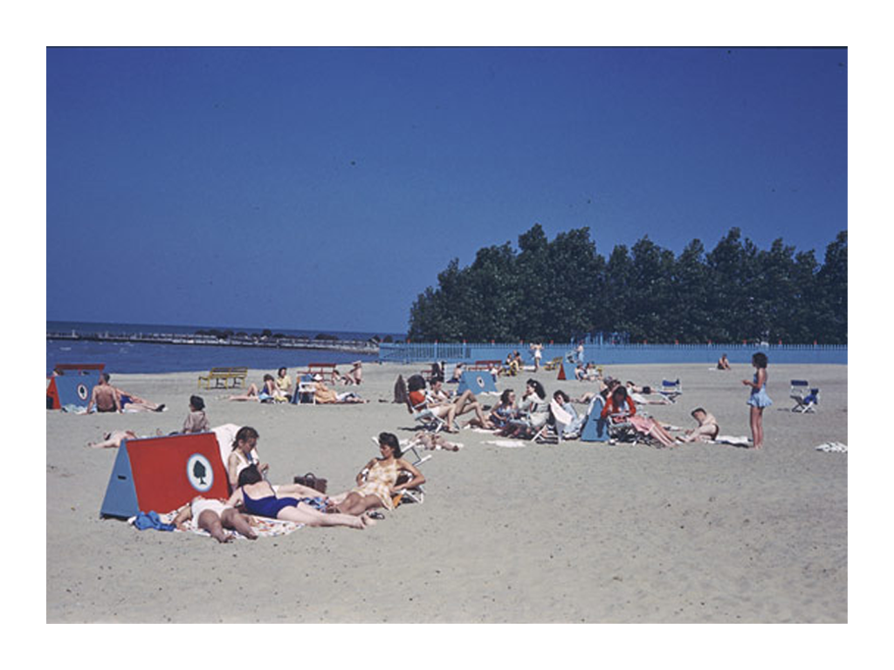
1970s
Photo courtesy of IMLS Digital Collections & Content (@flickr.com) - granted under creative commons licence - attribution

Slide 12
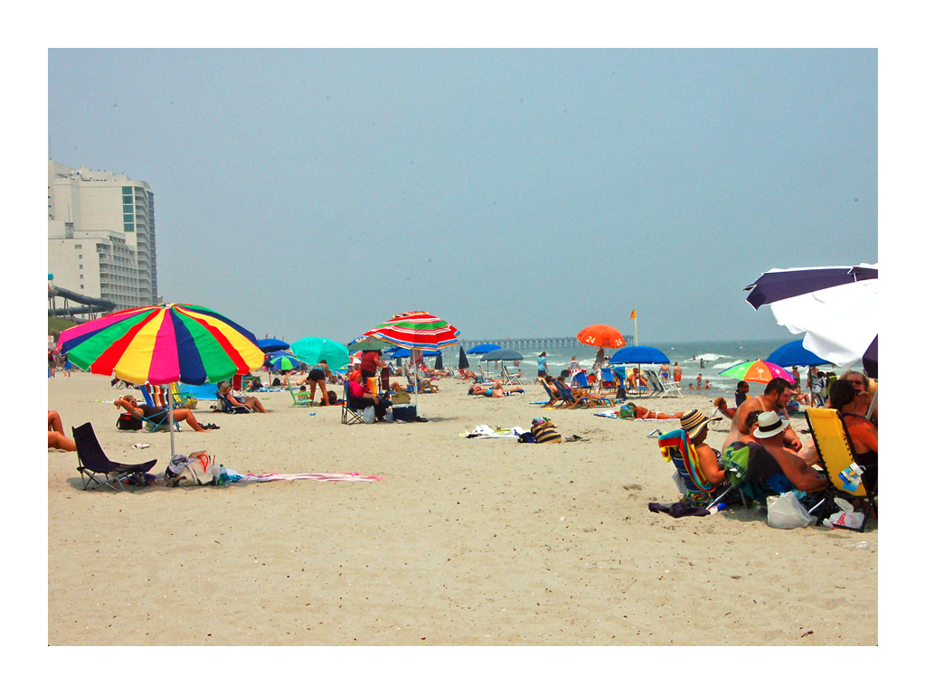
2011

