Slide 1
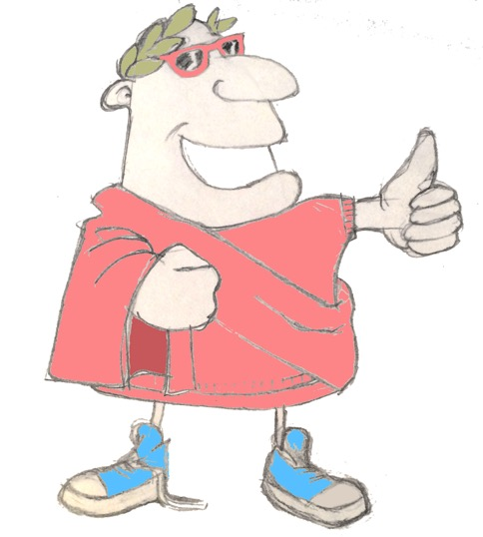
maximum Classics – 29
Getting possessive
Language L.O. to understand how Latin nouns show possession (of, ‘s, s’)

Slide 2
word roots challenge
locus
place
What English words do we get from these Latin words?
stella
star
digitus
finger
via
street
frigidus/frigida
cold
corona
crown
mirus/mira
amazing
habitare
to live
numerare
to count
videre
to see

Slide 3
Explosive endings
bam
bas
bat
bamus
batis
bant

Slide 4
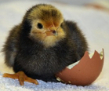
Quick fire verbs (mixed tenses)
audire
cantare
esse
clamare
audiebam
clamant
es
cantamus
clamabatis
canto
audit
est
clamas
cantabat

Slide 5
Quick on the draw
corona
femina
equus
iratus/irata
mirus/mira
esse
cantare
habere
regina
frigidus/frigida
locus
amare
clamare
maga
via
in viā
cantabamus

Slide 6
Quick on the draw
corona
femina
equus
iratus/irata
mirus/mira
esse
cantare
habere
regina
frigidus/frigida
locus
amare
clamare
maga
via
“maga irata est!”
femina
clamat

Slide 7
Quick on the draw
corona
femina
equus
iratus/irata
mirus/mira
esse
cantare
habere
regina
frigidus/frigida
locus
amare
clamare
maga
via
regina
coronam
miram
habet

Slide 8
Quick on the draw
corona
femina
equus
iratus/irata
mirus/mira
esse
cantare
habere
regina
frigidus/frigida
locus
amare
clamare
maga
via
equi
locos
frigidos
amant

Slide 9
Recap: subject & object
Noun endings in Latin show if the noun is the subject (doing the action) or object having the action done to it) in a sentence.
‘a’ noun endings | one (singular) | more than one (plural)
subject
object
‘us’ noun endings | one (singular) | more than one (plural)
subject
object
a
ae
us
i
am
as
um
os
regina coronam miram habet
equi locos frigidos amant

Slide 10
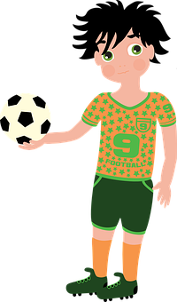
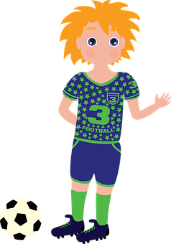
Possessive nouns
How does the English language show ‘possession’, when someone owns something?
of
’s
s’
The football of the boy
The boy’s football
The boys’ footballs

Slide 11
Possessive nouns
Noun endings in Latin not only show if the subject (doing the action) or object having the action done to it) , but can also show us a possessive noun that owns something in the sentence (of, ‘s or s’ in English).
‘a’ noun endings | one (singular) | more than one (plural)
subject
object
‘us’ noun endings | one (singular) | more than one (plural)
subject
object
a
ae
us
i
am
as
um
os
ae
arum
i
orum
possessive
possessive

Slide 12
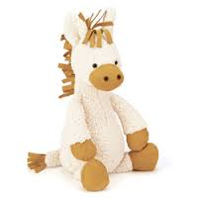
cuius equus?
Carlottae
Maximi
Leniti
Iuliae
equus _________ est
ae
i
possessive ‘a’ nouns
possessive ‘us’ nouns

Slide 13
Possessive nouns
‘a’ noun endings | one (singular) | more than one (plural)
subject
object
‘us’ noun endings | one (singular) | more than one (plural)
subject
object
a
ae
us
i
am
as
um
os
ae
arum
i
orum
possessive
possessive
femina
equum
reginae
amat
The woman loves the horse of the queen.
The woman loves the queen’s horse.

Slide 14
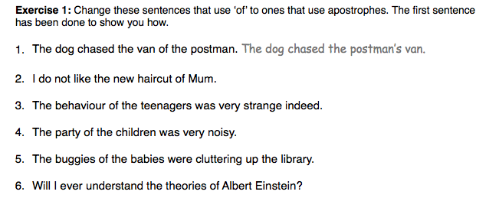
Possessive nouns: ex. 1

Slide 15
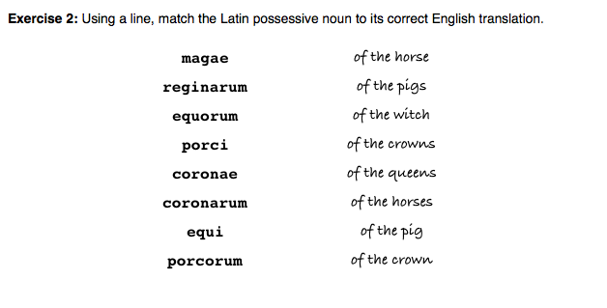
Possessive nouns: ex. 2
Look back at the slide showing the possessive endings if you have forgotten!

Slide 16
Possessive nouns: ex. 3
All the vocabulary has been used on previous slides!

Slide 17
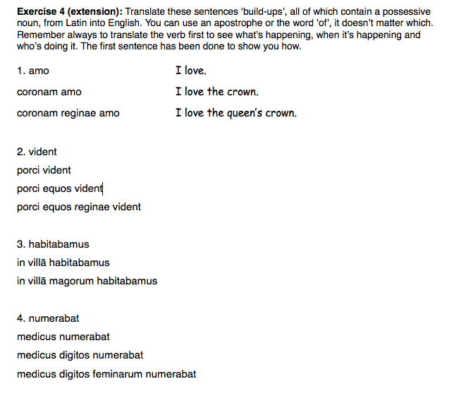
Possessive nouns: ex. 4 (extension)

Slide 18
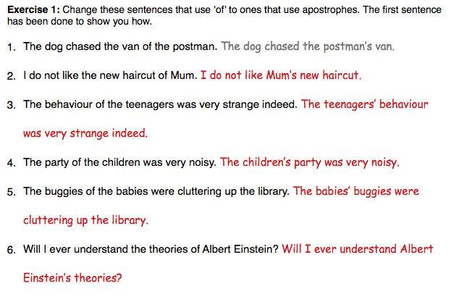
Possessive nouns: ex. 1
answers

Slide 19
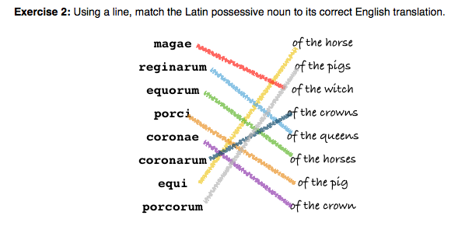
Possessive nouns: ex. 2
answers

Slide 20
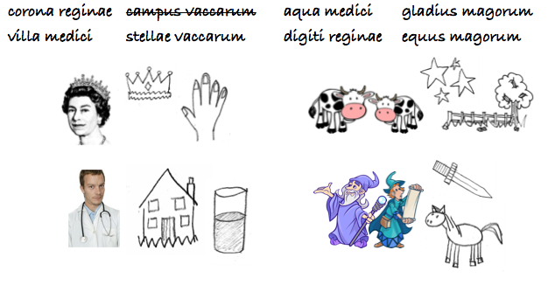
Possessive nouns: ex. 3
answers

Slide 21
Possessive nouns: ex. 4 (extension)
answers

Slide 22
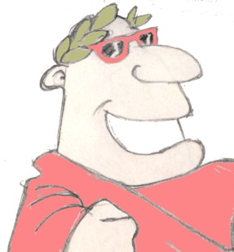
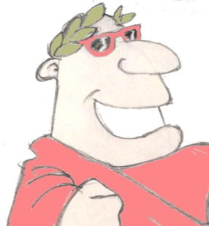
Plenary
What does the Latin verb ‘es’, mean?
What English words come from the Latin word ‘locus’, meaning ‘place’?
“corona reginae est.” Whose crown is it?

