Slide 1
maximum Classics – 28
Roman number time
L.O. to understand how to decode Roman numerals, including year dates

Slide 2
word roots challenge
What English words do we get from these Latin words?
decem
ten
numbers special!
unus
one
novem
nine
quinque
five
centum
hundred
octo
eight
mille
thousand

Slide 3
You may be wondering why December comes from the word decem (ten) or November from novem (nine).
The first month in the Roman calendar was March. January did not become the first month of the year until Pope Gregory changed the calendar in the sixteenth century.

Slide 4
Where can you find Roman numerals today?

Slide 5
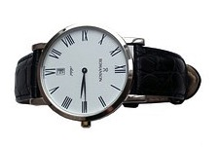

Slide 6
What do the letters represent?
M
e
D
i
C
a
L
1000
500
100
50
X
a
V
I
er
10
5
1

Slide 7
How do the numerals fit together?
XXXVII
10
+10
+10
+5
+1
+1
=37
EASY: If the numerals are the same size,
or get smaller as you go along,
JUST ADD THEM

Slide 8
How do the numerals fit together?
XXXIV
10
+10
+10
=30
5-1=4
30+4=34
TRICKIER: If you get a smaller numeral coming before a bigger numeral, SUBTRACT IT FROM THE FOLLOWING NUMBER, then add it to the total

Slide 9
HIC SITUS EST
My turn!
here lies
FLAVIUS
Flavius
for 25 years
ANNOS XXV VIXIT
dis manibus
to the spirits of the departed
he lived
D.M.

Slide 10
Your turn!
HIC SITA EST
CORNELIA
ANNOS LXI VIXIT
D.M.

Slide 11
Your turn!
HIC SITUS EST
SALVIUS
ANNOS XC VIXIT
D.M.

Slide 12
HIC SITUS EST
Your turn!
QUINTUS
ANNOS XXIV VIXIT
D.M.

Slide 13
Your turn!
HIC SITA EST
BARBILLA
ANNOS XLIII VIXIT
D.M.

Slide 14
How old were they?
25
Flavius ………
Cornelia ………
Salvius ………
Quintus ………
Barbilla ………
61
90
24
43

Slide 15
Why do you think that many Romans died at such a young age?

Slide 16
No vaccines, no hospitals, not such good medicine or doctors. Lots of ladies died during childbirth because there were no hospitals. Did you think of any other reasons?

Slide 17
Time for a brain break!
We’re going to play Mythical Battle. It’s like Rock, Paper, Scissors but with slightly different moves. Why not give it a try?

Slide 18
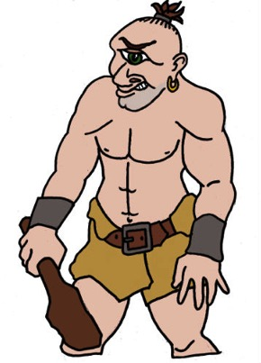
Brain break: mythical battle
MEDUSA BEATS THE CYCLOPS
by turning him to stone
THE CYCLOPS BEATS PEGASUS
PEGASUS BEATS MEDUSA
using his strength
by out-flying her

Slide 19
Year dates
Year date numbers work in exactly the same way as regular Roman numerals, but big numbers can mean long strings of letters to decode!
EASY
MMXVII
1000
+1000
+10
+5
+1
+1
=2017

Slide 20
Year dates
MEDIUM
MMIX
1000
+1000
+9
(10-1)
=2009

Slide 21
Year dates
TRICKY!
MCMLXIV
1000
+ 900
(1000-10)
+50
+10
+4
(5-1)
=1964

Slide 22
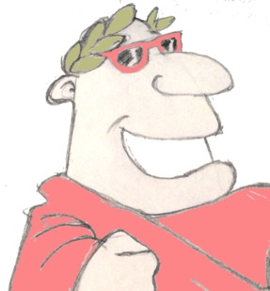
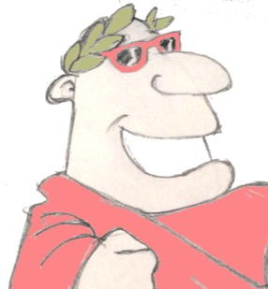
Plenary
What English words come from ‘centum’, the Latin for hundred?
How old are you, in Roman numerals?
In Roman numerals, in which year were you born?

Slide 23
Can you write today’s date in Roman numerals?
How about the year you were born?
Can you write some calculations in Roman numerals?

