Slide 1
The Benin Kingdom
Lesson 3
Key Question: What can we learn about Benin society from images and artefacts that have survived??
LO: To investigate and interpret the past.

Slide 2
Key Vocabulary
chronology
Events in order of time.
portray
To represent of describe something or someone in a painting, film, book or other artistic work.
civilisation
A human society with a high level of culture, government, understanding of the world around them.
artefact
An object made by a person that is of historical interest.
Oba
The traditional ruler and head of the Benin Kingdom.
hypothesis
An idea or explanation for something that is based on known facts but has not yet been proved.
Freedom from being governed or ruled by another country
Notes:
Use for EAL children too.

Slide 3
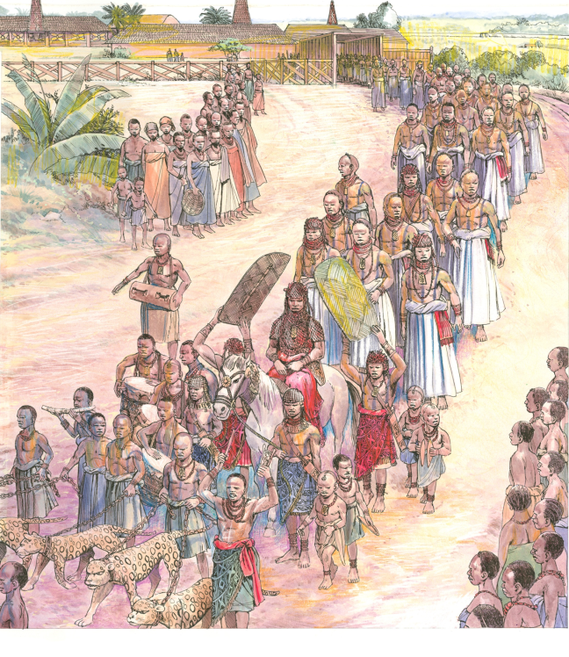
❶
❽
❷
❼
❸
❻
❹
❺

Slide 4
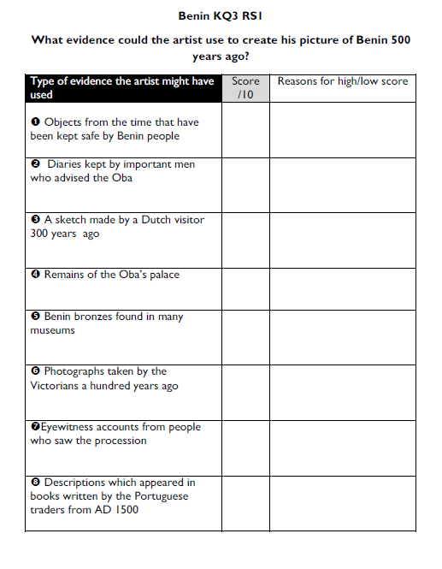
How did the artist know what to draw?

Slide 5
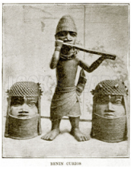
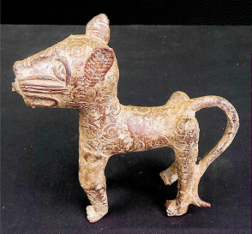
Image of a leopard – artwork from Benin

Slide 6
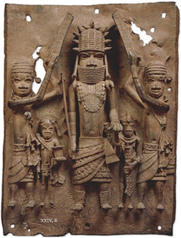
This plaque shows an Oba surrounded by his attendants, two of whom are depicted holding up their shields in a formal protective stance. Only the Oba was allowed to be shaded in this way within the city. You can see them shown clearly here, as well as in a much later Dutch engraving from the 17th century (see next slide).

Slide 7
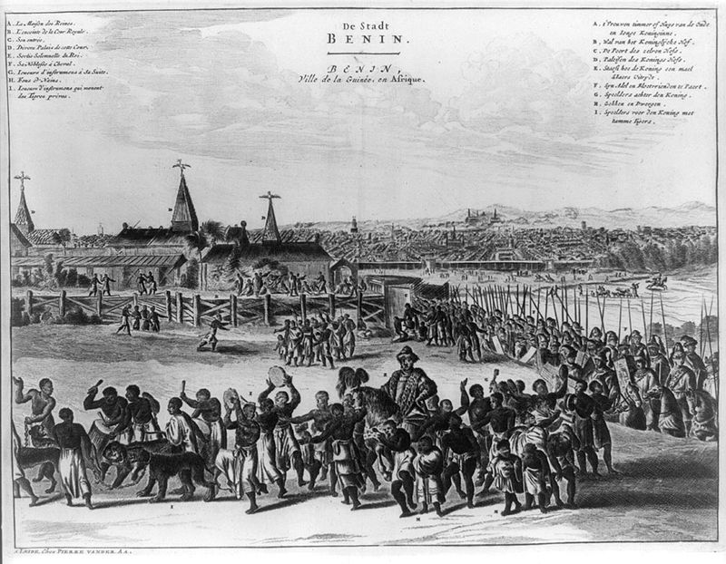
http://upload.wikimedia.org/wikipedia/commons/thumb/5/53/Ancient_Benin_city.JPG/800px-Ancient_Benin_city.JPG

Slide 8
Task 4: Call my Bluff!
Each group will get an image of an artefact. Each person will get a sticky note.
On your sticky note, write down:
What you think the artefact is.
What you think it was used for.
Why you think this.
Do not share your ideas yet!

Slide 9
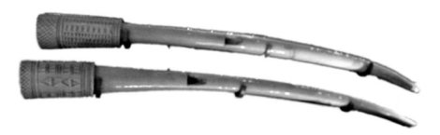
1

Slide 10
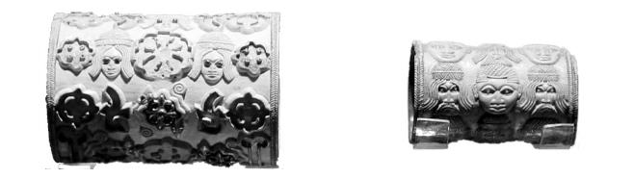
2

Slide 11
3

Slide 12
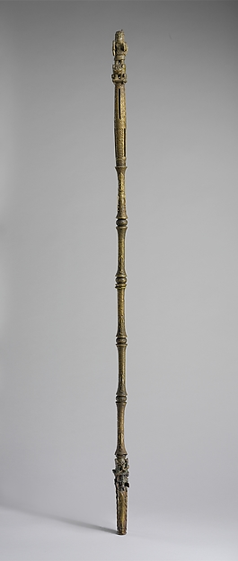
4

Slide 13
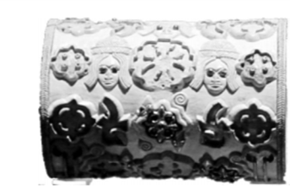



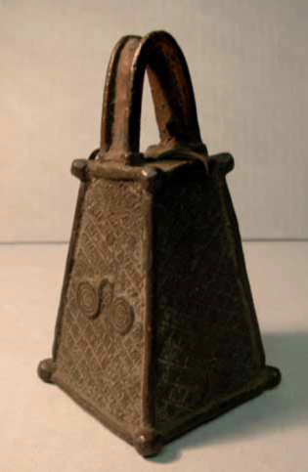

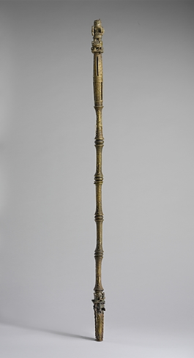


Slide 14
Task 4: Call my Bluff!
I will now collect in your hypotheses.
I will read out each one, including the REAL answer.
Which one do you think is the professional historian’s answer?
Let’s vote!

Slide 15
ANSWERS BELOW! DO NOT REVEAL TOO EARLY!

Slide 16
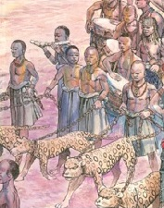
ARTEFACT 1
This is horn, just like the one used in the Oba’s procession

Slide 17
ARTEFACT 2
An armlet…

Slide 18
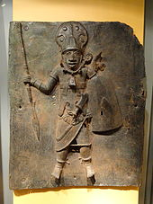
Armlets were worn on the arms. The armlets are decorated with carved faces. Some of the faces have long hair, beards and moustaches and wear hats.
They are probably Portuguese men, maybe traders. The smaller armlet is also decorated with faces of men with short hair and no beards. They may be men from Benin.
Armlets were not used just for body decoration in ancient Benin. Jewellery showed what job someone did, what group they belonged to or their relationship with the Oba. As these armlets are made of ivory and gold, which were royal materials, they may have belonged to the Oba or members of his family.
armlet
http://en.wikipedia.org/wiki/Benin_Bronzes#/media/File:Relief_-_Staatliches_Museum_f%C3%BCr_V%C3%B6lkerkunde_M%C3%BCnchen_-_DSC08432.JPG

Slide 19
ARTEFACT 3
A bell was used by the Oba who shook it at the altar to contact his spirits.
Warriors also rang the bell for protection during battle.

Slide 20
ARTEFACT 4
This is an Ukhurhe or rattle staff. It was made of ivory and was used for calling up the spirits. It is carved to look like a bamboo cane. There is a carved slot at the bottom end which holds a small rod. It is this rod that makes the stick rattle when the sick is shaken up and down. At the other end of the stick is a clenched fist. This shows that the owner was a powerful person.

Slide 21
This object is… It comes from (place and time). You can see the detail such as…It tells us that…
Imagine you are creating a museum exhibit on Benin.
Do a sketch of each artefact.
Write a caption for each one. You might like to use these sentence frames to help you.
TASK 5

Slide 22
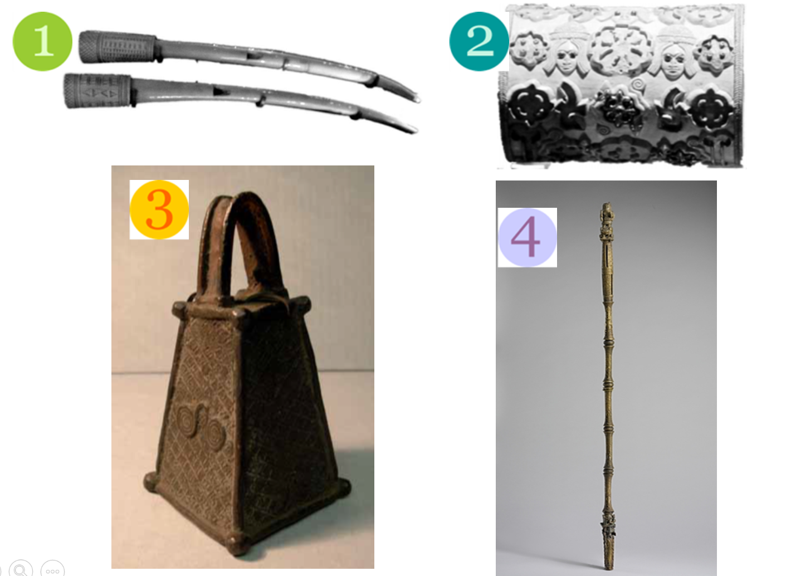
Reflection
Which object do you think is the most interesting?
Which object tells you the most about the Benin Empire?

