Slide 1
The Benin Kingdom Lesson 2
Key Question: Why should we study the Benin Kingdom?
LO: To build an overview of world history.

Slide 2
Key Vocabulary
chronology
Events in order of time.
portray
To represent of describe something or someone in a painting, film, book or other artistic work.
civilisation
A human society with a high level of culture, government, understanding of the world around them.
ancestors
A person related to you who lived a long time ago.
kingdom
A country or area that is ruled by a particular person.
trade
The activity of buying and selling, or exchanging goods / services between people or countries.
independence
Freedom from being governed or ruled by another country
Notes:
Use for EAL children too.

Slide 3
Task 1: Cut up these events and put them in chronological order.

Slide 4
Task 2:
Which event do you think is the most important in the history of Africa and its people?
Which event is the least important?
Use a Diamond 9 to organise your thoughts. Be ready to justify your choices.

Slide 5
Task 3: Look at the three sources.
What deductions can you make about the Benin Kingdom?

Slide 6
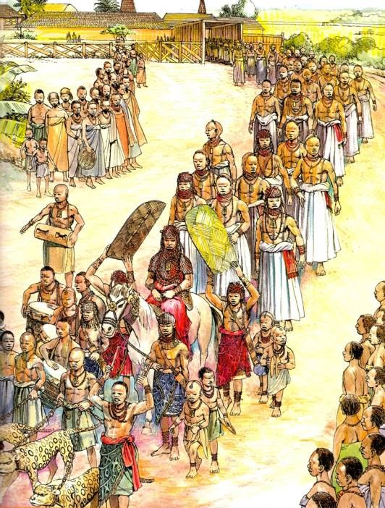
An important procession, depicting the Oba, ruler of the Benin Kingdom.

Slide 7
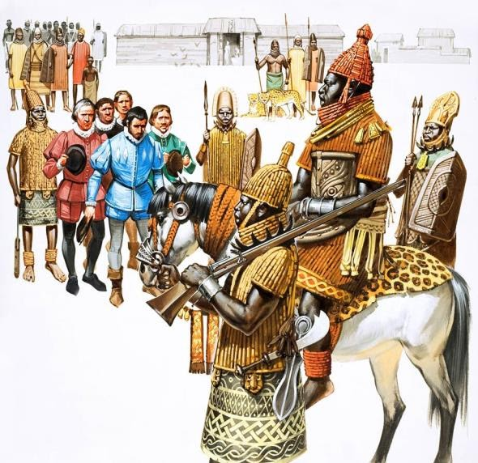
Painting of the Oba meeting Europeans who want to trade with Benin.

Slide 8
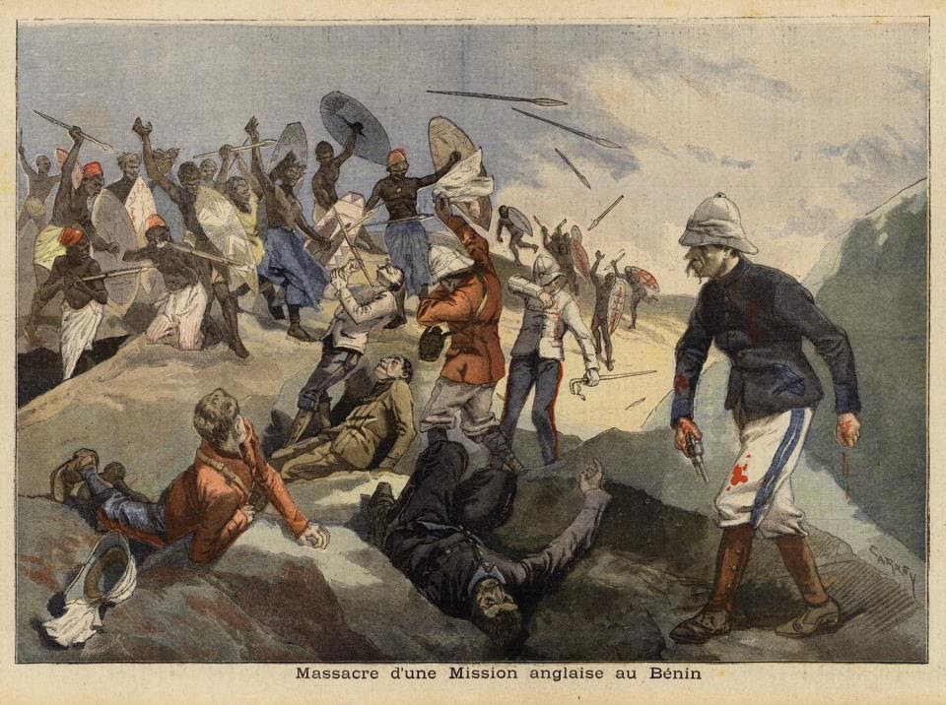
Painting of Victorian soldiers attacking Benin in late Victorian times.

Slide 9
What are some of the reasons that historians think that we should study the Benin Kingdom?
It’s important to learn about different cultures as many people in Britain have their family roots in places like Benin.
It’s important to learn about other countries’ history, not just Britain’s.
It’s important to learn how badly Britain treated some countries in the British Empire during the reign of Queen Victoria.

Slide 10
Timeline
What does it tell us?
Notes:
Shows the period we are studying, when the Europeans came and when Benin was destroyed at the end of the 19th Century.

Slide 11
What are some of the reasons that historians think that we should study the Benin Kingdom?
A highly successful empire, shows that in many ways, Benin society was far more advanced, particularly in terms of what they produced, compared to Britain at the time.
They produced beautiful works of art, which are world famous, and are showcased in many major museums across the world.
They built earth boundary walls which covered more than 1000km. They were the largest earthwork structure in the world, possibly up to four times as long as the Great Wall of China.

Slide 12
Task 4: Write a Tweet to complete the sentence
I think we should study Benin in our school because…
Your Tweet must:
Include what you think is the most important reason.
Include a hashtag of a key word
Be no more than 280 characters!

