Slide 1
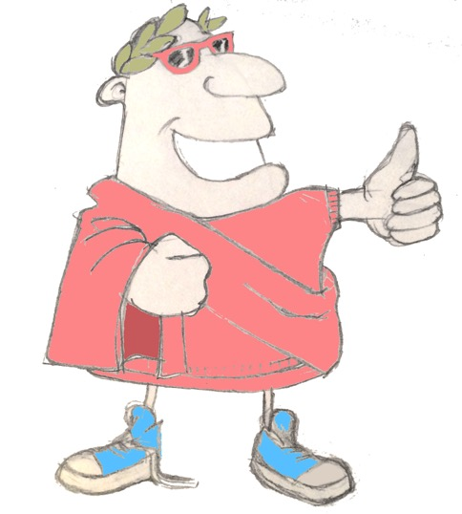
maximum Classics – 24
All in the past
Language L.O. to look at tenses in English and Latin, especially the past continuous/progressive
Culture L.O. to discover and debate Aristotle’s ideas on being a good person

Slide 2
word roots challenge
anima
life/spirit
Which English words can you find from these Latin ones?
invitare
!!
fortunatus/fortunata
lucky
solus/sola
alone
corona
crown
totus/tota
whole
audire
to hear
clamare
shout
locus
place

Slide 3
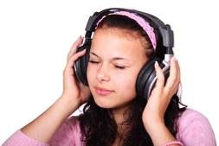
Quick fire verbs
audire
invitare
clamare
audio
clamant
invitamus
clamatis
invito
audit
clamas
invitat

Slide 4
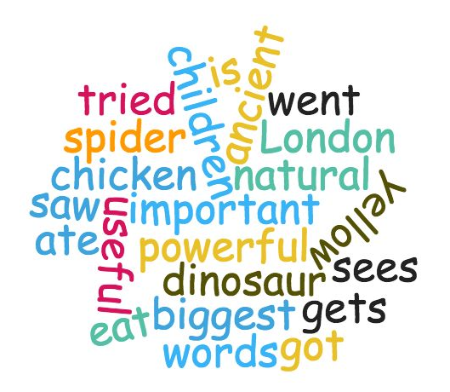
Spot the verbs
Which of these words are verbs?

Slide 5
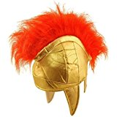
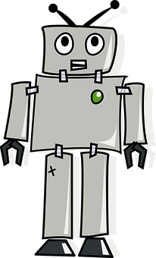
Tense Hat Game
past
present
future
The dog is listening to its owner.
Which tense is this?

Slide 6
Tense Hat Game
past
present
future
I went to the ice cream shop.

Slide 7
Tense Hat Game
past
present
future
Which tense is this?
The dog was happily munching his food.

Slide 8
Tense Hat Game
past
present
future
Which tense is this?
I will see you next Saturday.

Slide 9
Tense Hat Game
past
present
future
Which tense is this?
Did you remember your book?

Slide 10
Tense Hat Game
past
present
future
Which tense is this?
My gran is going to get me a big present this year.

Slide 11
Tense Hat Game
past
present
future
Which tense is this?
We are tying our shoelaces.

Slide 12
Tense Hat Game
past
present
future
Which tense is this?
On Monday, the weather will be great.

Slide 13
Tense Hat Game
past
present
future
Which tense is this?
Oh, I see.

Slide 14
Tense Hat Game
past
present
future
Which tense is this?
I invited my friend over for tea.

Slide 15
Tense Hat Game
past
present
future
Which tense is this?
You were shouting so loudly!

Slide 16
Tense
past
past perfect
“Hello!” Mia shouted to her friend.
Ru was shouting loudly.
past progressive/past continuous
=
ONGOING action in the past

Slide 17
Part 1: Sort the verbs in the word cloud below into the correct boxes: past, present or future.
they will eat
past
present
future
I ran
can you see?
did you hear?
it was raining
he is going to help
I will try
he gave up
I was running
we were walking
Part 2: Turn the verbs in these sentences from past perfect into past progressive (past continuous). The first one has been done to show you how.
1. I ran through the park. I was running through the park.
2. The teacher showed me how to swim front crawl.
3. He sat there, motionless.
4. The fat cat sat on the mat with a rat.
5. Did you really try hard?
6. The bus rumbled down the road.
7. Only the brave ladies danced to the crazy music.
8. I did not wind my little sister up!
9. The wind howled and the trees shook.
10. The silly hamster just didn’t listen to me.

Slide 18
Part 1: Sort the verbs in the word cloud below into the correct boxes: past, present or future.
they will eat
past
present
future
I ran
can you see?
did you hear?
it was raining
he is going to help
I will try
he gave up
I was running
we were walking
Part 2: Turn the verbs in these sentences from past perfect into past progressive (past continuous). The first one has been done to show you how.
1. I ran through the park. I was running through the park.
2. The teacher showed me how to swim front crawl. The teacher was showing me how to swim front crawl.
3. He sat there, motionless. He was sitting there, motionless.
4. The fat cat sat on the mat with a rat. The fat cat was sitting on the mat with a rat.
5. Did you really try hard? Were you trying really hard?
6. The bus rumbled down the road. The bus was rumbling down the road.
7. Only the brave ladies danced to the crazy music. Only the brave ladies were dancing to the crazy music.
8. I did not wind my little sister up! I was not winding my little sister up!
9. The wind howled and the trees shook. The wind was howling and the trees were shaking.
10. The silly hamster just didn’t listen to me. The silly hamster just wasn’t listening to me.

Slide 19
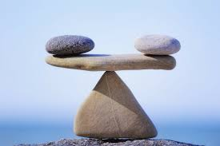
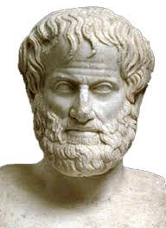
How to be good?
Now that those who practise justice do so involuntarily and because they have not the power to be unjust will best appear if we imagine something of this kind: having given both to the just and the unjust power to do what they will, let us watch and see whither desire will lead them; then we shall discover in the very act the just and unjust man to be proceeding along the same road, following their interest, which all natures deem to be their good, and are only diverted into the path of justice by the force of law. The liberty which we are supposing may be most completely given to them in the form of such a power as is said to have been possessed by Gyges the ancestor of Croesus the Lydian. According to the tradition, Gyges was a shepherd in the service of the king of Lydia; there was a great storm, and an earthquake made an opening in the earth at the place where he was feeding his flock. Amazed at the sight, he descended into the opening, where, among other marvels, he beheld a hollow brazen horse, having doors, at which he stooping and looking in saw a dead body of stature, as appeared to him, more than human, and having nothing on but a gold ring; this he took from the finger of the dead and reascended. Now the shepherds met together, according to custom, that they might send their monthly report about the flocks to the king; into their assembly he came having the ring on his finger, and as he was sitting among them he chanced to turn the collet of the ring inside his hand, when instantly he became invisible to the rest of the company and they began to speak of him as if he were no longer present. He was astonished at this, and again touching the ring he turned the collet outwards and reappeared; he made several trials of the ring, and always with the same result-when he turned the collet inwards he became invisible, when outwards he reappeared. Whereupon he contrived to be chosen one of the messengers who were sent to the court; where as soon as he arrived he seduced the queen, and with her help conspired against the king and slew him, and took the kingdom. Suppose now that there were two such magic rings, and the just put on one of them and the unjust the other;,no man can be imagined to be of such an iron nature that he would stand fast in justice. No man would keep his hands off what was not his own when he could safely take what he liked out of the market, or go into houses and lie with any one at his pleasure, or kill or release from prison whom he would, and in all respects be like a God among men. Then the actions of the just would be as the actions of the unjust; they would both come at last to the same point. And this we may truly affirm to be a great proof that a man is just, not willingly or because he thinks that justice is any good to him individually, but of necessity, for wherever any one thinks that he can safely be unjust, there he is unjust. For all men believe in their hearts that injustice is far more profitable to the individual than justice, and he who argues as I have been supposing, will say that they are right. If you could imagine any one obtaining this power of becoming invisible, and never doing any wrong or touching what was another's, he would be thought by the lookers-on to be a most wretched idiot, although they would praise him to one another's faces, and keep up appearances with one another from a fear that they too might suffer injustice. Enough of this.
Aristotle
?
μηδεν ’αγαν
meden agan!

Slide 20
Aristotle’s ‘middle path’ to being good
too little
just right
too much
cowardly
brave
rash/impetuous
stingy
generous
over-spending
anti-social
friendly
obsequious
(“sucks up”)
shy
modest
show-off
humourless
witty
buffoon/clown

Slide 21
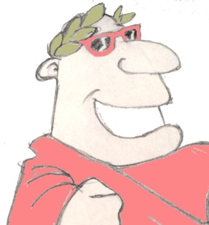
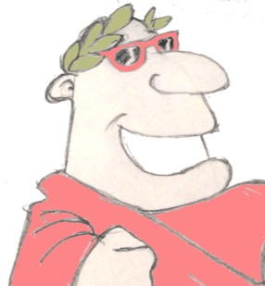
Plenary
What English word comes from the Latin ‘solus’, meaning ‘alone’?
“I was writing a letter”: what tense does that sentence use?
What did Aristotle believe was the key to a good personality?

