Slide 1
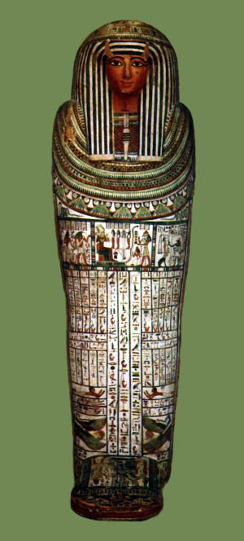
Mummification

Slide 2
What happened when pharaohs died?
The Egyptians believed that when they died, they would go to the underworld, or afterlife. This was their life after death. They also believed that due to living a new life, they would need to be a complete person. Only rich people could afford to be mummified ready for the afterlife, and they would be buried with lots of their possessions, food and drink. Sometimes, they were even buried with their slaves and pets to serve and protect them in their new life.
To ensure that they would be a person in the afterlife, the pharaohs were mummified.

Slide 3
What did they do to the pharaoh’s body?
They had to make sure that the pharaoh didn’t rot.
Think about bread that you have at home, or your sandwiches that you bring to school. What do you do to them to make sure that they don’t go rotten?
Exactly- you wrap them up to stop air and moisture getting to them. That is just what the Egyptians had to do to the pharaoh’s bodies so that they didn’t go rotten.
It is called preserving the body.

Slide 4
So, how did they preserve the pharaoh’s body?
It usually took around 70 days to embalm a body and the process would be performed by a priest who would wear the mask of a jackal to represent Anubis, the god of death and embalming.
There were around 10 steps to mummification

Slide 5
So, how did they preserve the pharaoh’s body?
The body was washed and purified- the pharaoh had to be clean ready for their next life.
The brain was usually removed, but not always. If it was, it would have been removed with a hook which was poked up the nose to reach the brain and then wiggled around to turn the brain into mush.
A small cut would be made in the left hand side of the pharaoh’s body and the lungs, stomach, liver and intestines were removed and put into separate pots, called canopic jars. The heart was not removed because it was thought to be the centre of intelligence and emotion.

Slide 6
So, how did they preserve the pharaoh’s body?
The body was then covered with a natural salt called natron which helped to dry out the body to stop it from decaying. The body would be buried in this natron for 40 days. After this, the body would be thinner and darker because it had no moisture in it.
Resin soaked linin would then be inserted into the body through the cut in the side to fill the empty space.
A make-up artist would then ensure that the pharaoh was looking their best for their next life with make-up and a wig.

Slide 7
So, how did they preserve the pharaoh’s body?
Oils of myrrh, juniper and crushed thyme leaves were then used to perfume the body.
Pine resin was then melted and applied to the body to seal and help preserve it. The wound would be covered whilst a priest wafted incense to purify the air.
The body was then wrapped in linin. Different shaped charms would be placed between layers of the linin. These were called amulets.
The mask was then fitted, a cartouche with the pharaoh’s name would be attached to them, and they would be placed into their casket, and sometimes into a sarcophagus.

Slide 8
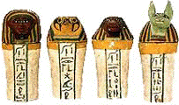
Canopic Jars
The canopic jars were each different, they all had the head of a different animal which each represented the sons of Horus. The canopic jars were placed in a special chest which was placed in the tomb with the pharaoh.
1. Imsety had a human head, protected the liver.
2. Qebehsenuf had the head of a falcon and guarded the intestines.
3. Hapy had a baboon head protected the lungs.
4. Duamatef had the head of a jackal, and guarded the stomach.

