Slide 1


Geography
Beside the Seaside
Year One
Geography | Year 2 | Beside the Seaside | Let’s Explore a Seaside Town | Lesson 4

Slide 2
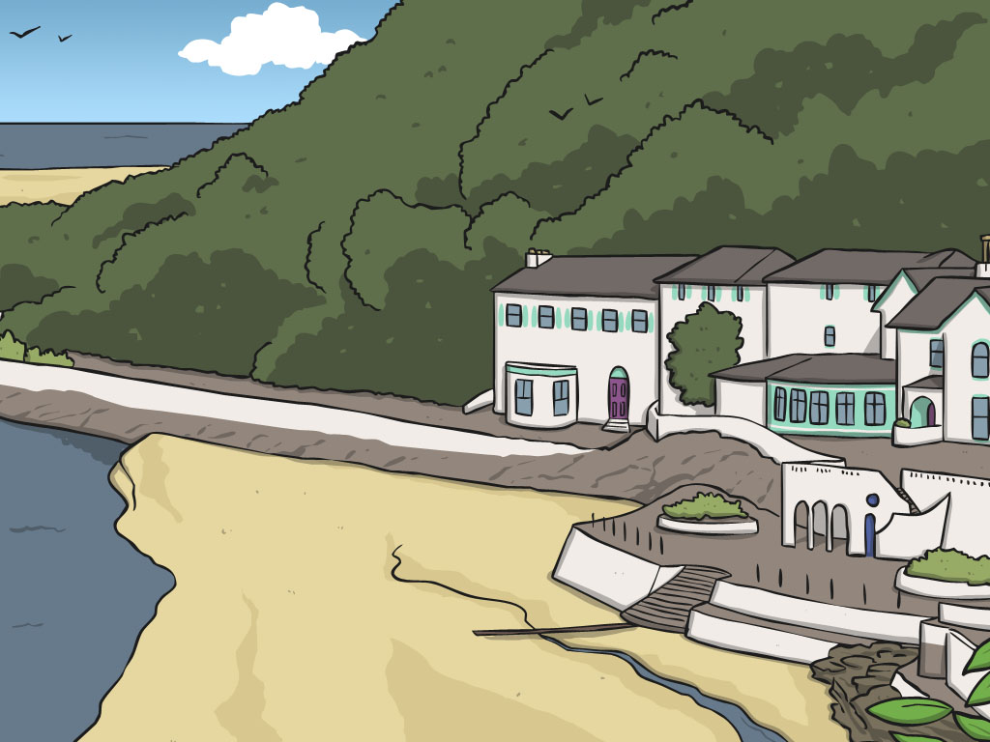

Let’s Explore a Seaside Town

Slide 3
Aim
I can describe a seaside town in the UK.
I can describe places and routes on a map.
Success Criteria
I can use key words to group human and physical features of the seaside.
I can use key words to describe the town of St. Ives and some of the man-made and natural features that exist there.
I can begin to compare my own local area with St. Ives.
I can plan a route for a tour around St. Ives using a map and compass directions.

Slide 4

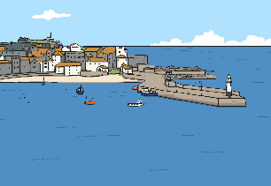
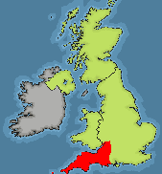
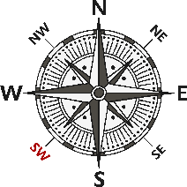
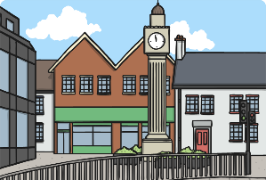
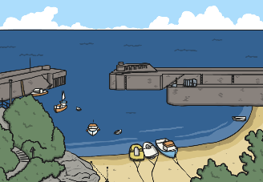
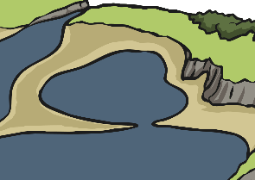
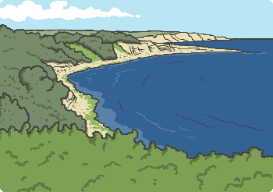

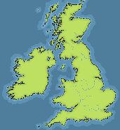


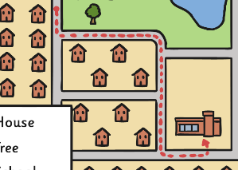







Key Words
St. Ives
Cornwall
South West
town
harbour
bay
coast
headland
map
map symbols
route
attractions

Slide 5
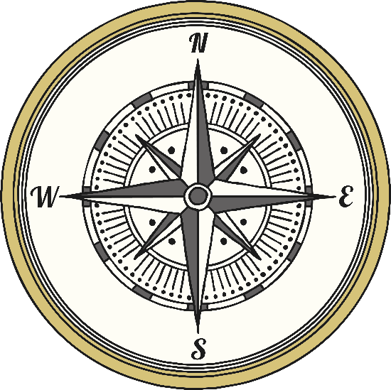
Key Words
north
west
east
south
compass directions
man-made
natural
key

Slide 6
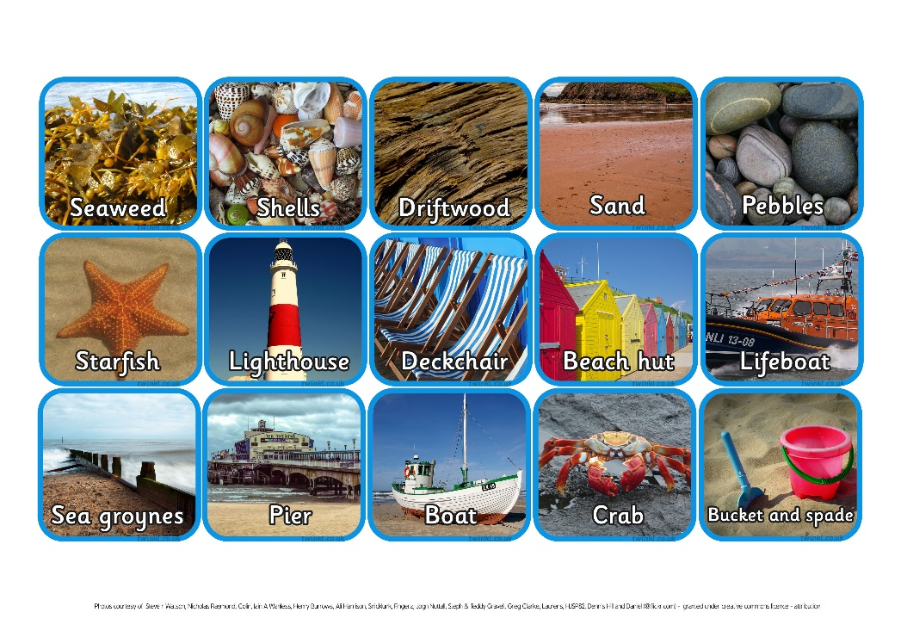
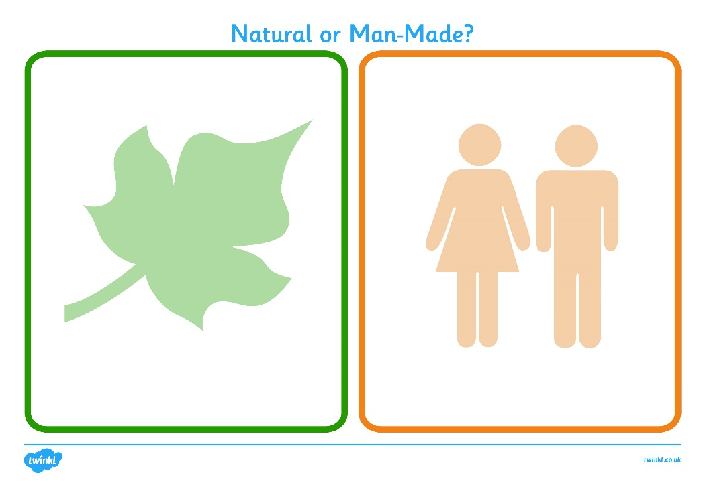
Seaside Sort –
Natural or Man-made?

Slide 7
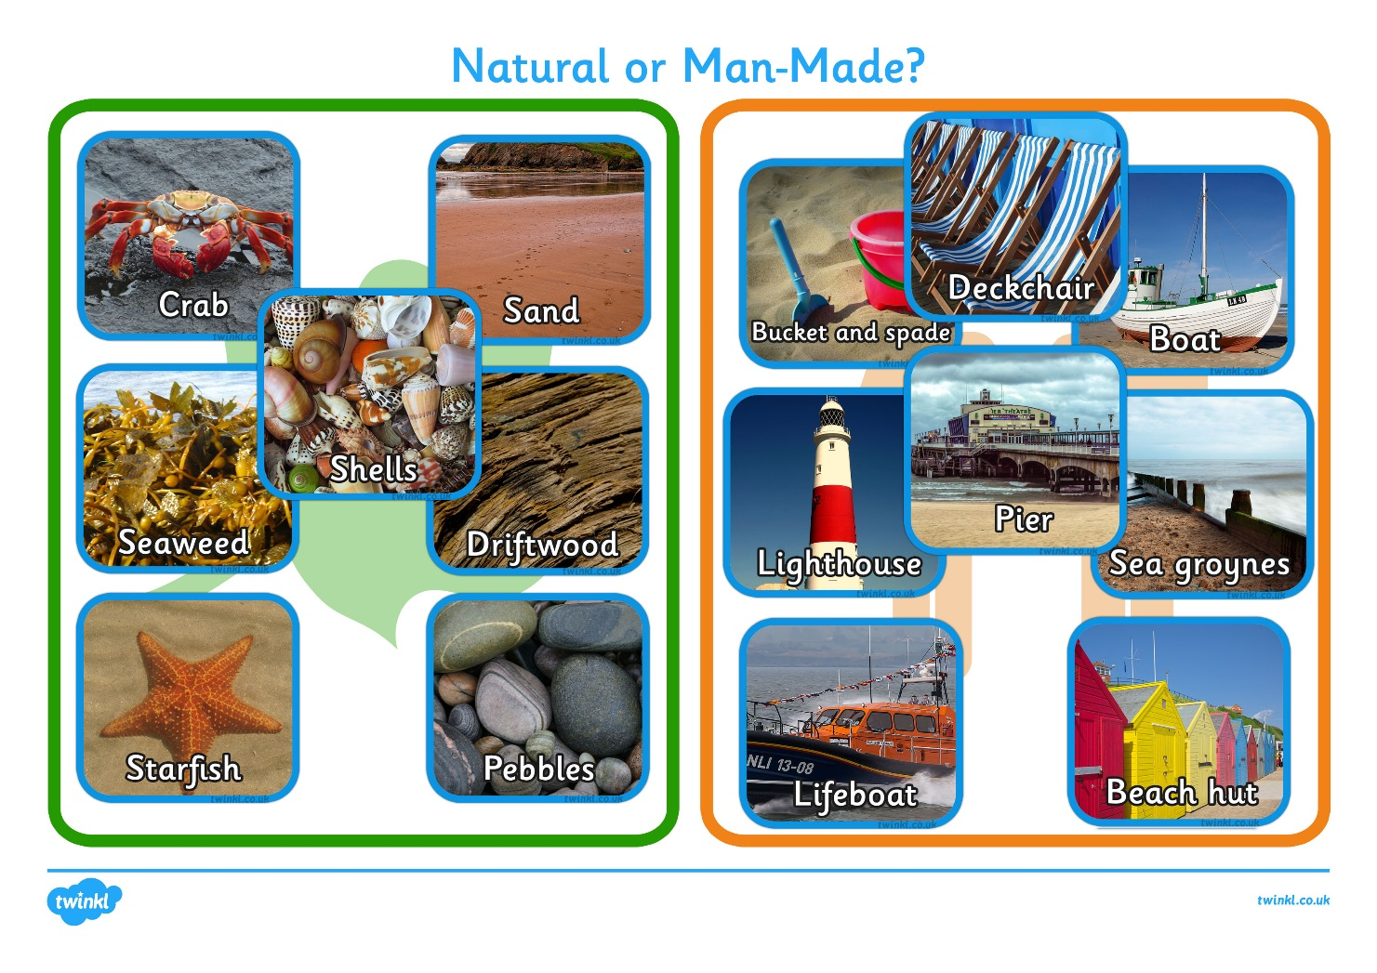
Seaside Sort –
Natural or Man-made?

Slide 8

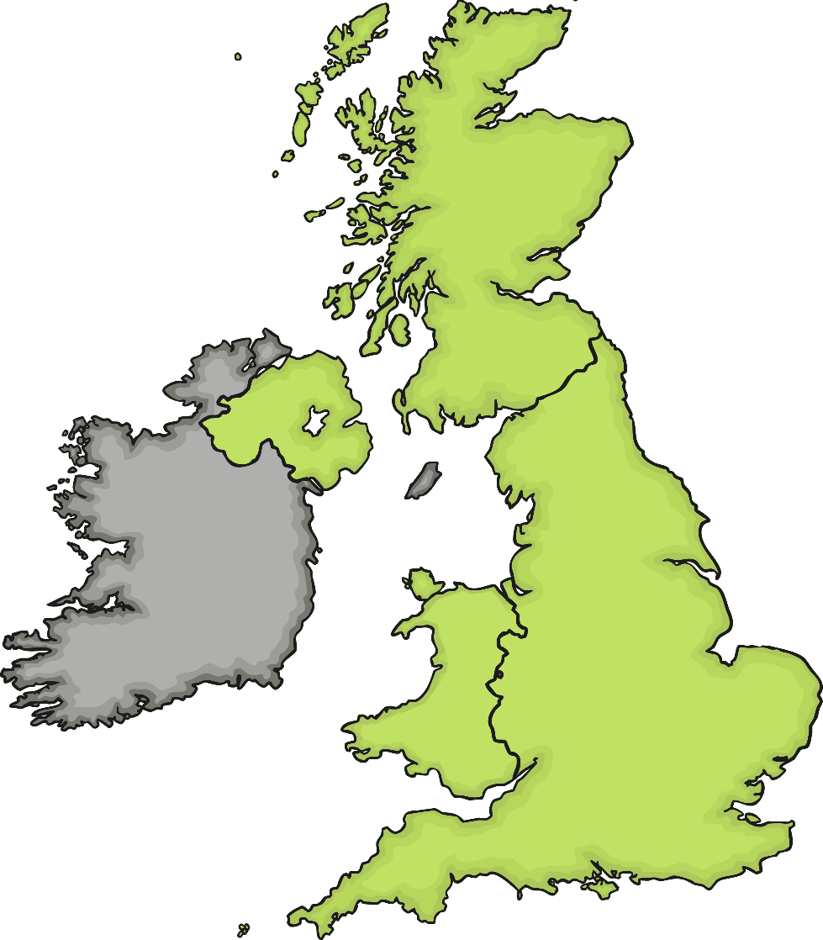
Where is St. Ives?

Slide 9
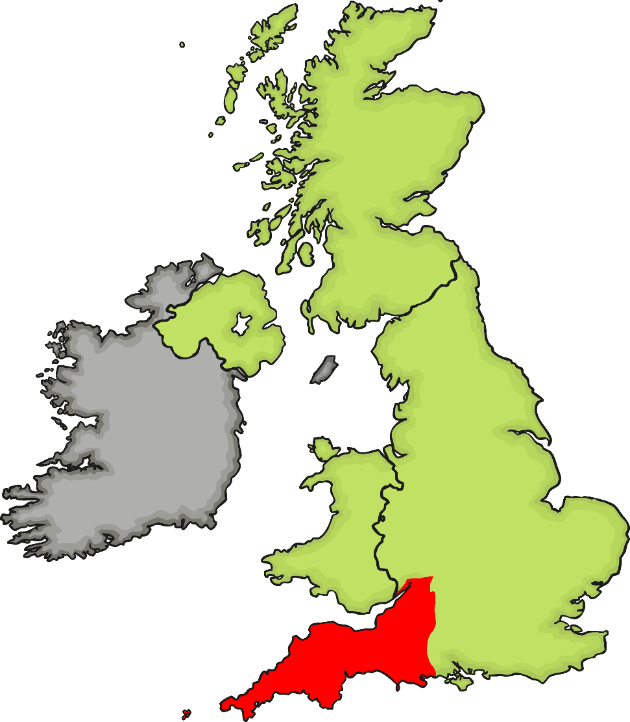
Where is St. Ives?

Slide 10
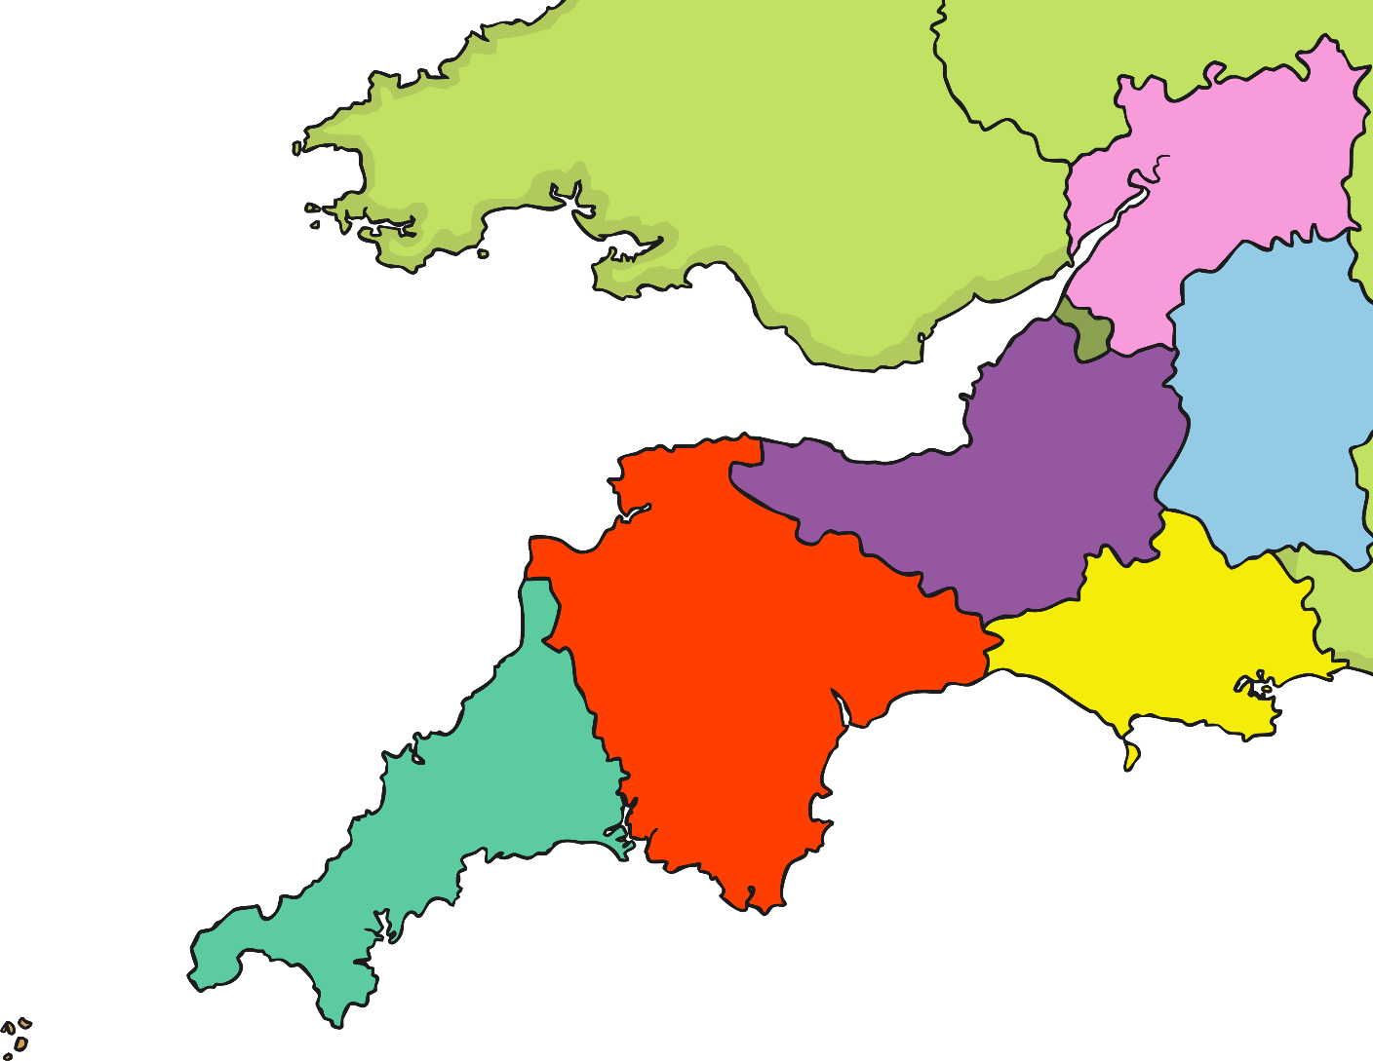
Where is St. Ives?
Notes:
Click on the red area to show the South West counties of the UK.

Slide 11
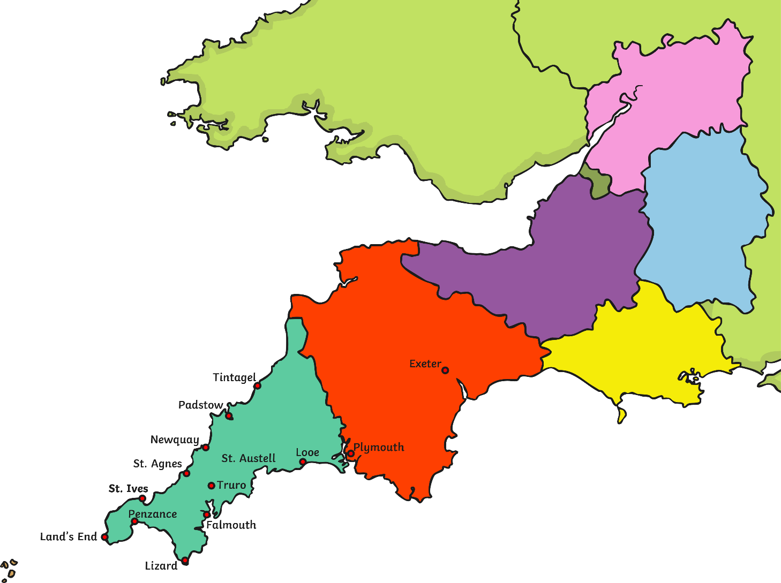
Where is St. Ives?

Slide 12

Where is St. Ives?

Slide 13
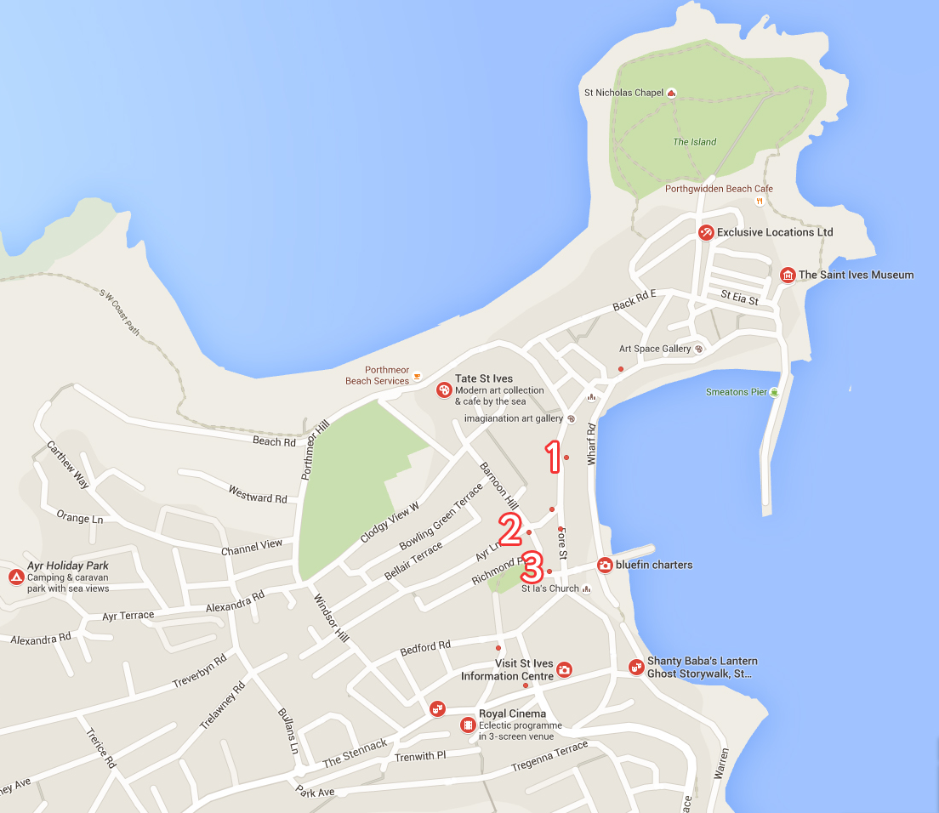
Where is St. Ives?
The Seafood Cafe
Barbara Hepworth Museum and Sculpture Garden
St. Ives Photo Gallery

Slide 14

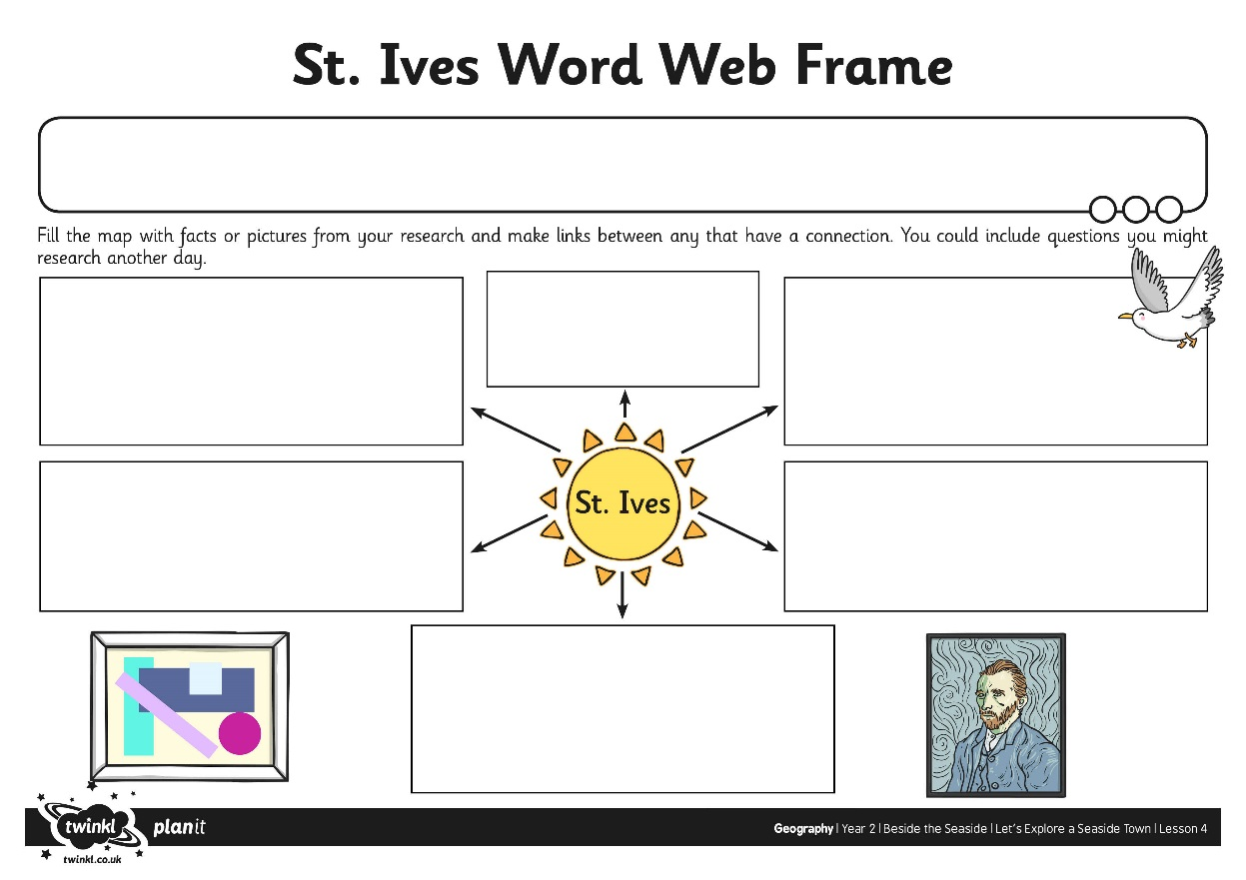
Let’s Explore St. Ives
We are going to explore what the seaside town of St. Ives is like, without leaving the classroom, by looking at videos and photographs.
Use your Word Web Frame to make notes, draw pictures and record your observations about the town as we go!

Slide 15
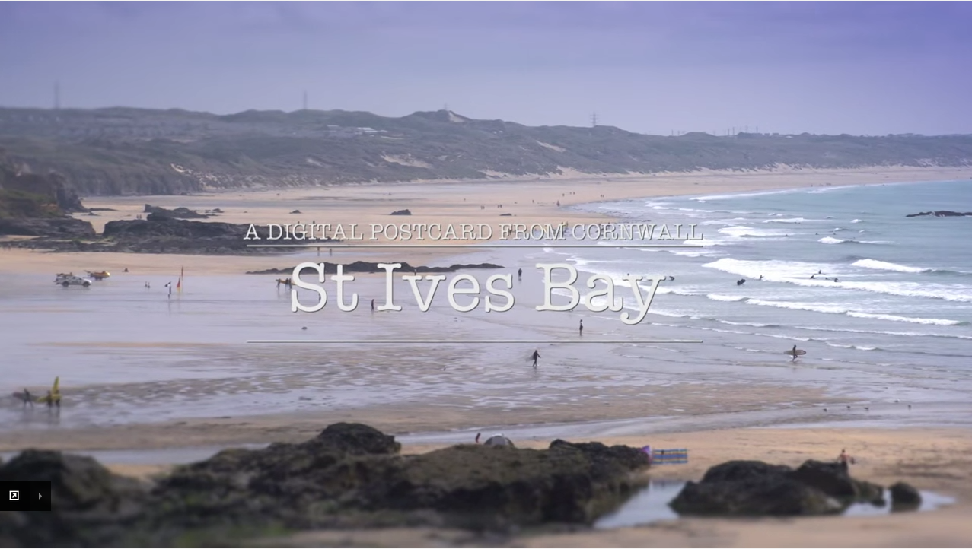
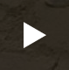
Let’s Explore St. Ives
Click to watch the video

Slide 16
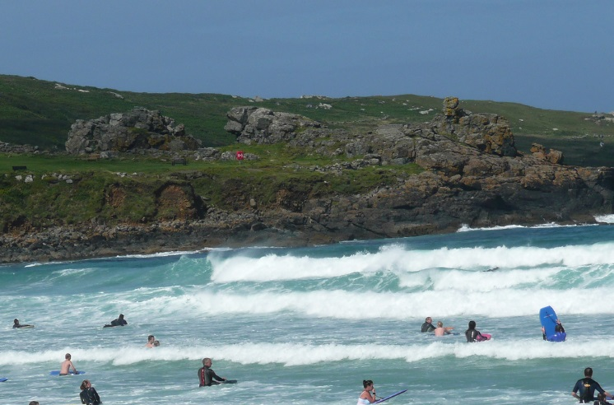
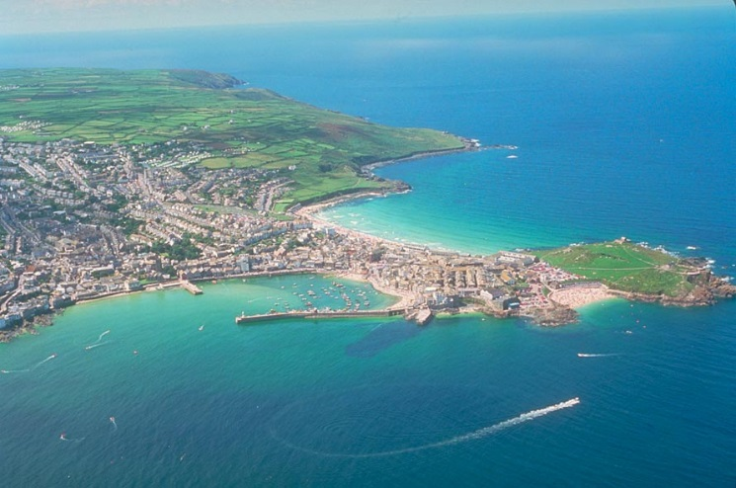
Let’s Explore St. Ives
About St. Ives
St. Ives is known as the ‘jewel’ in Cornwall’s crown. It is a popular resort for visitors, especially families. St. Ives has many attractions and things to do for all different kinds of tourists.
In the past, St. Ives was a busy fishing village. Although much of the fishing has reduced, the harbour is still in use for boat trips, tourist fishing and seal spotting tours to other locations on the coast.
The town has four beaches. The golden sands and great conditions for watersports are enjoyed by everyone.
Photo courtesy of john47kent, Ethreon (@flickr.com) - granted under creative commons licence

Slide 17
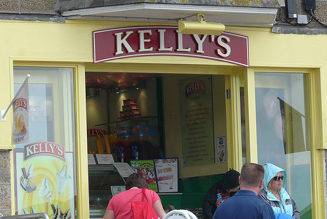
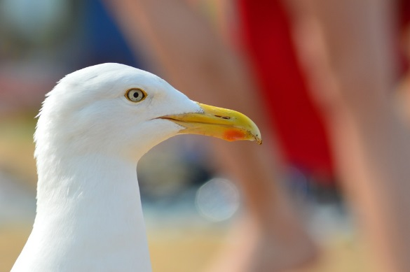
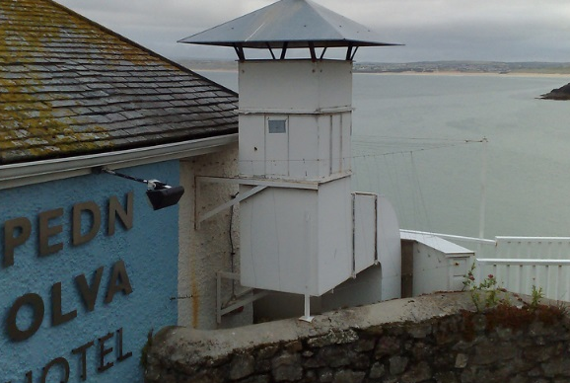
Let’s Explore St. Ives
Places to Stay and Eat
There are many places to stay in St. Ives, ranging from large hotels to small guest houses and holiday cottages. St. Ives offers a wide range of places to eat, including cafes, restaurants, fine dining and the traditional fish and chips and ice cream. Don’t forget to watch out for the seagulls!
Photo courtesy of Loz Flowers, tawlaker (@flickr.com) - granted under creative commons licence

Slide 18
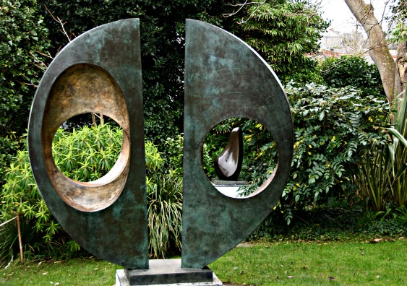
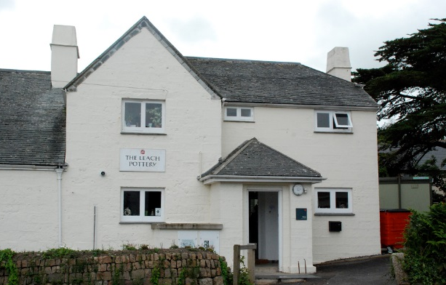

Let’s Explore St. Ives
Things to do
The famous artist Barbara Hepworth lived in St. Ives and there is a museum in the centre of the town which attracts many tourists to see her works.
Leach Pottery was started in St.Ives in 1920 by Bernard Leach which is also another popular attraction for tourists to visit.
Tate St. Ives offers many changing exhibitions and there are many smaller art galleries scattered all around the town itself.

Slide 19

Let’s Explore St. Ives
What did you find out about St. Ives?
What attractions are there?
What do you think the weather is like?
Why do you think tourists visit St Ives?

Slide 20


A Trip Around St. Ives
You are going to imagine you are a tour guide in St. Ives.
You are going to plan a guided tour around St. Ives using a map. You must visit at least 5 locations, use compass directions and position key words (near, far, left, right) to describe the route.

Slide 21
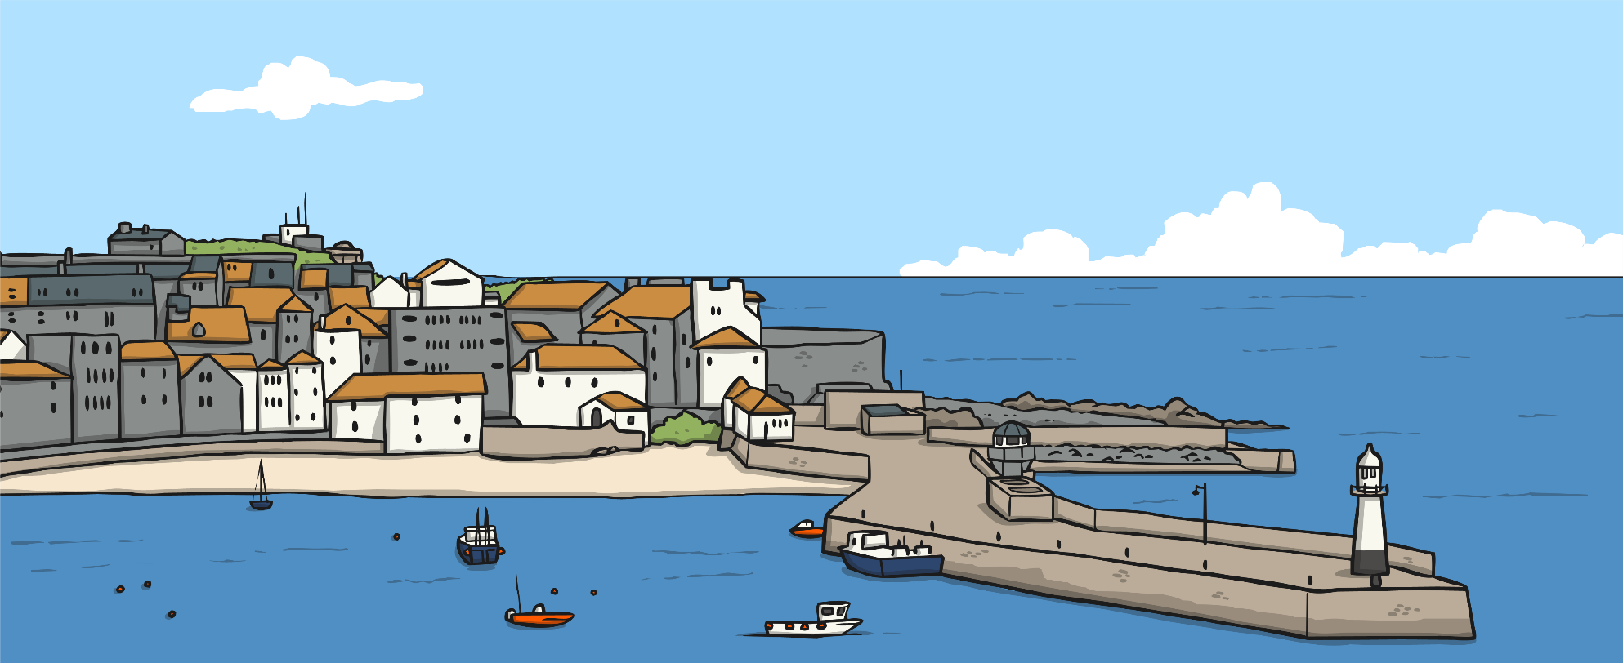
Let’s Compare
Think about where you live. What is it like? What can you do there?
How is St. Ives different or similar to where you live?

Slide 22

Aim
I can describe a seaside town in the UK.
I can describe places and routes on a map.
Success Criteria
I can use key words to group human and physical features of the seaside.
I can use key words to describe the town of St. Ives and some of the man-made and natural features that exist there.
I can begin to compare my own local area with St. Ives.
I can plan a route for a tour around St. Ives using a map and compass directions.

