Slide 1
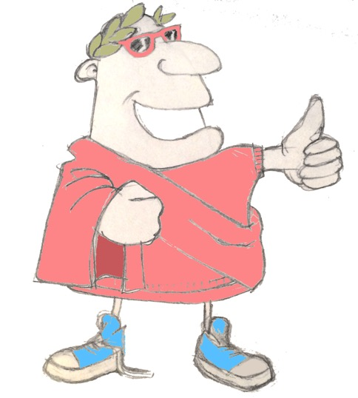
maximum Classics – 27
Putting it all together
Language L.O. to recap and use all out Latin language learning so far

Slide 2
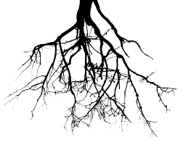
word roots challenge
luna
moon
What English words do we get from these Latin ones?
ridere
to laugh/smile
malus/mala
bad
maximus/maxima
very big
digitus
finger
sub
under
campus
field
circum
around
ventus
wind

Slide 3
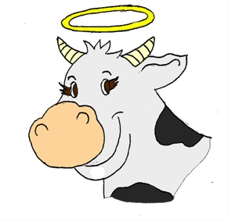
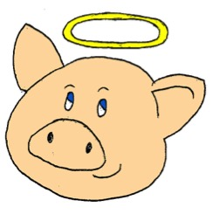
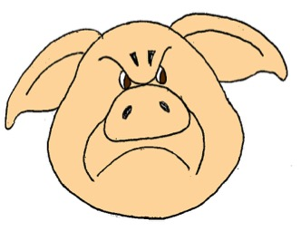
vacca
sordidus
iratus
porcus
porcus
iratus

Slide 4
vacca
sordidus
iratus
porcus
vacca
sordida

Slide 5
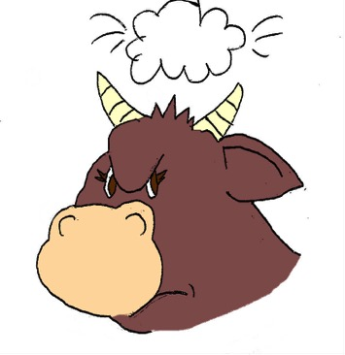
vacca
sordidus
iratus
porcus
vaccae
iratae

Slide 6
vacca
sordidus
iratus
porcus
porci
sordidi

Slide 7
vacca
sordidus
iratus
porcus
sordidum
vacca porcum ……………… videt

Slide 8
vacca
sordidus
iratus
porcus
!
iratas
porcus vaccas ………… videt

Slide 9
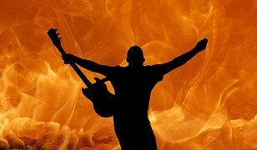
Verb endings

Slide 10
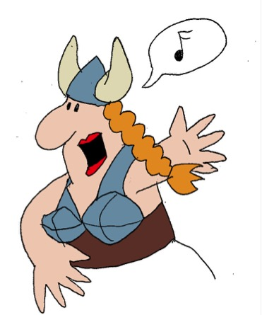
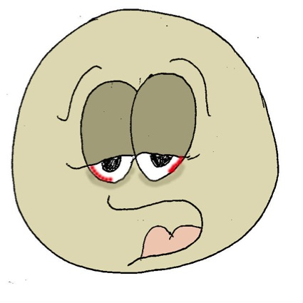
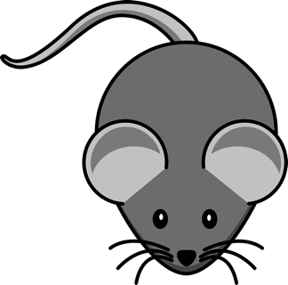
‘being’ verbs
sum
I am
es
you are
est
he/she/it is
sumus
we are
estis
y’all are
sunt
they are

Slide 11
Explosive endings
bam
bas
bat
bamus
batis
bant

Slide 12
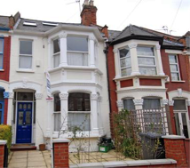
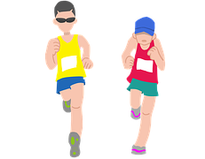
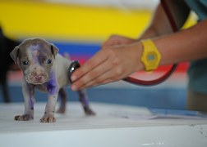
Quick fire verbs – present & past cont. mix-up
habitare
currere
curare
habitabam
curant
currebat
habitamus
curatis
currebamus
currit
curabas

Slide 13
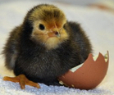
Quick on the draw
iratus/irata
mirus/mira
esse
laudare
audire
femina
medicus
femina
est
irata

Slide 14
Quick on the draw
iratus/irata
mirus/mira
esse
laudare
audire
femina
medicus
femina
laudat
mira
medicum

Slide 15
Quick on the draw
iratus/irata
mirus/mira
esse
laudare
audire
femina
medicus
miri
audiunt
medici
feminam

Slide 16
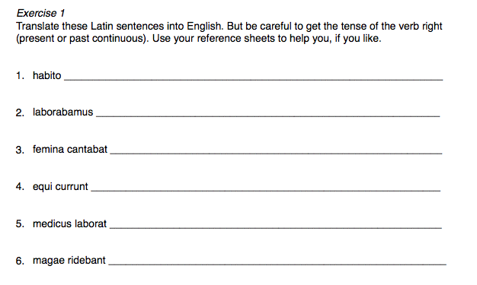
Longer Latin sentences

Slide 17
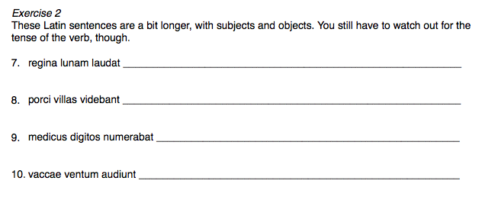
Longer Latin sentences

Slide 18
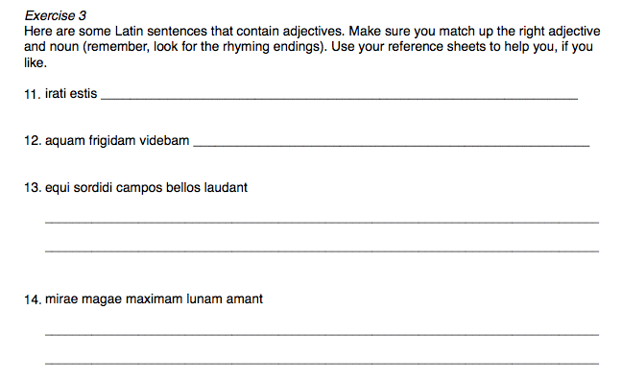
Longer Latin sentences

Slide 19
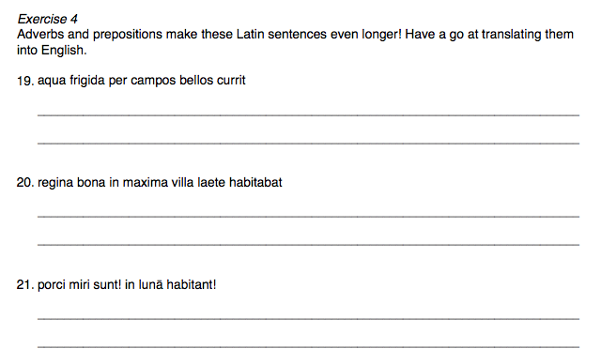
Longer Latin sentences

Slide 20
Longer Latin sentences
answers
I live.
We were working.
The woman was singing.
The horses are running.
The doctor is working.
The witches were laughing/were smiling.

Slide 21
Longer Latin sentences
answers
The queen is praising the moon.
The pigs were seeing the houses.
The doctor was counting the fingers.
The cows hear the wind.

Slide 22
Longer Latin sentences
answers
Y’all/you are angry.
I was seeing the cold water.
The dirty horses praise the beautiful fields.
The amazing witches love the very big moon.

Slide 23
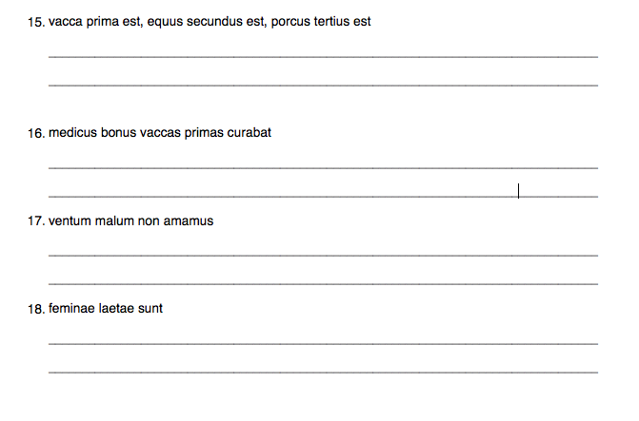
Longer Latin sentences
answers
The cow is first, the horse is second, the pig is third.
The good doctor was looking after the first cows.
We do not love the bad wind.
The women are happy.

Slide 24
Longer Latin sentences
answers
Cold water is running through the beautiful fields.
The good queen was living happily in a very big house.
The pigs are amazing! They are living on the moon!

Slide 25
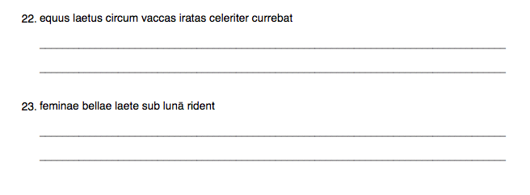
Longer Latin sentences
answers
The happy horse was running quickly around the angry cows.
The beautiful women are laughing happily under the moon.

Slide 26
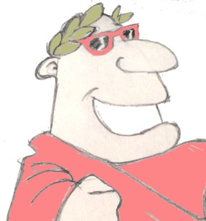
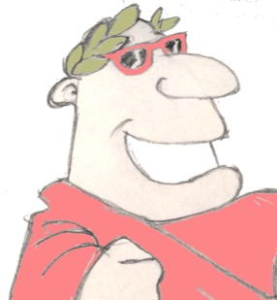
Plenary
If a Latin verb ends in ‘bant’, who was doing it? And when are/were they doing it?
What English words come from the Latin word ‘ventus’, meaning ‘wind’?
vaccas iratas amatis?

