Slide 1
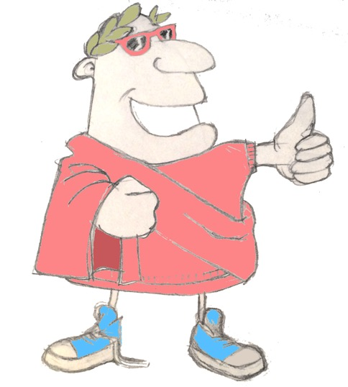
maximum Classics – 25
Really real
Language L.O. to translate Latin past continuous/progressive verbs
Culture L.O. to encounter and discuss Ancient Greek ideas about reality

Slide 2
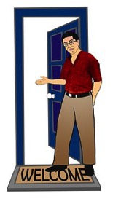
Quick fire verbs
audire
invitare
consumere
clamare
invito
clamant
consumimus
auditis
clamo
audit
invitas
consumit

Slide 3
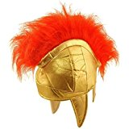
Tense
past
past perfect
“Hello!” Mia shouted to her friend.
Ru was shouting loudly.
past progressive/past continuous
=
ONGOING action in the past

Slide 4
Past progressive/continuous
We are learning some new verb endings today. Do you notice anything that is the same or different?
present
past Progressive/continuous
o
s
t
mus
tis
nt
I
you
he/she/it
we
y’all
they
bam
bas
bat
bamus
batis
bant

Slide 5
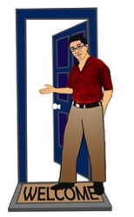
Quick fire verbs – past progressive/continuous
audire
invitare
clamare
audiebam
clamabant
invitabamus
audiebat
clamabatis
invitabam
I
you
he/she/it
we
y’all
they
bam
bas
bat
bamus
batis
bant
clamabas
invitabat

Slide 6
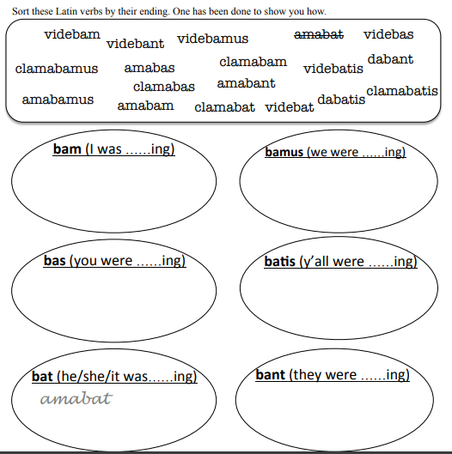
Have a go at sorting these Latin verbs by their ending, answers on the next slide!

Slide 7
Answers to sorting task
bam (I was ……ing)
bamus (we were ……ing)
videbam
amabam
clamabamus
clamabam
amabamus
videbamus
bas (you were ……ing)
batis (y’all were ……ing)
amabas
clamabatis
clamabas
videbatis
videbas
dabatis
bat (he/she/it was……ing)
bant (they were ……ing)
amabat
amabant
videbant
clamabat
videbat
dabant

Slide 8
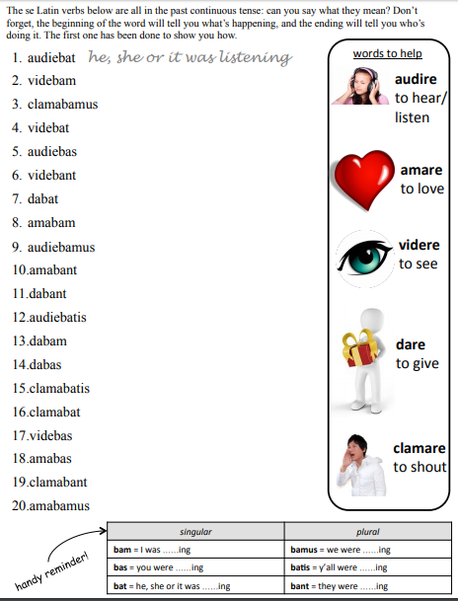
Now for some translation, don’t worry, I will attach the sheets separately to the blog for easier viewing!
Answers on the next slide

Slide 9
Answers to translating task
audiebat he, she or it was listening
videbam I was seeing
clamabamus we were shouting
videbat he, she or it was seeing
audiebas you were listening
videbant they were seeing
dabat he, she or it was giving
amabam I was loving
audiebamus we were listening
amabant they were loving
dabant they were giving
audiebatis y’all were listening
dabam I was giving
dabas you were giving
clamabatis y’all were shouting
clamabat he, she or it was shouting
videbas you were seeing
amabas you were loving
clamabant they were shouting
amabamus we were loving

Slide 10
Look at the close ups on the following slides and see of you can guess what the mystery object is.
Next click will reveal the truth!

Slide 11
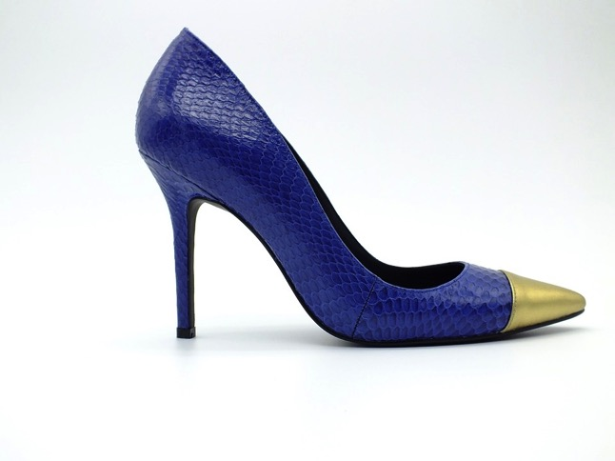
What is this object in real life?
Now that those who practise justice do so involuntarily and because they have not the power to be unjust will best appear if we imagine something of this kind: having given both to the just and the unjust power to do what they will, let us watch and see whither desire will lead them; then we shall discover in the very act the just and unjust man to be proceeding along the same road, following their interest, which all natures deem to be their good, and are only diverted into the path of justice by the force of law. The liberty which we are supposing may be most completely given to them in the form of such a power as is said to have been possessed by Gyges the ancestor of Croesus the Lydian. According to the tradition, Gyges was a shepherd in the service of the king of Lydia; there was a great storm, and an earthquake made an opening in the earth at the place where he was feeding his flock. Amazed at the sight, he descended into the opening, where, among other marvels, he beheld a hollow brazen horse, having doors, at which he stooping and looking in saw a dead body of stature, as appeared to him, more than human, and having nothing on but a gold ring; this he took from the finger of the dead and reascended. Now the shepherds met together, according to custom, that they might send their monthly report about the flocks to the king; into their assembly he came having the ring on his finger, and as he was sitting among them he chanced to turn the collet of the ring inside his hand, when instantly he became invisible to the rest of the company and they began to speak of him as if he were no longer present. He was astonished at this, and again touching the ring he turned the collet outwards and reappeared; he made several trials of the ring, and always with the same result-when he turned the collet inwards he became invisible, when outwards he reappeared. Whereupon he contrived to be chosen one of the messengers who were sent to the court; where as soon as he arrived he seduced the queen, and with her help conspired against the king and slew him, and took the kingdom. Suppose now that there were two such magic rings, and the just put on one of them and the unjust the other;,no man can be imagined to be of such an iron nature that he would stand fast in justice. No man would keep his hands off what was not his own when he could safely take what he liked out of the market, or go into houses and lie with any one at his pleasure, or kill or release from prison whom he would, and in all respects be like a God among men. Then the actions of the just would be as the actions of the unjust; they would both come at last to the same point. And this we may truly affirm to be a great proof that a man is just, not willingly or because he thinks that justice is any good to him individually, but of necessity, for wherever any one thinks that he can safely be unjust, there he is unjust. For all men believe in their hearts that injustice is far more profitable to the individual than justice, and he who argues as I have been supposing, will say that they are right. If you could imagine any one obtaining this power of becoming invisible, and never doing any wrong or touching what was another's, he would be thought by the lookers-on to be a most wretched idiot, although they would praise him to one another's faces, and keep up appearances with one another from a fear that they too might suffer injustice. Enough of this.

Slide 12
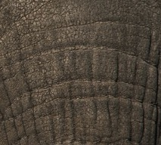
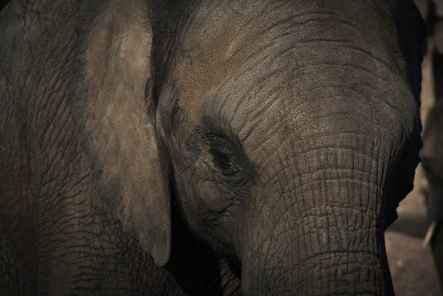
Now that those who practise justice do so involuntarily and because they have not the power to be unjust will best appear if we imagine something of this kind: having given both to the just and the unjust power to do what they will, let us watch and see whither desire will lead them; then we shall discover in the very act the just and unjust man to be proceeding along the same road, following their interest, which all natures deem to be their good, and are only diverted into the path of justice by the force of law. The liberty which we are supposing may be most completely given to them in the form of such a power as is said to have been possessed by Gyges the ancestor of Croesus the Lydian. According to the tradition, Gyges was a shepherd in the service of the king of Lydia; there was a great storm, and an earthquake made an opening in the earth at the place where he was feeding his flock. Amazed at the sight, he descended into the opening, where, among other marvels, he beheld a hollow brazen horse, having doors, at which he stooping and looking in saw a dead body of stature, as appeared to him, more than human, and having nothing on but a gold ring; this he took from the finger of the dead and reascended. Now the shepherds met together, according to custom, that they might send their monthly report about the flocks to the king; into their assembly he came having the ring on his finger, and as he was sitting among them he chanced to turn the collet of the ring inside his hand, when instantly he became invisible to the rest of the company and they began to speak of him as if he were no longer present. He was astonished at this, and again touching the ring he turned the collet outwards and reappeared; he made several trials of the ring, and always with the same result-when he turned the collet inwards he became invisible, when outwards he reappeared. Whereupon he contrived to be chosen one of the messengers who were sent to the court; where as soon as he arrived he seduced the queen, and with her help conspired against the king and slew him, and took the kingdom. Suppose now that there were two such magic rings, and the just put on one of them and the unjust the other;,no man can be imagined to be of such an iron nature that he would stand fast in justice. No man would keep his hands off what was not his own when he could safely take what he liked out of the market, or go into houses and lie with any one at his pleasure, or kill or release from prison whom he would, and in all respects be like a God among men. Then the actions of the just would be as the actions of the unjust; they would both come at last to the same point. And this we may truly affirm to be a great proof that a man is just, not willingly or because he thinks that justice is any good to him individually, but of necessity, for wherever any one thinks that he can safely be unjust, there he is unjust. For all men believe in their hearts that injustice is far more profitable to the individual than justice, and he who argues as I have been supposing, will say that they are right. If you could imagine any one obtaining this power of becoming invisible, and never doing any wrong or touching what was another's, he would be thought by the lookers-on to be a most wretched idiot, although they would praise him to one another's faces, and keep up appearances with one another from a fear that they too might suffer injustice. Enough of this.
What is this object in real life?

Slide 13
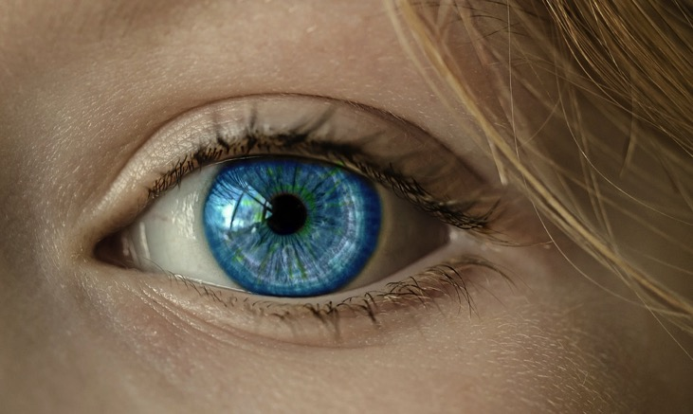
Now that those who practise justice do so involuntarily and because they have not the power to be unjust will best appear if we imagine something of this kind: having given both to the just and the unjust power to do what they will, let us watch and see whither desire will lead them; then we shall discover in the very act the just and unjust man to be proceeding along the same road, following their interest, which all natures deem to be their good, and are only diverted into the path of justice by the force of law. The liberty which we are supposing may be most completely given to them in the form of such a power as is said to have been possessed by Gyges the ancestor of Croesus the Lydian. According to the tradition, Gyges was a shepherd in the service of the king of Lydia; there was a great storm, and an earthquake made an opening in the earth at the place where he was feeding his flock. Amazed at the sight, he descended into the opening, where, among other marvels, he beheld a hollow brazen horse, having doors, at which he stooping and looking in saw a dead body of stature, as appeared to him, more than human, and having nothing on but a gold ring; this he took from the finger of the dead and reascended. Now the shepherds met together, according to custom, that they might send their monthly report about the flocks to the king; into their assembly he came having the ring on his finger, and as he was sitting among them he chanced to turn the collet of the ring inside his hand, when instantly he became invisible to the rest of the company and they began to speak of him as if he were no longer present. He was astonished at this, and again touching the ring he turned the collet outwards and reappeared; he made several trials of the ring, and always with the same result-when he turned the collet inwards he became invisible, when outwards he reappeared. Whereupon he contrived to be chosen one of the messengers who were sent to the court; where as soon as he arrived he seduced the queen, and with her help conspired against the king and slew him, and took the kingdom. Suppose now that there were two such magic rings, and the just put on one of them and the unjust the other;,no man can be imagined to be of such an iron nature that he would stand fast in justice. No man would keep his hands off what was not his own when he could safely take what he liked out of the market, or go into houses and lie with any one at his pleasure, or kill or release from prison whom he would, and in all respects be like a God among men. Then the actions of the just would be as the actions of the unjust; they would both come at last to the same point. And this we may truly affirm to be a great proof that a man is just, not willingly or because he thinks that justice is any good to him individually, but of necessity, for wherever any one thinks that he can safely be unjust, there he is unjust. For all men believe in their hearts that injustice is far more profitable to the individual than justice, and he who argues as I have been supposing, will say that they are right. If you could imagine any one obtaining this power of becoming invisible, and never doing any wrong or touching what was another's, he would be thought by the lookers-on to be a most wretched idiot, although they would praise him to one another's faces, and keep up appearances with one another from a fear that they too might suffer injustice. Enough of this.
What is this object in real life?
What did you base your guesses on?
Experience!

Slide 14
Greek philosophers spent a long time arguing about what reality really is.
Plato (we met him when we talked about why you should be a good person) believed that reality is all in our minds and everything in the world is an imperfect, shadowy reflection of that.
Aristotle disagreed with his teacher Plato. He argued that reality is created from our experiences, what we see, hear, feel and so on.
What do you think? There is no right or wrong in philosophy so just consider your arguments here

Slide 15
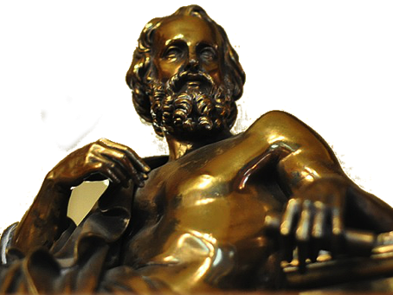
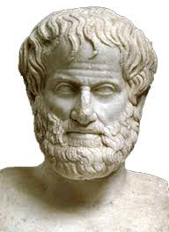
What is reality?
Now that those who practise justice do so involuntarily and because they have not the power to be unjust will best appear if we imagine something of this kind: having given both to the just and the unjust power to do what they will, let us watch and see whither desire will lead them; then we shall discover in the very act the just and unjust man to be proceeding along the same road, following their interest, which all natures deem to be their good, and are only diverted into the path of justice by the force of law. The liberty which we are supposing may be most completely given to them in the form of such a power as is said to have been possessed by Gyges the ancestor of Croesus the Lydian. According to the tradition, Gyges was a shepherd in the service of the king of Lydia; there was a great storm, and an earthquake made an opening in the earth at the place where he was feeding his flock. Amazed at the sight, he descended into the opening, where, among other marvels, he beheld a hollow brazen horse, having doors, at which he stooping and looking in saw a dead body of stature, as appeared to him, more than human, and having nothing on but a gold ring; this he took from the finger of the dead and reascended. Now the shepherds met together, according to custom, that they might send their monthly report about the flocks to the king; into their assembly he came having the ring on his finger, and as he was sitting among them he chanced to turn the collet of the ring inside his hand, when instantly he became invisible to the rest of the company and they began to speak of him as if he were no longer present. He was astonished at this, and again touching the ring he turned the collet outwards and reappeared; he made several trials of the ring, and always with the same result-when he turned the collet inwards he became invisible, when outwards he reappeared. Whereupon he contrived to be chosen one of the messengers who were sent to the court; where as soon as he arrived he seduced the queen, and with her help conspired against the king and slew him, and took the kingdom. Suppose now that there were two such magic rings, and the just put on one of them and the unjust the other;,no man can be imagined to be of such an iron nature that he would stand fast in justice. No man would keep his hands off what was not his own when he could safely take what he liked out of the market, or go into houses and lie with any one at his pleasure, or kill or release from prison whom he would, and in all respects be like a God among men. Then the actions of the just would be as the actions of the unjust; they would both come at last to the same point. And this we may truly affirm to be a great proof that a man is just, not willingly or because he thinks that justice is any good to him individually, but of necessity, for wherever any one thinks that he can safely be unjust, there he is unjust. For all men believe in their hearts that injustice is far more profitable to the individual than justice, and he who argues as I have been supposing, will say that they are right. If you could imagine any one obtaining this power of becoming invisible, and never doing any wrong or touching what was another's, he would be thought by the lookers-on to be a most wretched idiot, although they would praise him to one another's faces, and keep up appearances with one another from a fear that they too might suffer injustice. Enough of this.
Plato
‘Real’ things exist in our heads as ideas or ‘perfect forms’. In life, we see shadowy, incomplete versions of these ‘perfect forms’.
NO WAY DUDE!!
We use our experiences in the world and our memories of them to know what is real.
Aristotle
If we want to understand reality better, ask these kinds of questions:
What’s the thing made of? How was it made? (And, most especially) What’s its purpose? WHAT’S ITS POINT?!!

Slide 16
Aristotle’s reality
Now that those who practise justice do so involuntarily and because they have not the power to be unjust will best appear if we imagine something of this kind: having given both to the just and the unjust power to do what they will, let us watch and see whither desire will lead them; then we shall discover in the very act the just and unjust man to be proceeding along the same road, following their interest, which all natures deem to be their good, and are only diverted into the path of justice by the force of law. The liberty which we are supposing may be most completely given to them in the form of such a power as is said to have been possessed by Gyges the ancestor of Croesus the Lydian. According to the tradition, Gyges was a shepherd in the service of the king of Lydia; there was a great storm, and an earthquake made an opening in the earth at the place where he was feeding his flock. Amazed at the sight, he descended into the opening, where, among other marvels, he beheld a hollow brazen horse, having doors, at which he stooping and looking in saw a dead body of stature, as appeared to him, more than human, and having nothing on but a gold ring; this he took from the finger of the dead and reascended. Now the shepherds met together, according to custom, that they might send their monthly report about the flocks to the king; into their assembly he came having the ring on his finger, and as he was sitting among them he chanced to turn the collet of the ring inside his hand, when instantly he became invisible to the rest of the company and they began to speak of him as if he were no longer present. He was astonished at this, and again touching the ring he turned the collet outwards and reappeared; he made several trials of the ring, and always with the same result-when he turned the collet inwards he became invisible, when outwards he reappeared. Whereupon he contrived to be chosen one of the messengers who were sent to the court; where as soon as he arrived he seduced the queen, and with her help conspired against the king and slew him, and took the kingdom. Suppose now that there were two such magic rings, and the just put on one of them and the unjust the other;,no man can be imagined to be of such an iron nature that he would stand fast in justice. No man would keep his hands off what was not his own when he could safely take what he liked out of the market, or go into houses and lie with any one at his pleasure, or kill or release from prison whom he would, and in all respects be like a God among men. Then the actions of the just would be as the actions of the unjust; they would both come at last to the same point. And this we may truly affirm to be a great proof that a man is just, not willingly or because he thinks that justice is any good to him individually, but of necessity, for wherever any one thinks that he can safely be unjust, there he is unjust. For all men believe in their hearts that injustice is far more profitable to the individual than justice, and he who argues as I have been supposing, will say that they are right. If you could imagine any one obtaining this power of becoming invisible, and never doing any wrong or touching what was another's, he would be thought by the lookers-on to be a most wretched idiot, although they would praise him to one another's faces, and keep up appearances with one another from a fear that they too might suffer injustice. Enough of this.
Aristotle says we understand the real world around us because of our experiences in life. Use your experiences (memories, learning, knowledge) to answer Aristotle’s key questions about the following things.
 | What is it made of? | How was it made? | What is its purpose?
a daisy
a house
flies
spaghetti bolognese
books

Slide 17
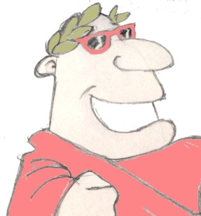
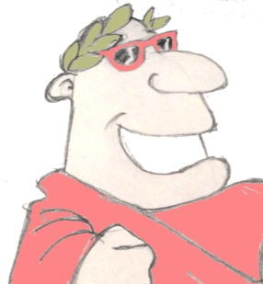
Plenary
What English word comes from the Latin ‘clamare’, meaning ‘to shout’?
What’s the difference between the past perfect and the past continuous tenses?
How does Aristotle say we understand about reality and the world around us?

