Slide 1
maximum Classics – 26
Stars in our eyes
Language L.O. to translate Latin past continuous/progressive verbs
Culture L.O. to learn about constellations and the myths behind them

Slide 2
Explosive endings
Do you remember the past continuous endings?
bam
bas
bat
bamus
batis
bant

Slide 3
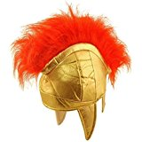
Past progressive/continuous
present
past Progressive/continuous
o
s
t
mus
tis
nt
I
you
he/she/it
we
y’all
they
bam
bas
bat
bamus
batis
bant

Slide 4
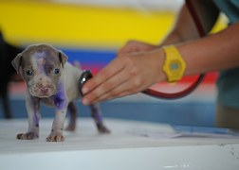
Quick fire verbs – present & past cont. mix-up
consumere
curare
dare
consumebam
curant
dabat
consumimus
dabamus
curatis
curabas
dat

Slide 5
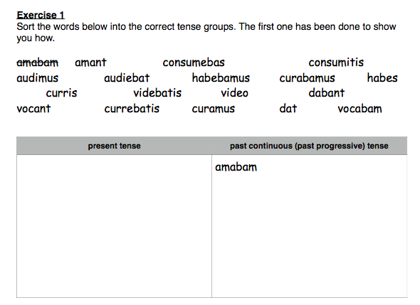
Present & Past Continuous verbs: Exercise

Slide 6
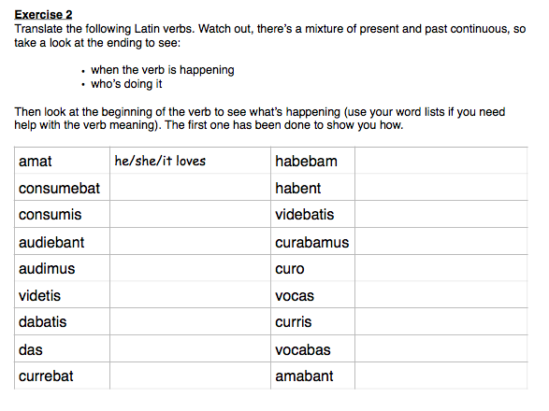
Present & Past Continuous verbs: Exercise

Slide 7
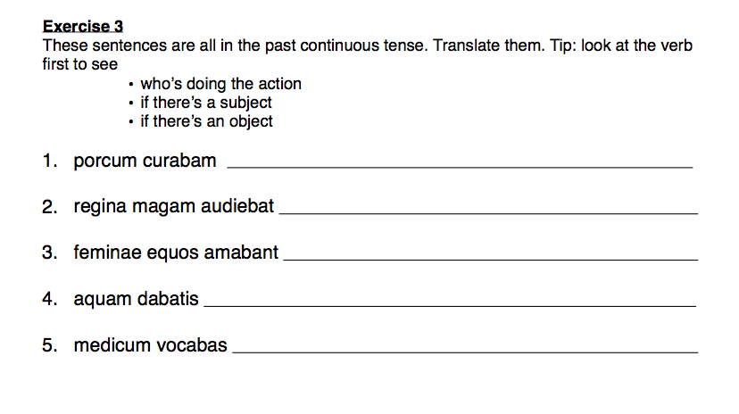
Present & Past Continuous verbs: Exercise

Slide 8
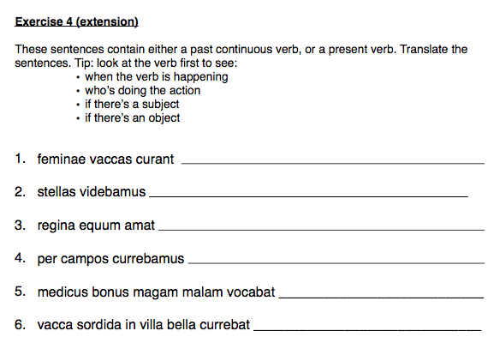
Present & Past Continuous verbs: Exercise

Slide 9
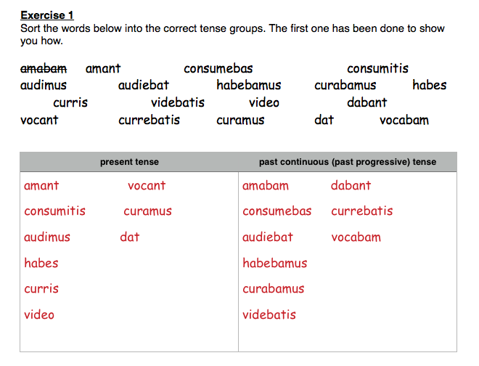
Present & Past Continuous verbs: Exercise

Slide 10
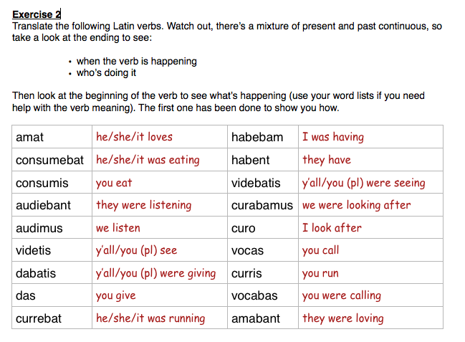
Present & Past Continuous verbs: Exercise

Slide 11
Present & Past Continuous verbs: Exercise

Slide 12
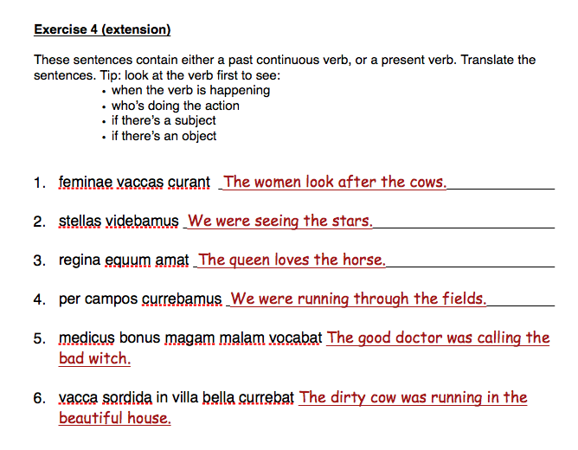
Present & Past Continuous verbs: Exercise

Slide 13
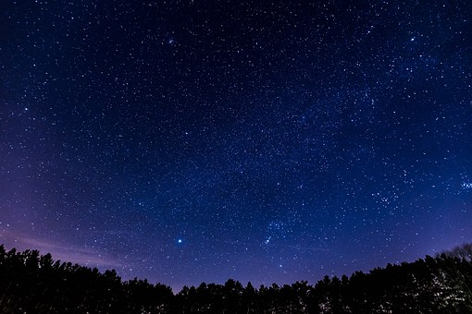
Astronomy: constellations
stella
constellation

Slide 14
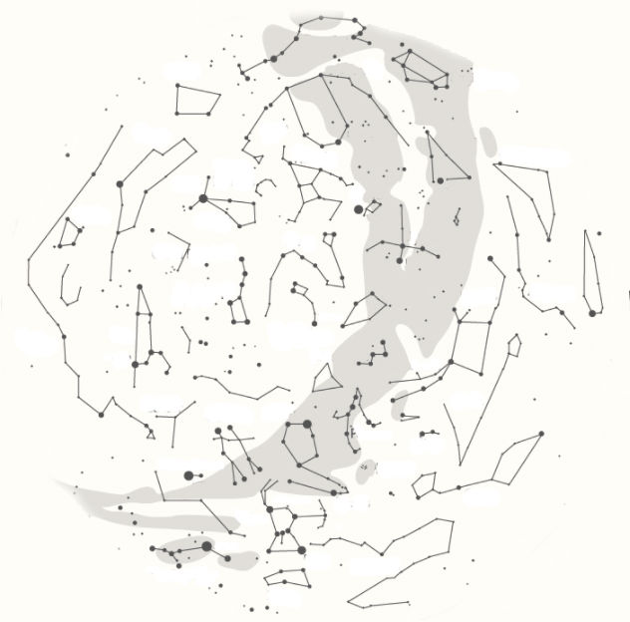
Astronomy: constellations
Ursa Major
The Big Bear
The Big Bear started her life as the beautiful huntress Callisto. The god Zeus fell in love with her, making Zeus’ wife, Hera, angry. Hera then turned Callisto into a bear, who then became a victim of a hunt. Saddened, Zeus turned his love into the constellation Ursa Major.

Slide 15
Astronomy: constellations
Hercules
Hercules (or Herakles in Ancient Greek) had to carry out twelve impossibly difficult tasks for the King of Mycenae. Using a combination of strength and cunning, he completed all twelve labours (and more besides!), and was commemorated for his heroic life by becoming a constellation.

Slide 16
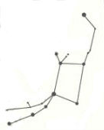
Astronomy: constellations
Can you find these constellations in the star map on the right? Trace over them in a coloured pen or pencil.
Cetus- The Whale
A sea monster sent as punishment to Ethiopia. Killed by the hero Perseus, but turned by the gods into a constellation.
Canis Major – The Big Dog
A magical dog that never failed to catch its prey until it met the Teumessian Fox. Their never-ending chase was commemorated by the gods in the stars.
Draco – The Dragon
A hundred-headed serpent who guarded the golden apples of the Hesperides. Killed by Hercules, then placed into the night sky by the gods.
Pegasus
The immortal winged horse who was born from the severed neck of Medusa.
Cygnus – The Swan
The form taken by the god Zeus in one of his many visits to mortal Earth.
Gemini – The Twins
Castor and Pollux, the twin sons of the god Zeus who rescued sailors in distress. They were commemorated for their bravery by being made into a constellation when they died.

Slide 17
Astronomy: constellations
Can you find these constellations in the star map on the right? Trace over them in a coloured pen or pencil.
Cetus- The Whale
A sea monster sent as punishment to Ethiopia. Killed by the hero Perseus, but turned by the gods into a constellation.
Canis Major – The Big Dog
A magical dog that never failed to catch its prey until it met the Teumessian Fox. Their never-ending chase was commemorated by the gods in the stars.
Draco – The Dragon
A hundred-headed serpent who guarded the golden apples of the Hesperides. Killed by Hercules, then placed into the night sky by the gods.
Pegasus
The immortal winged horse who was born from the severed neck of Medusa.
Cygnus – The Swan
The form taken by the god Zeus in one of his many visits to mortal Earth.
Gemini – The Twins
Castor and Pollux, the twin sons of the god Zeus who rescued sailors in distress. They were commemorated for their bravery by being made into a constellation when they died.

Slide 18
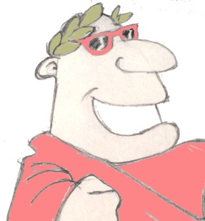
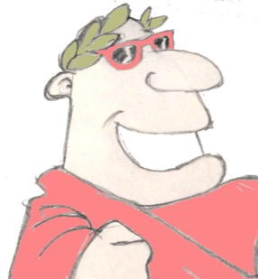
Plenary
If a Latin verb ends in ‘bam’, who was doing it? And when were they doing it?
What’s English word comes from the Latin word ‘stella’? What does ‘stella’ mean?
Name one constellation named after an animal.

