Slide 1
Inspiring
Here are some ideas of people, words and places which may inspire you.

Slide 2
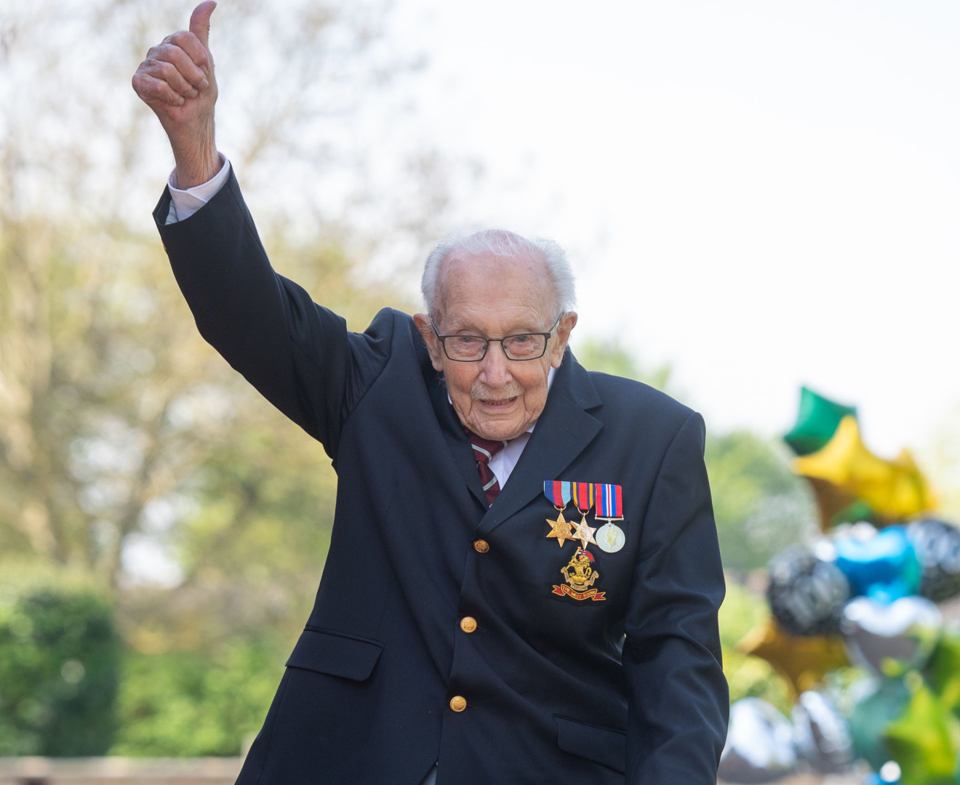
Captain Tom Moore
NHS Fundraiser during Covid 19 pandamic.

Slide 3
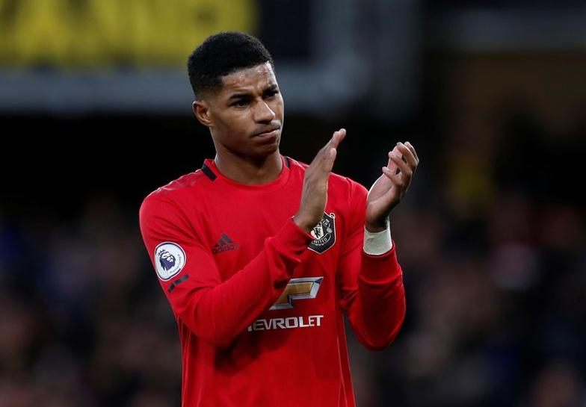
Marcus Rashford
Manchester United footballer and free school meals campaigner.

Slide 4
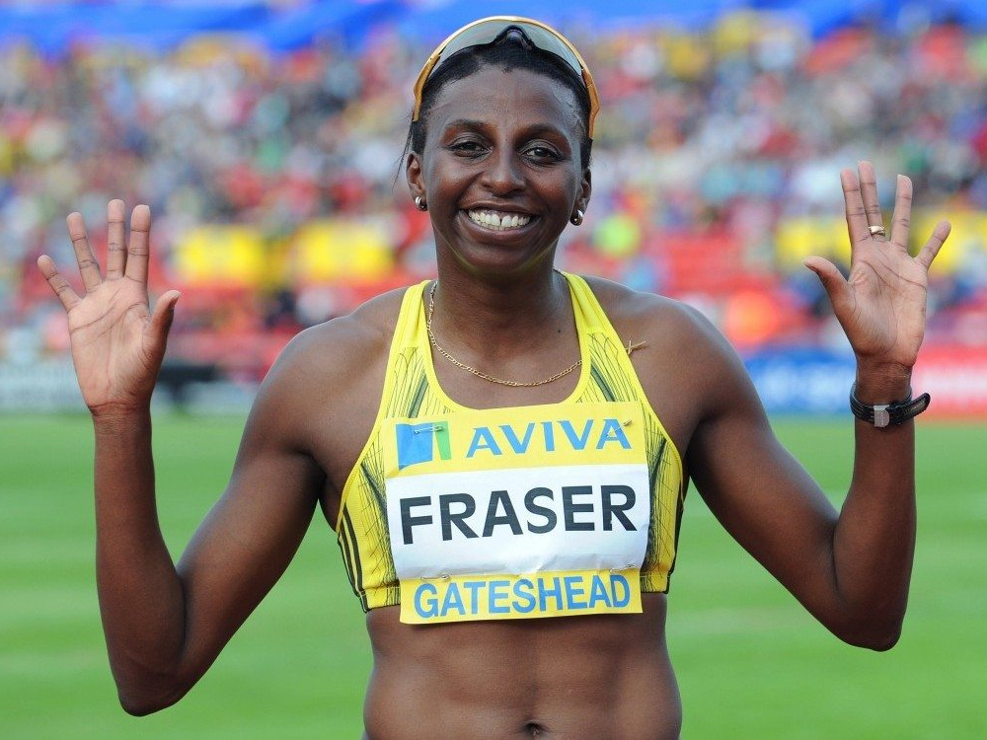
Donna Fraser
Croydon athlete and School Governor

Slide 5
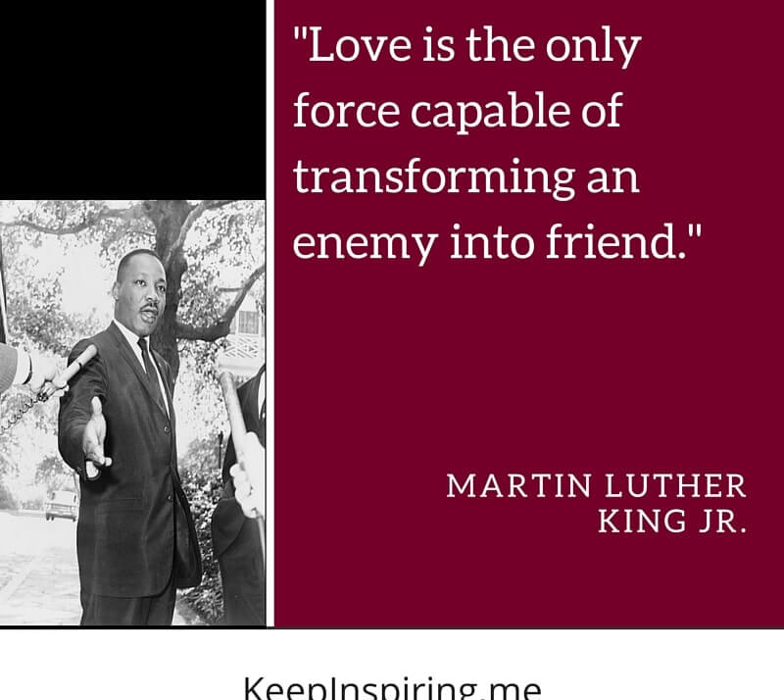
Quotation from Martin Luther King JR
Civil Rights Campaigner

Slide 6

Quotation from the New Testament
The Bible

Slide 7
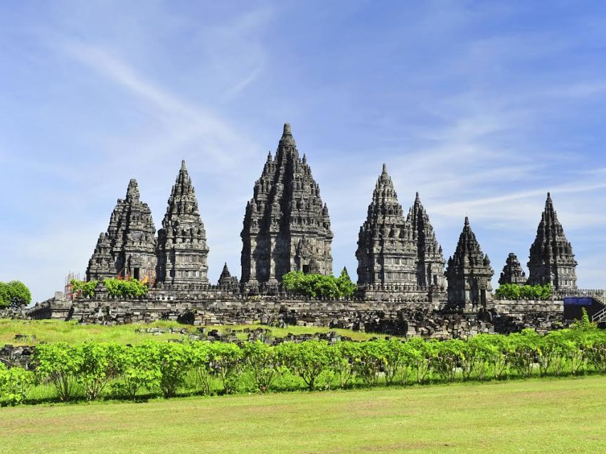
Virupaksha Hindu Temple
India

Slide 8
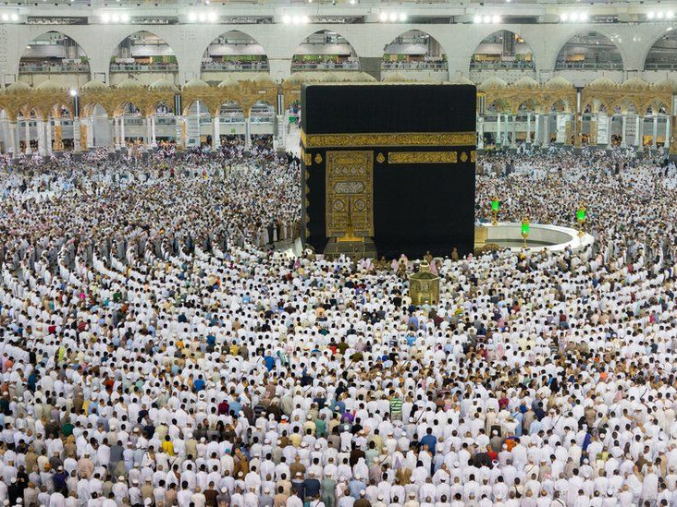
The Kaaba
Hajj Pilgrimage

Slide 9
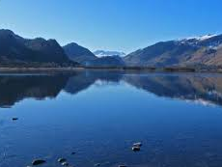
Lake Derwentwater
The Lake District, Cumbria, England

Slide 10
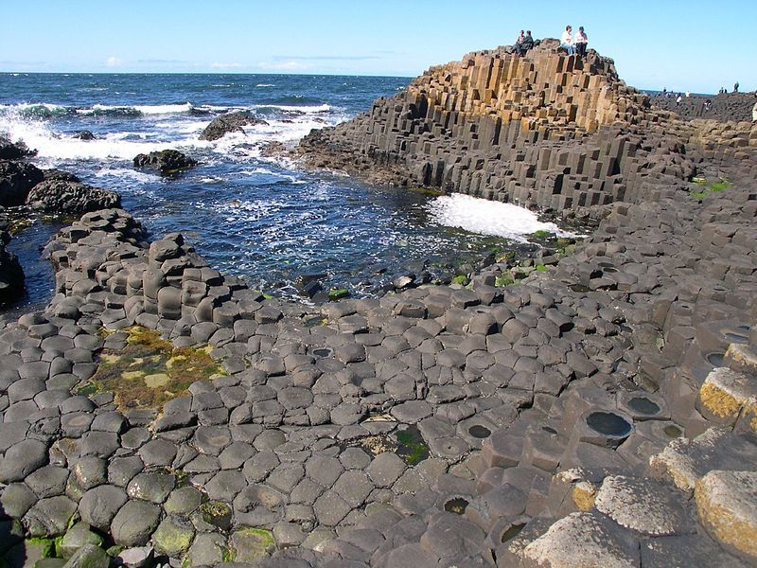
Giants Causeway
Ireland

Slide 11
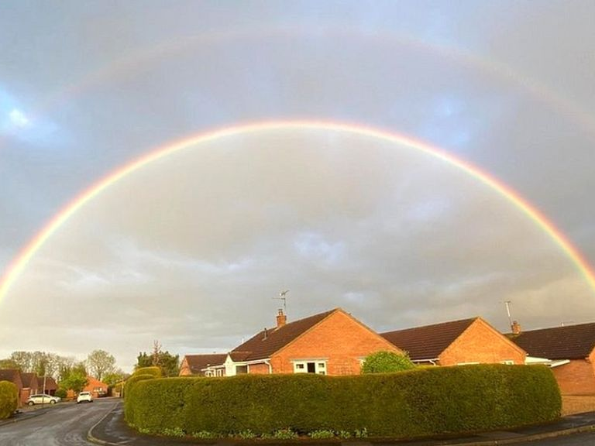
Double Rainbow
Appeared during clap for carers 30th April 2020

