Slide 1
LO: To write a poem about my ideal world.

Slide 2
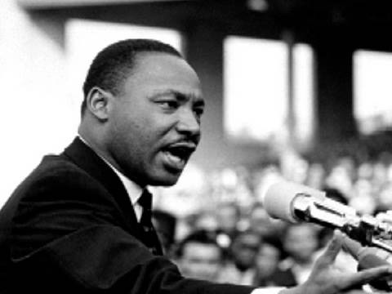
Who was Martin Luther King Jr?
Notes:
This slide contains two hyperlinks:
- On the question text – to a video about Martin Luther King Jr made by an American kindergarten girl, succinct and useful!
- On the photograph – an excerpt from Martin Luther King’s ‘I have a dream’ speech (the famous bit!)

Slide 3
We hold these truths to be self-evident: that all men are created equal. I have a dream that one day on the red hills of Georgia the sons of former slaves and the sons of former slave owners will be able to sit down together at the table of brotherhood. I have a dream that one day even the state of Mississippi, a state sweltering with the heat of injustice, sweltering with the heat of oppression, will be transformed into an oasis of freedom and justice. I have a dream that my four little children will one day live in a nation where they will not be judged by the colour of their skin but by the content of their character. I have a dream today. Martin Luther King Jr

Slide 4
I have a dream…
What would your dream school be like?
How will everyone be treated with respect?
What would your dream world be like?
How should you and people all over the world be treated?

Slide 5
LO: To write a poem about an ideal world. Success criteria: 1. It has ideas for a “dream” world. 2. Each verse starts with I have a dream 3. The last line is I have a dream today. Extension: Include a vision of what will happen in your dream world. Challenge: Use a thesaurus to make the best choice of words for your poem.

