Slide 1
Children’s Menu
Which items on these menus are healthy?
Which are not healthy?

Slide 2
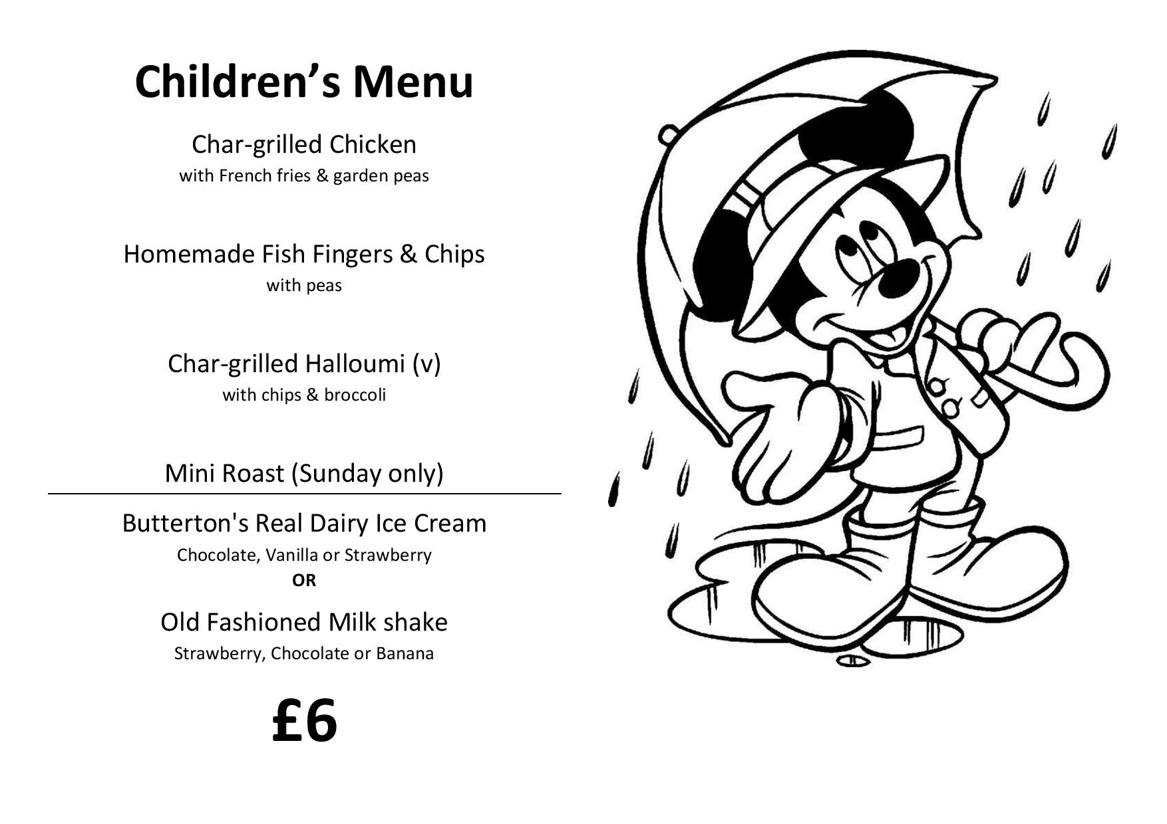

Slide 3
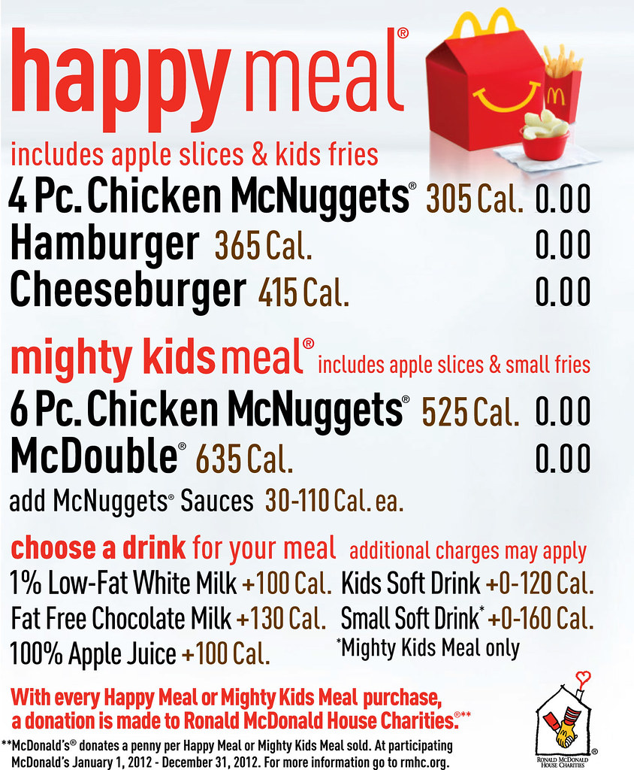

Slide 4
