Slide 1


Amusing Adverts to Persuade
Posters

Slide 2
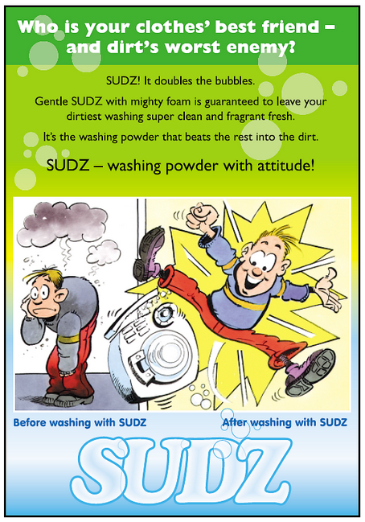

Slide 3


Slide 4


Slide 5


Slide 6


Slide 7
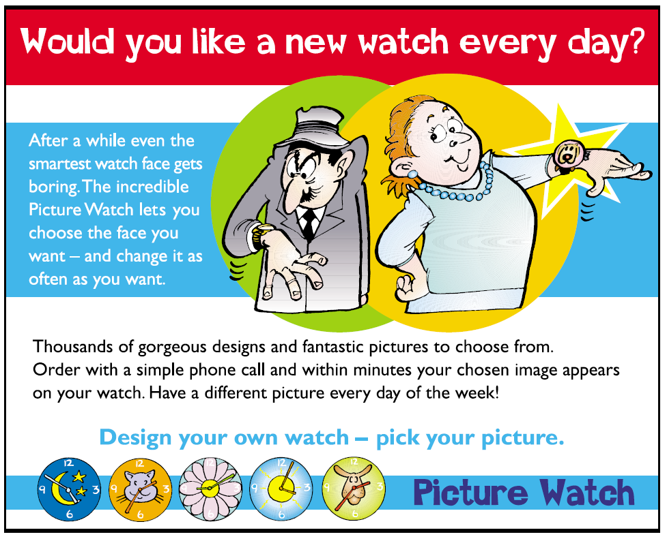

Slide 8


