Slide 2
Aim
To learn about the United Kingdom
Success Criteria
I can find the United Kingdom on a world map.
I can find the four countries on a map of the UK.
I can talk about the four countries who are part of the United Kingdom.

Slide 3
Starter Activity
What do you already know about the United Kingdom?
Think, pair, share your ideas!
?
?
?

Slide 4
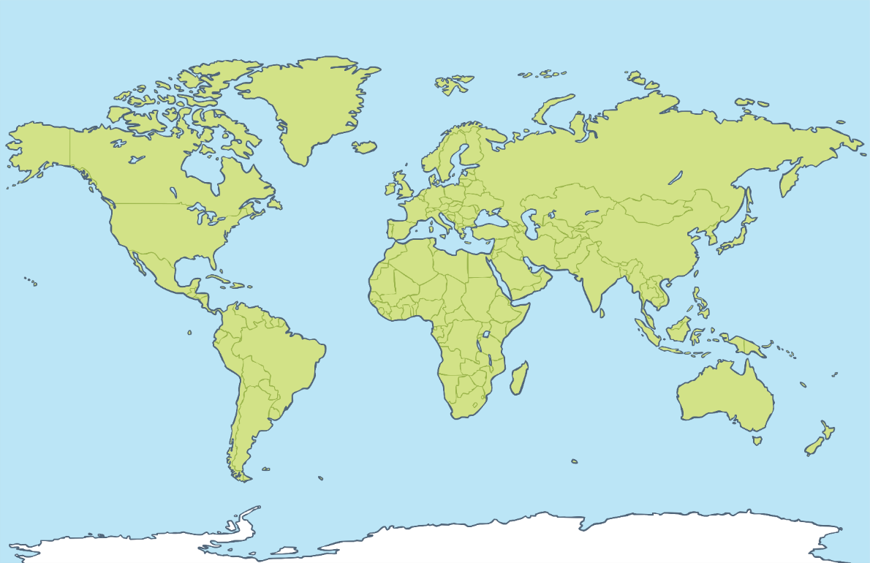
Continents
In which continent can the United Kingdom be found?
Click me to find out!

Slide 5
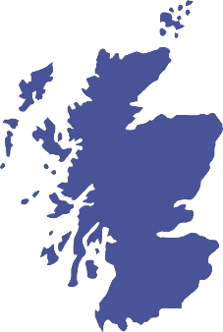
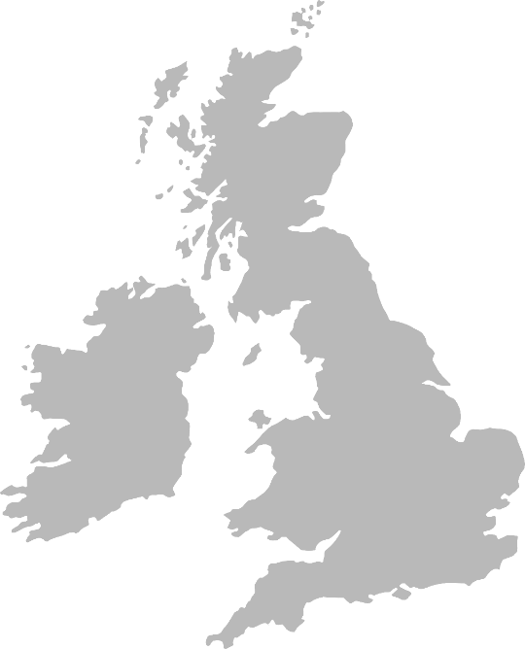
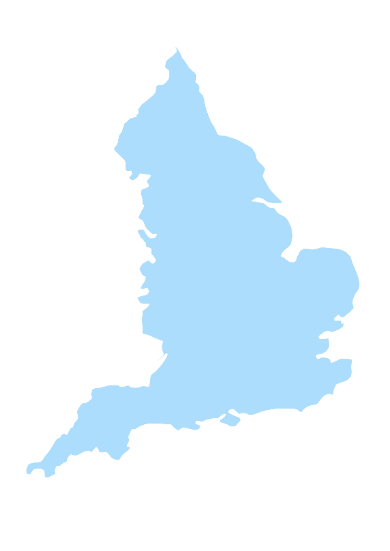
What Are The Four Countries Of The United Kingdom?
Scotland
Northern Ireland
Think, pair, share your ideas.
England
Wales
Click to see each country.

Slide 6
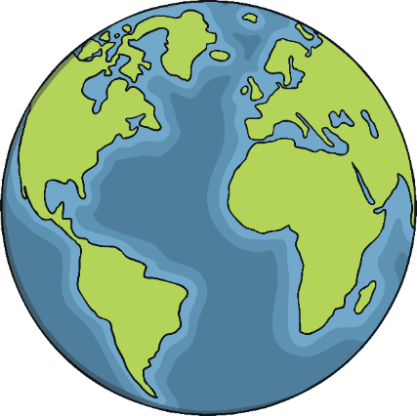
What Are The Physical And Human Features?
Human Features
Physical Features
are ways in which people have made changes to the land. For example, a motorway, statue or pier are features built by humans which have altered the way it looks.
describe the natural environment of a place.

Slide 7
England
Scotland
Northern Ireland
England
Wales

Slide 8
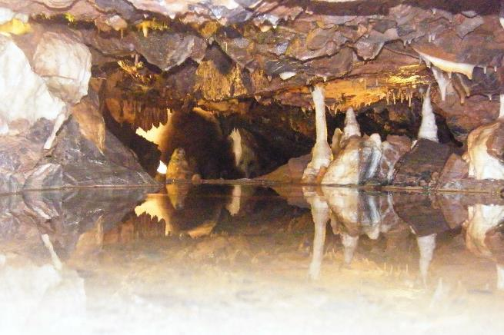
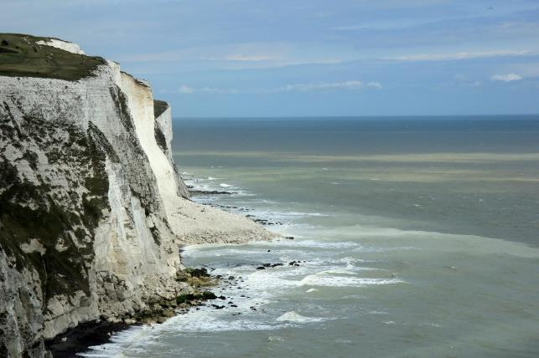
Physical Features
White Cliffs of Dover
Cliffs that form part of England’s coastline. The cliffs contain chalk and streaks of dark flint.
Cheddar Gorge
Britain's biggest Gorge with dramatic cliffs and caves and caverns.
Photos courtesy of Karen Roe, kevgibbo, Steven's Transport Photos and Stuart Pinfold (@flickr.com) granted under creative commons licence attribution

Slide 9
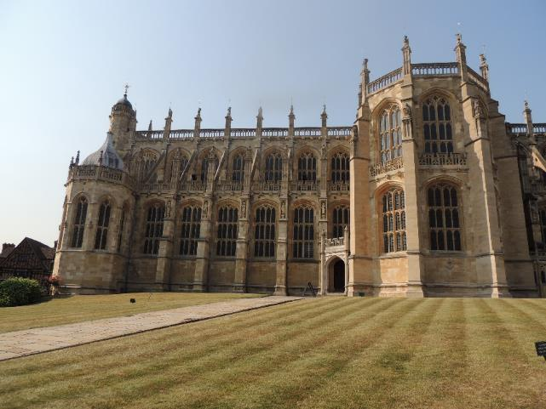
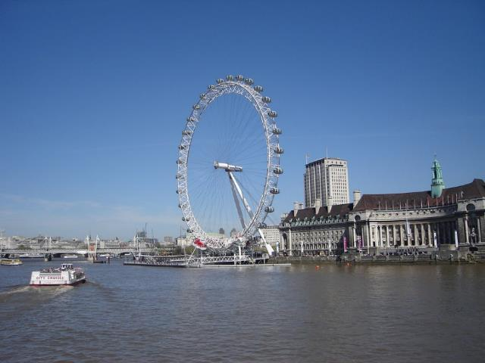
Human Features
London Eye
Ferris wheel allowing people to see views across the capital city of London.
Windsor Castle
Kings and Queens have lived here.
Photos courtesy of Karen Roe, kevgibbo, Steven's Transport Photos and Stuart Pinfold (@flickr.com) granted under creative commons licence attribution

Slide 10
English Foods
Yorkshire
Rhubarb
Lincolnshire
Peas, Pork
Gloucestershire and the Cotswolds
Rapeseed and Salmon
South East and Kent
Cherries
Devon
Clotted Cream
Sussex
Dover Sole
Cornwall
Tea
Hampshire
Truffles
Isle of Wight
Tomatoes

Slide 11
Wales
Scotland
Northern Ireland
England
Wales

Slide 12
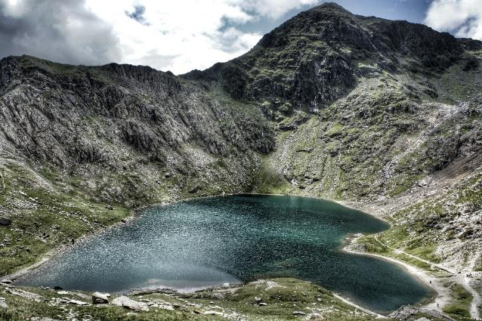
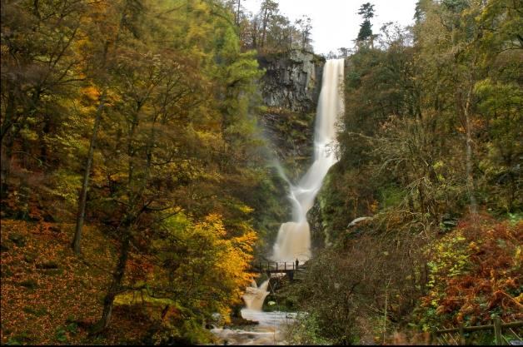
Physical Features
Pistyll Rhaeadr
An 80 metre high waterfall.
Snowdon
The highest mountain in Wales at 1,085 metres above sea level.
Photos courtesy erwlas and ...Like Clockwork (@flickr.com) granted under creative commons licence attribution

Slide 13
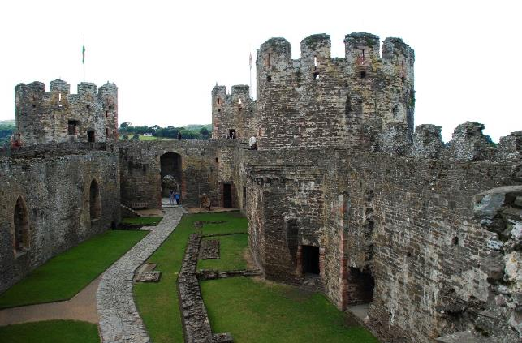
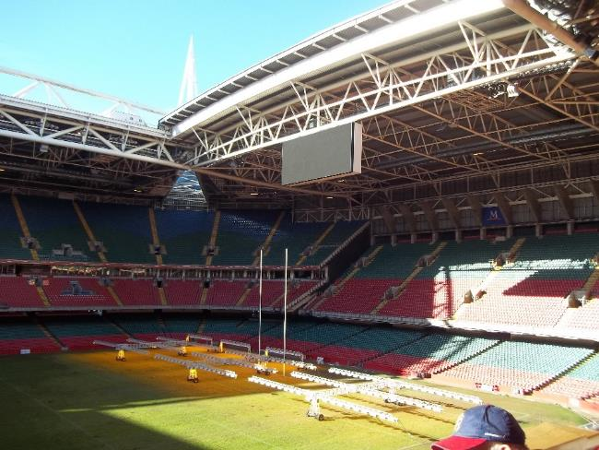
Human Features
The Principality Stadium
A national stadium of Wales located in the Welsh capital city of Cardiff.
Conwy Castle
A medieval fortress in Conwy on the North Coast of Wales, built by Edward I.
Photos courtesy of Suzanne Gielis and markhealey (@flickr.com) granted under creative commons licence attribution

Slide 14
Welsh Foods
Welsh Lamb
Welsh Coastline
Seaweed, Laver, Cockles
Welsh Rarebit

Slide 15
Northern Ireland
Scotland
Northern Ireland
England
Wales

Slide 16
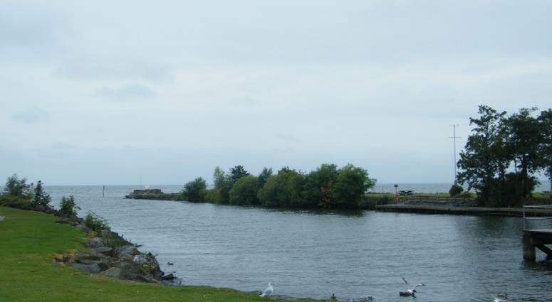
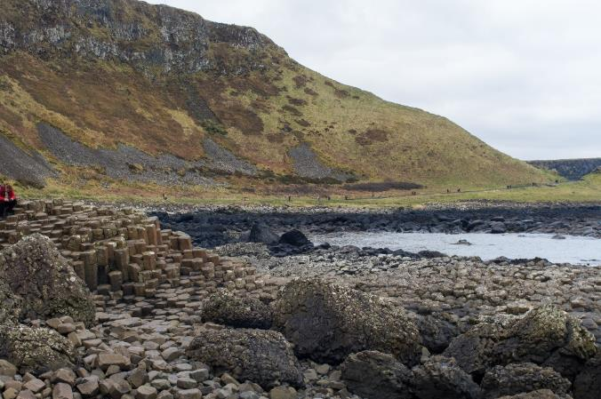
Physical Features
Giant’s Causeway
An area of about 40,000 interlocking basalt columns caused by an ancient volcanic eruption.
Lough Neagh
A freshwater lake, it is the largest lake in Northern Ireland.
Photos courtesy of facildeuntar and leateds (@flickr.com) granted under creative commons licence attribution

Slide 17
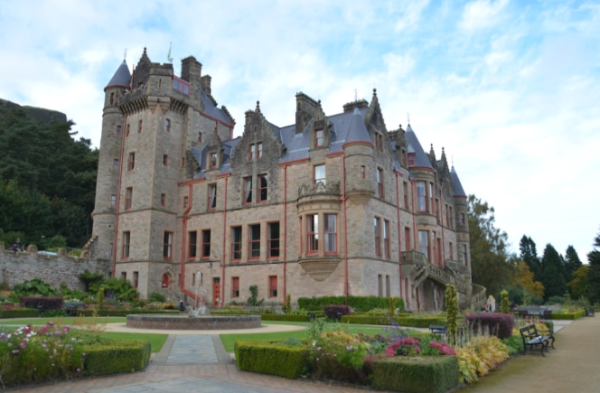
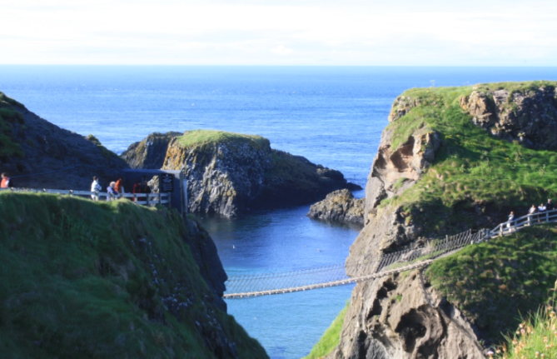
Human Features
Carrick-a-Rede Rope Bridge
A famous rope bridge; the bridge links the mainland to the tiny island of Carrickarede.
Belfast Castle
Situated in the capital city of Belfast.
Photos courtesy of jonesworth and tsiubiu (@flickr.com) granted under creative commons licence attribution

Slide 18
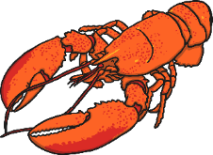
Northern Ireland Foods
Irish Lobster
Dexter Beef
Soda bread

Slide 19
Scotland
Scotland
Northern Ireland
England
Wales

Slide 20
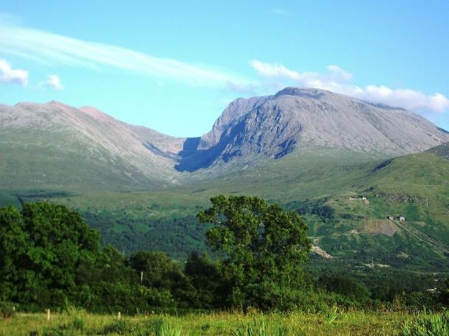
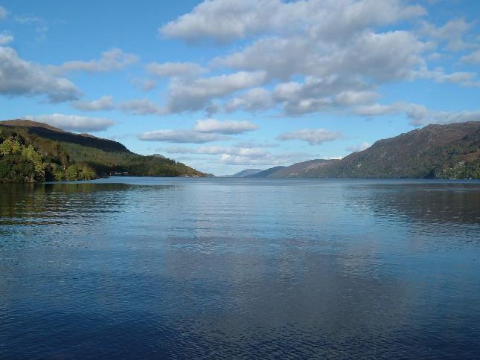
Physical Features
Loch Ness
A large, deep, freshwater loch extending for approximately 23 miles.
Ben Nevis
The highest mountain in the British Isles at 1,344 metres.
Photos courtesy of conner 395 (@flickr.com) granted under creative commons licence attribution

Slide 21
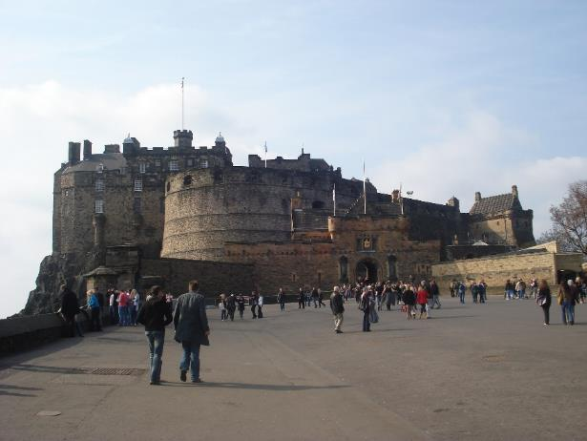
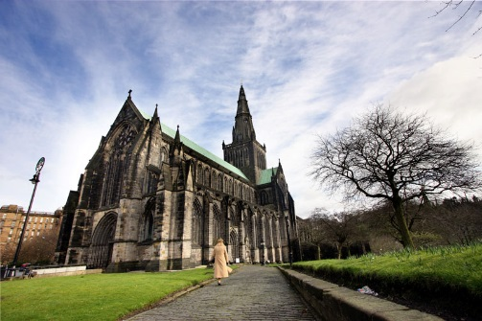
Human Features
Glasgow Cathedral
A place of worship.
Edinburgh Castle
A historic fortress in the capital city of Edinburgh.
Photos courtesy of mike138 and kevgibbo(@flickr.com) granted under creative commons licence attribution

Slide 22
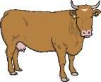
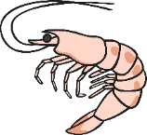
Scottish Foods
Haggis
Scottish Highlands
Highland Cattle
West Coast Langoustines
Scottish Lowlands
Whisky and Raspberries
Scottish Shortbread

Slide 23
Weather and Climate
The United Kingdom is in the Northern Hemisphere above the Equator.
It is an island and surrounded by sea on all sides, this has an effect on the weather with a changeable climate from day to day.
Generally, the south is usually a little warmer than the north and the west wetter than the east.

Slide 24
Seasons in the UK
Spring: (March, April and May) rain showers, blossoming trees and flowering plants.
Summer: (June, July and August) is the warmest season, with long sunny days, occasional thunderstorms and sometimes heat waves.
Autumn: (September, October and November) can be mild and dry or wet and windy. Leaves begin to fall from the trees and the temperature becomes cooler.
Winter: (December, January and February) the coldest season, with freezing temperatures, icy conditions and sometimes snow.

Slide 25
Flags
England: St Georges Cross

Slide 26
Flags
Wales: Baner Cymru or Y Ddraig Goch, meaning The Red Dragon

Slide 27
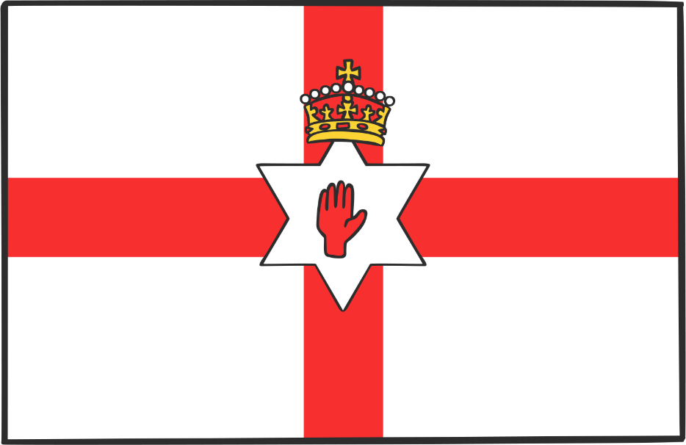
Flags
Northern Ireland: Saint Patrick's Saltire

Slide 28
Flags
Scotland: St Andrew’s Cross

Slide 29
Interesting Facts About The United Kingdom
The English drink more tea than anywhere else in the world.
Chickens outnumber humans in England.
Windsor Castle is the largest royal home in the world.
A past king called William the Conqueror ordered everyone to be in their beds by 8pm.
The sports football, rugby and cricket were all created in the United Kingdom.

Slide 30
Plenary
Share with your partner three new facts about the United Kingdom.
How many countries are there in the UK?
If you could go anywhere in the UK, where would you go and what would you do?

