Slide 1
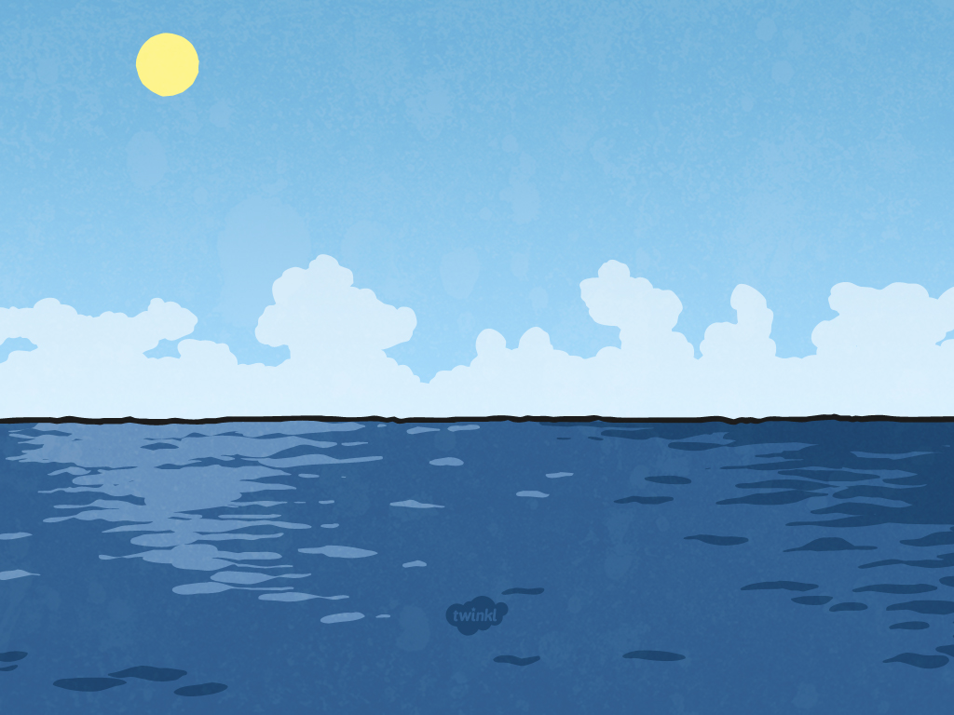
Oceans of the World Quiz

Slide 2
How many oceans are there in the world?

Slide 3
5

Slide 4
Which is the largest ocean?

Slide 5
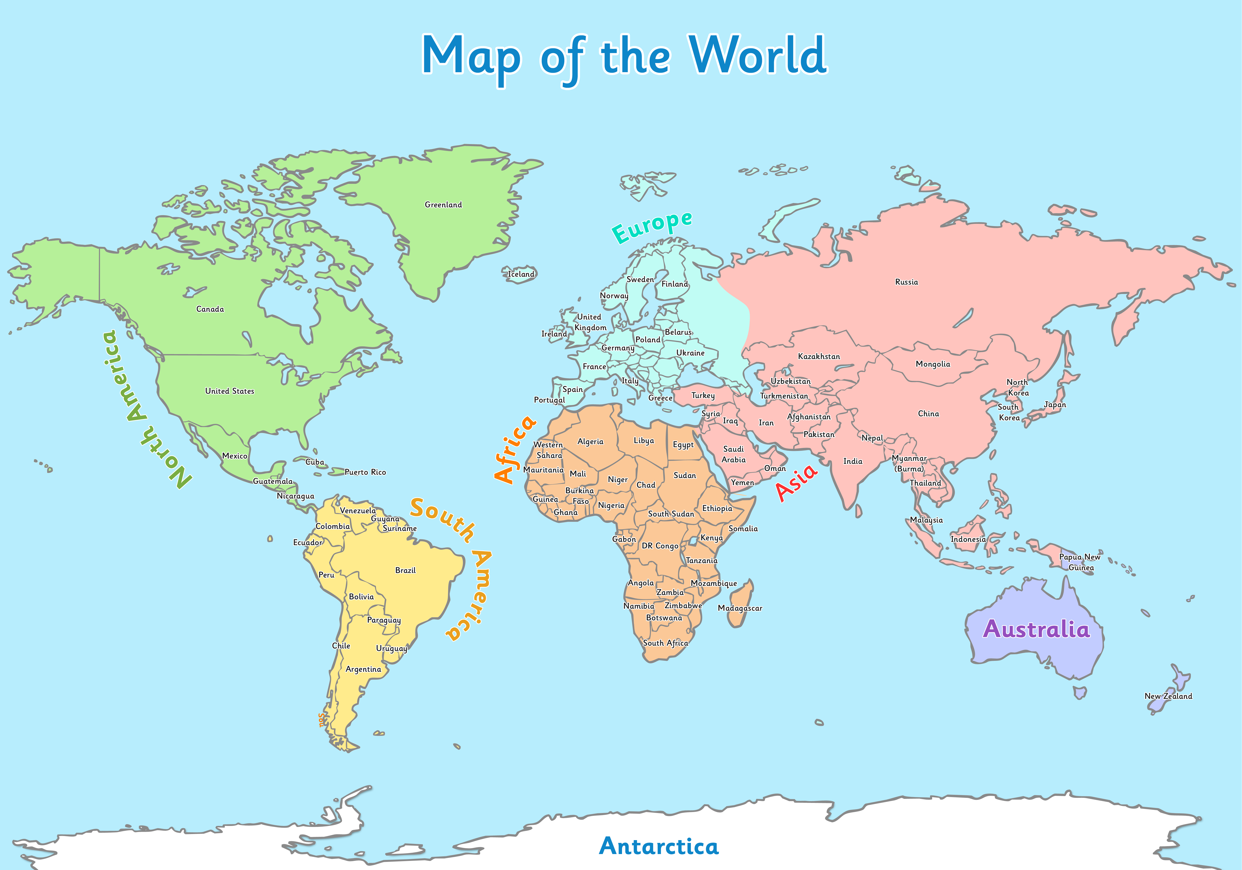
The Pacific Ocean

Slide 6
Which is the smallest ocean?

Slide 7
The Arctic Ocean

Slide 8
Which ocean surrounds Antarctica?

Slide 9
The Antarctic Ocean

Slide 10
Which ocean is the furthest North?

Slide 11
The Arctic Ocean

Slide 12
Which ocean can be found between North America and Africa?

Slide 13
The Atlantic Ocean

Slide 14
Which ocean can be found between North
America and Asia?

Slide 15
The Pacific Ocean

Slide 16
What is the other name for the Antarctic Ocean?

Slide 17
The Southern Ocean

