Slide 1
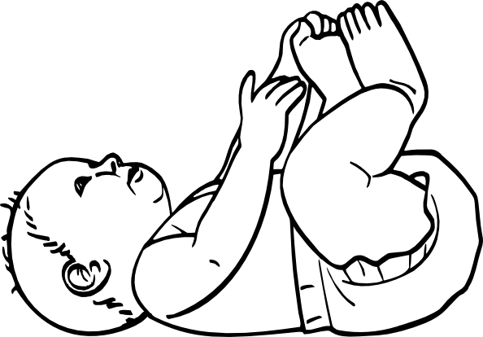
Your Life So Far
Name:
Choose 2-3 events of special importance. What made these events important to you?
was important in my life because...
was important in my life because…
was important in my life because…

Slide 2
Your Life So Far
Name:
Choose 2-3 events of special importance. What made these events important to you?
was important in my life because...
was important in my life because…
was important in my life because…

