Slide 1
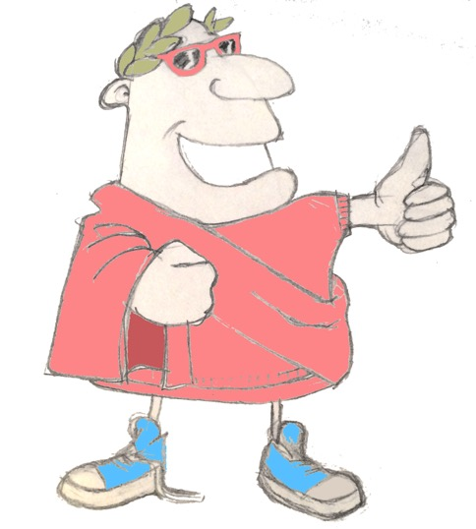
maximum Classics – 20
Epic!
Language L.O. to recap adjectival agreement in gender and to introduce agreement in number
Culture L.O. to encounter stories and characters from Homer’s Iliad and Odyssey

Slide 2
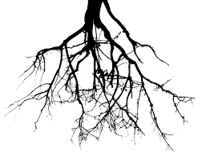
word roots challenge
What English words can you find in these Latin words?
laudare
to praise
femina
woman
iratus/irata
angry
mirus/mira
amazing
audire
to hear
medicus
doctor

Slide 3
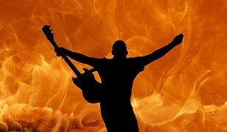
Verb endings

Slide 4
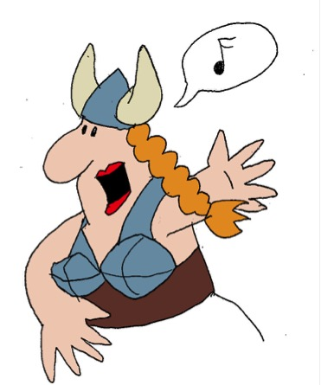
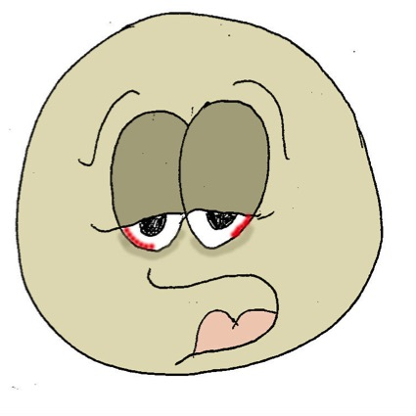
‘being’ verbs
sum
I am
es
you are
est
he/she/it is
sumus
we are
estis
y’all are
sunt
they are

Slide 5
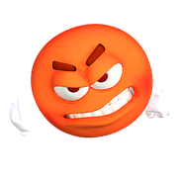
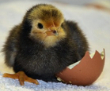
Quick on the draw
iratus/irata
mirus/mira
esse
laudare
audire
femina
medicus
word class?
nouns
verbs
word class?
word class?
adjectives
medicus
audit

Slide 6
Quick on the draw
iratus/irata
mirus/mira
esse
laudare
audire
femina
medicus
femina
est
irata

Slide 7
Quick on the draw
iratus/irata
mirus/mira
esse
laudare
audire
femina
medicus
femina
laudat
mira
medicum

Slide 8
Quick on the draw
iratus/irata
mirus/mira
esse
laudare
audire
femina
medicus
miri
audiunt
medici
feminam

Slide 9
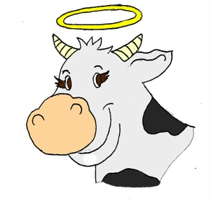
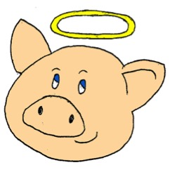
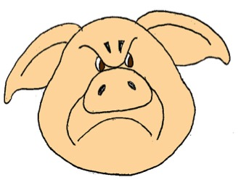
vacca
bonus
malus
porcus
porcus
malus
look for the rhyme!

Slide 10
vacca
bonus
malus
porcus
porcus
bonus
look for the rhyme!

Slide 11
vacca
bonus
malus
porcus
vacca
bona
look for the rhyme!

Slide 12
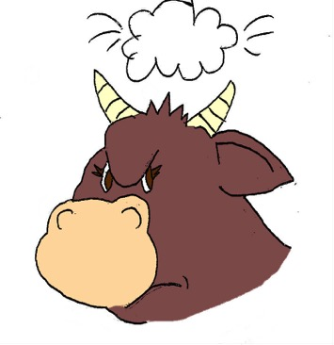
vacca
bonus
malus
porcus
vacca
mala
look for the rhyme!

Slide 13
vacca
bonus
malus
porcus
vaccae
bonae

Slide 14
vacca
bonus
malus
porcus
vaccae
malae

Slide 15
vacca
bonus
malus
porcus
porci
mali

Slide 16
vacca
bonus
malus
porcus
porci
boni

Slide 17
nouns & adjectives
Adjectives have to have the same ending as the nouns they’re describing:
feminine or masculine
singular or plural
feminine‘a’ noun endings | one (singular) | more than one (plural)
masculine ‘us’ noun endings | one (singular) | more than one (plural)
a
ae
us
i
Just remember to look for the rhyming endings!

Slide 18
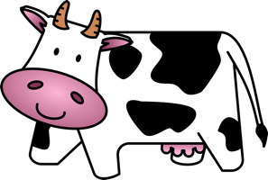
Worksheet – Building sentences with adjectives
These sentences will build up gradually. See if you can write what they mean in English. Use your word lists to help you if you can’t remember a word. Then add an illustration if you like.
vacca = ……………………………………………………..
vacca bella = ………………………………………………
vacca bella ridet = ……………………………………….
The cow
ha ha moo!
The beautiful cow
The beautiful cow laughs
equus = ………………………………………………………..
equus laetus = ……………………………………………….
equus laetus cantat = ……………………………………...
porci = ………………………………………………….……..
porci irati = ……………………………………………………
porci irati laborant = ……………………………………….
magae = ………………………………………………….…..
magae mirae = ………………………………………………
magae mirae consumunt = ……………………………….

Slide 19
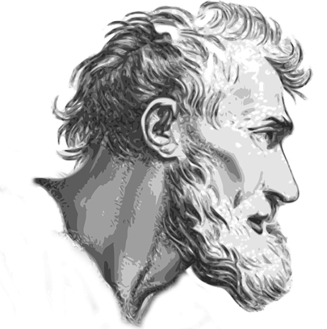
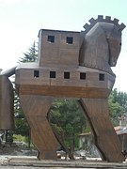
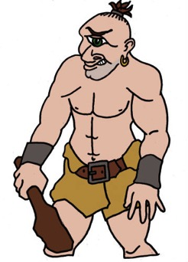
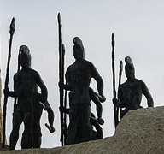
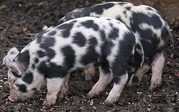
Homer his epics
What do you know about the Homeric epics? Read the epic story to give you an idea.
12th century B.C.?
8th century B.C.?
People turned into animals by witches
The Trojan War
The Cyclops
The Trojan Horse

Slide 20
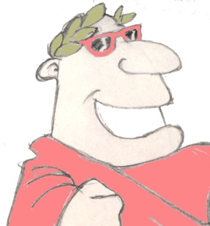
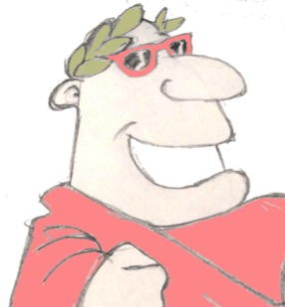
Plenary
What does ‘iratus’ mean? Can you think of an English word that comes from it?
Which Ancient Greek poet gave us the story of the Trojan War?
Are porci ‘malae’?

