Slide 2
How to play
Work out the correct change and click on the answer box to check your answer.
For a challenge, can you work out how to make each answer using the smallest amount of coins?

Slide 3
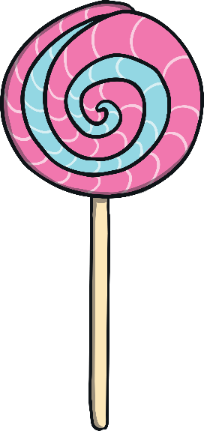
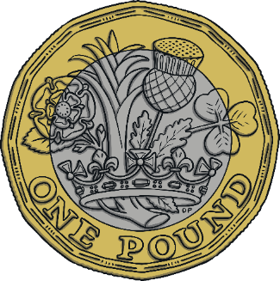
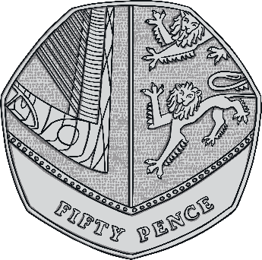
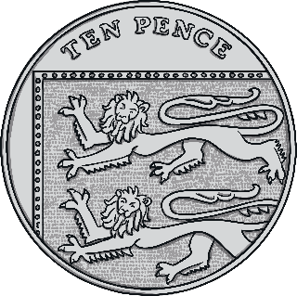
How much change from £1?
I have £1 and buy a lolly for 40p. How much change will I get?
60p
40p
answer
Challenge: Which coins could you get?
challenge answer

Slide 4
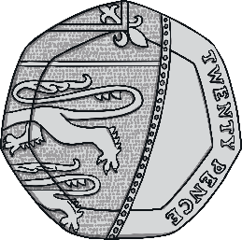
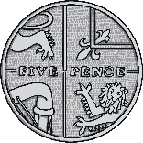
How much change from 50p?
I have 50p and buy a chew sweet for 15p. How much change will I get?
35p
15p
answer
Challenge: Which coins could you get?
challenge answer

Slide 5
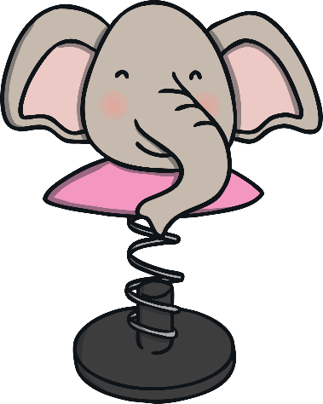
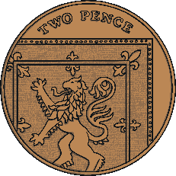
How much change from 20p?
I have 20p and buy a small toy for 11p. How much change will I get?
9p
11p
answer
Challenge: Which coins could you get?
challenge answer

Slide 6
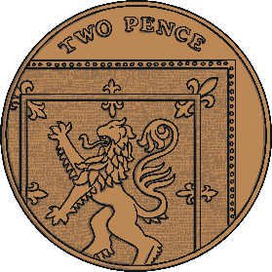
How much change from 10p?
I have 10p and buy an ice lolly or 6p. How much change will I get?
4p
6p
answer
Challenge: Which coins could you get?
challenge answer

Slide 7
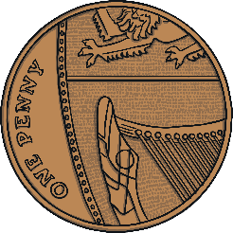
How much change from £1?
I have £1 and buy a teddy for 79p. How much change will I get?
21p
79p
answer
Challenge: Which coins could you get?
challenge answer

Slide 8
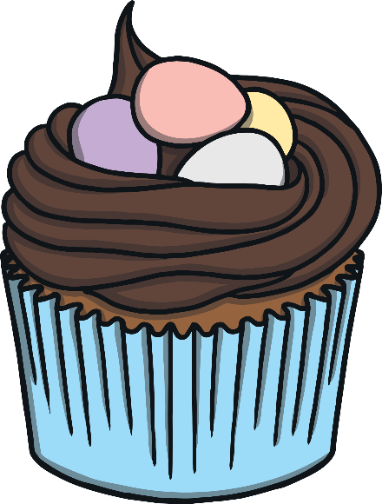
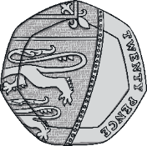
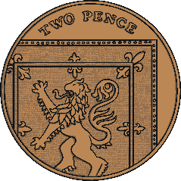
How much change from £1?
I have £1 and buy a cake for 52p. How much change will I get?
48p
52p
answer
Challenge: Which coins could you get?
challenge answer

Slide 9
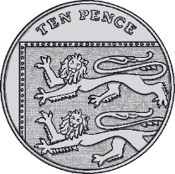
How much change from 50p?
I have 50p and buy a pencil for 13p. How much change will I get?
37p
13p
answer
Challenge: Which coins could you get?
challenge answer

Slide 10
How much change from 50p?
I have 50p and buy an apple for 29p. How much change will I get?
21p
29p
answer
Challenge: Which coins could you get?
challenge answer

Slide 11
How much change from 20p?
I have 20p and buy chewing gum for 4p. How much change will I get?
16p
4p
answer
Challenge: Which coins could you get?
challenge answer

Slide 12
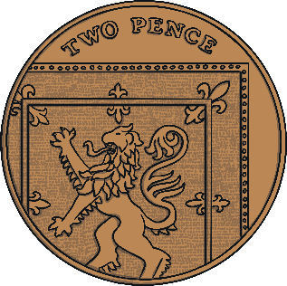
How much change from 10p?
I have 10p and buy a banana for 3p. How much change will I get?
7p
3p
answer
Challenge: Which coins could you get?
challenge answer

