Slide 1
The Benin Kingdom
Lesson 1
Key Question: When was the Benin Kingdom in power?
LO: To develop understanding of chronology

Slide 2
Key Vocabulary
chronology
Events in order of time.
era
A period of time marked by something important.
civilisation
A human society with a high level of culture, government, understanding of the world around them.
period
A meaningful and large interval of time.
duration
The length of time between events.
continuity
A length of time where many aspects of life stay the same.
Notes:
Use for EAL children too.

Slide 3
Knowledge Harvest
What do you already know about Benin?
What would you like to know about Benin?

Slide 4
What was the Benin Kingdom?
Benin was one of the most important kingdoms in West Africa in the 15th and 16th centuries.
It was founded in around CE 900.
In 1897, the Kingdom came to end.
The people that lived there were called the Edo people.

Slide 5
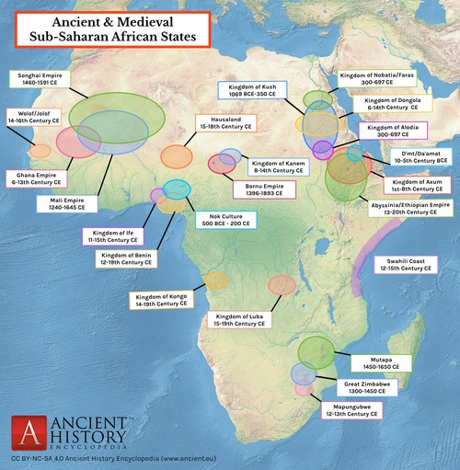
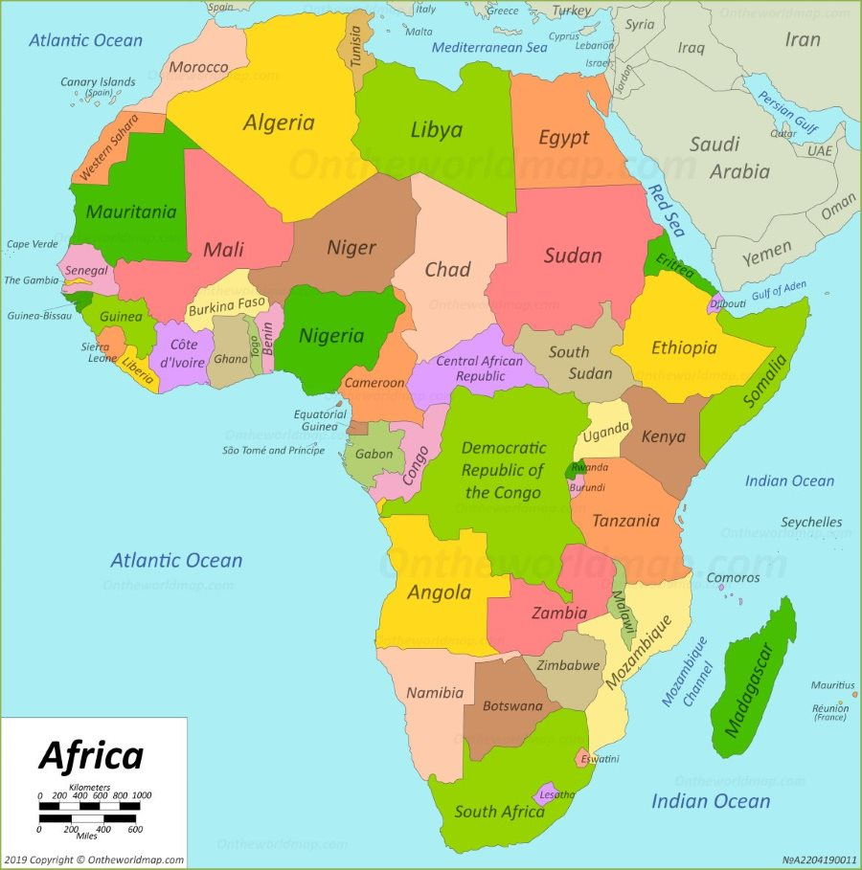
Notes:
One map shows where the Benin Kingdom was and the other is a modern map of Africa. Point out on the modern map that there is a country called Benin now, but that this was named after the Kingdom and is not in the same place. The Benin Kingdom was where Nigeria is now.

Slide 6

Let’s go back in time with a brief history of some of the world!
Notes:
Give each child in the room a tabard (YOU WILL NEED TO MAKE THESE IN ADVANCE) with a century on it from 1000BC -2000 AD. Get them to put themselves in order. Label the centuries in which the Benin Kingdom was in existence (900 – 1897 AD) with a coloured sticker / symbol so it stands out, or use a different coloured paper to make the tabards (ten tabards). Highlight the stickers. What do the children think they mean? Add in key periods by giving children a visual symbol from that era to hold. The correct number of these are on the slides to print out.
Ancient Egypt and the Stone Age, although important periods in the primary curriculum, are not featured here since they are before the earliest date on this timeline, 1000BC
The WWII symbols is smaller to indicate comparative scale.
Which periods in history that we have studied ran concurrently? What was the longest period in history of these examples?
In books, write a summary of what they have learnt. Stick in a photo of the chronology activity as evidence.

Slide 7
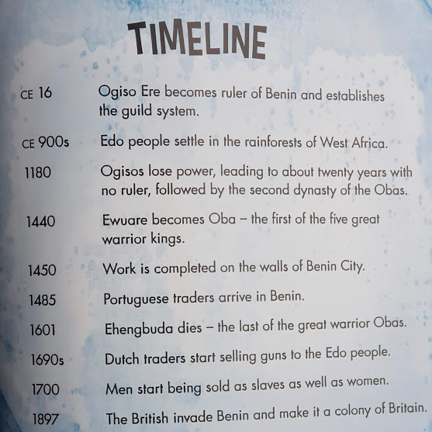
Look at this timeline of the Benin Kingdom.
What is the last date?
What do you think happened for this to be the last date on the timeline?
??????????????????????????
Notes:
Image taken from The Genius of The Benin Kingdom by Sonya Newland.

Slide 8
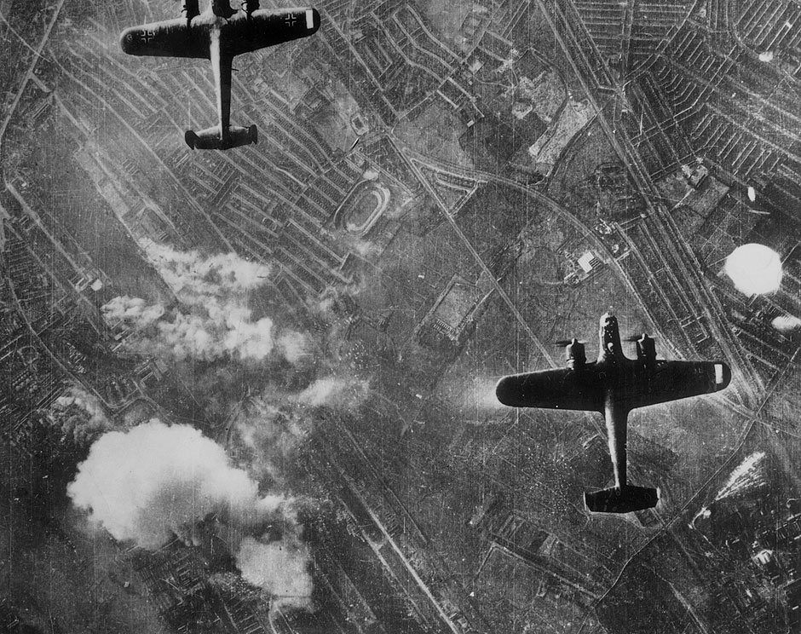
WWII
1939 AD - 1945 AD

Slide 9
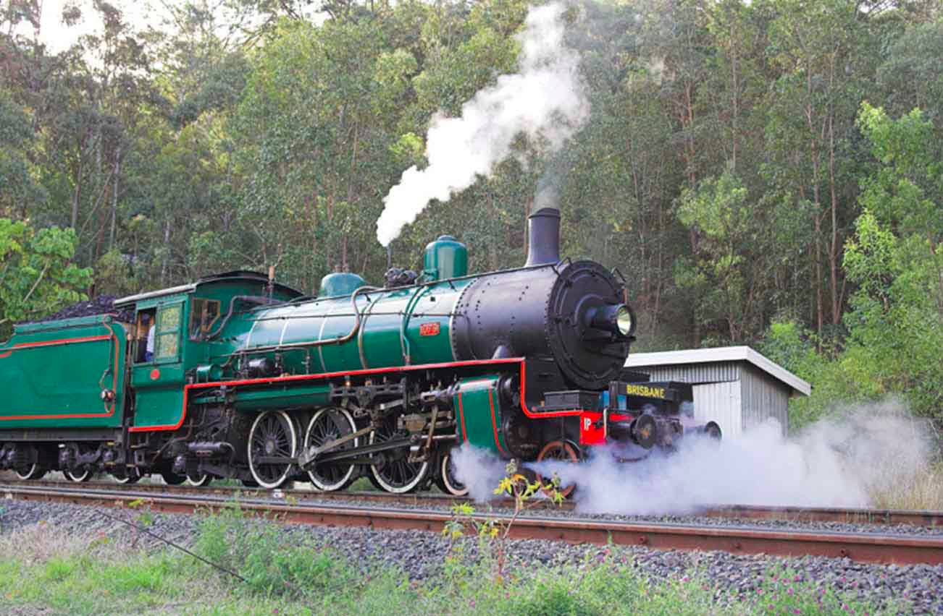
Industrial Age
1760 AD - 1840 AD

Slide 10
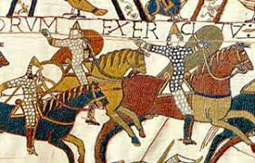
Normans
1066 AD - 1135 AD

Slide 11
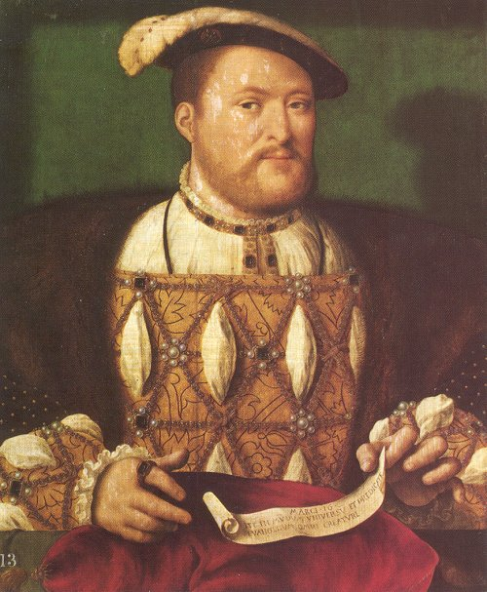
Tudors
1485 AD - 1603 AD
Notes:
Tudors were an important period in British history. Was a Catholic country but Henry, who went through 6 wives created his own religion, The Church of England, so he could get a divorce.
Jump back to the Normans. Invaded England in 1066 from France. 72% of the time, William actually ruled from France - unique period in British history for this. Lasted half a century when civil war broke out when Henry I, William’s son died. This civil war is known as The Anarchy.

Slide 12
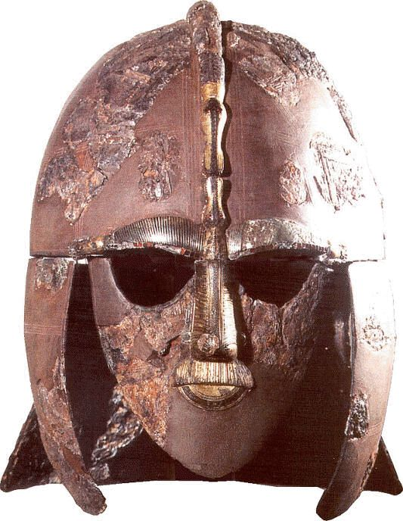
Anglo-
Saxons
410 AD - 1066 AD
Notes:
Vikings and Anglo Saxon rule ended in 1066 when both Harold and Harald were beaten in battle. These were the Anglo Saxon and Viking claimants to the throne. Vikings invaded England in 793, landing first at Lindisfarne monastery. Anglo Saxons were a mixture of people from continental Europe and indigenous British tribes who ruled England after the Romans left.

Slide 13
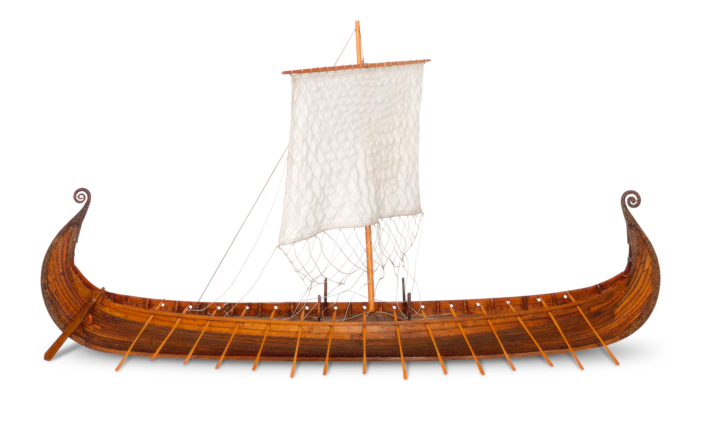
Vikings
793 AD - 1066 AD
Notes:
Vikings and Anglo Saxon rule ended in 1066 when both Harold and Harald were beaten in battle. These were the Anglo Saxon and Viking claimants to the throne. Vikings invaded England in 793, landing first at Lindisfarne monastery. Anglo Saxons were a mixture of people from continental Europe and indigenous British tribes who ruled England after the Romans left.

Slide 14
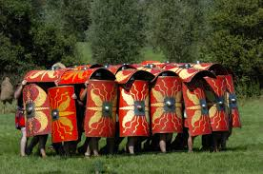
Romans in Britain
43 AD - 410 AD
Notes:
Roman invasion of Britain took place in 43 AD. They stayed until 410 AD when the Emperor of Rome recalled troops from Britain because they were needed elsewhere in the empire. Iron Age showed development of iron working technology; huge population growth; further developments in farming; use of hillforts for defence against other tribes.

Slide 15
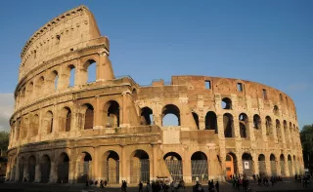
Ancient Rome
753 BC - 476 AD
Notes:
Meanwhile, while Britain was in the Iron Age, Ancient Greece was coming to an end. Roman rule took over although many aspects of Greek life influenced Roman culture. Ancient Greece began before Rome which was founded in 753 BC by Romulus.

Slide 16
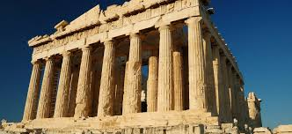
Ancient Greece
800 BC - 146 BC
Notes:
Meanwhile, while Britain was in the Iron Age, Ancient Greece was coming to an end. Roman rule took over although many aspects of Greek life influenced Roman culture. Ancient Greece began before Rome which was founded in 753 BC by Romulus.

