Slide 1
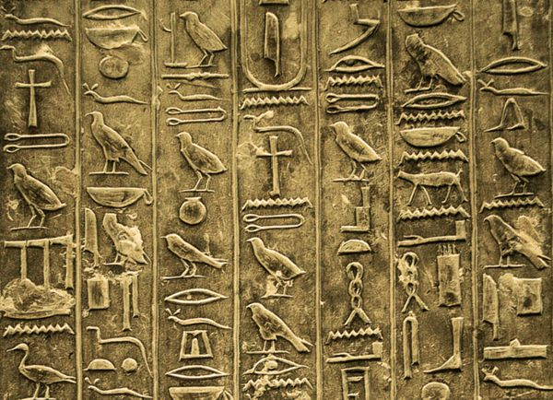
Ancient Egyptian Hieroglyphs

Slide 2
Success Criteria
I understand that the ancient Egyptians spoke and wrote their own language.
I know that some symbols they used represented sounds, and others represented meanings.
I can write my own name in hieroglyphs.

Slide 3
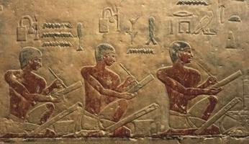
“Man decays,
his body turns to dust – but writing causes him to be remembered”.
Scribes were one of the most prestigious roles in Ancient Egypt. Only the best and brightest boys were chosen to attend scribe school and it took 12 years to train. They were promised high status and lots of money.

Slide 4
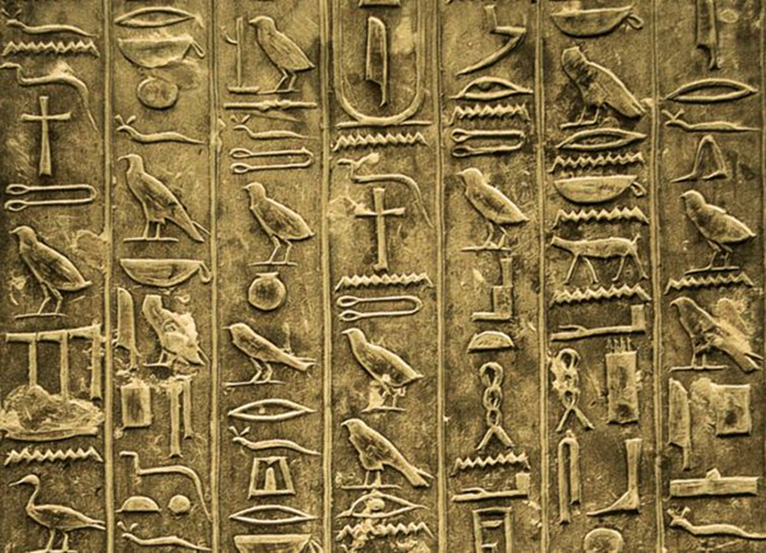
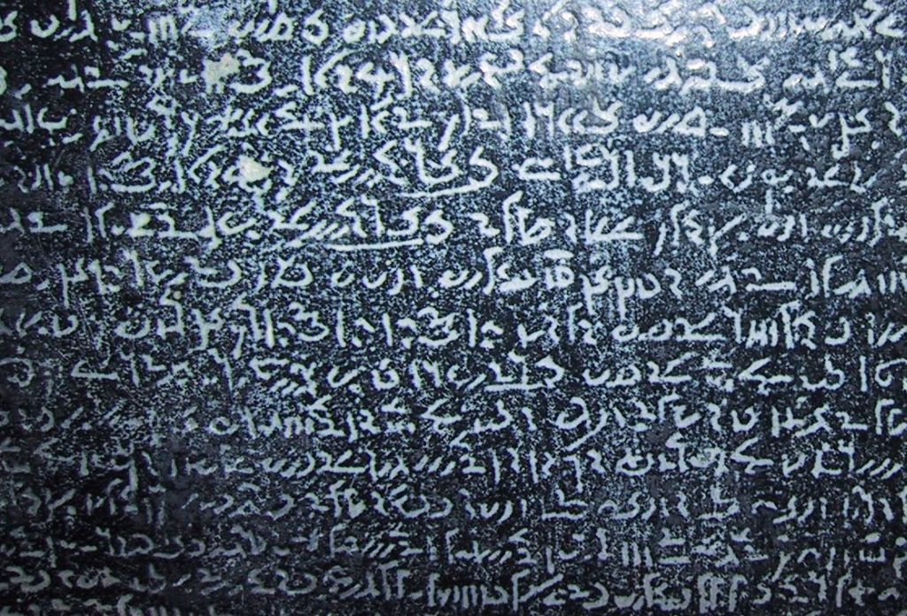
Did you know? Only 1 out of every 100 Egyptians was able to read and write
What is Ancient Egyptian writing called?
[Hieroglyphics – hiero = sacred, glyph = carving]
They started writing like that 5000 years ago until 400 AD (1600 years ago).
After that, they wrote in another language called Demotic and everyone forgot how to read and write hieroglyphs.
It was an unbroken code.

Slide 5
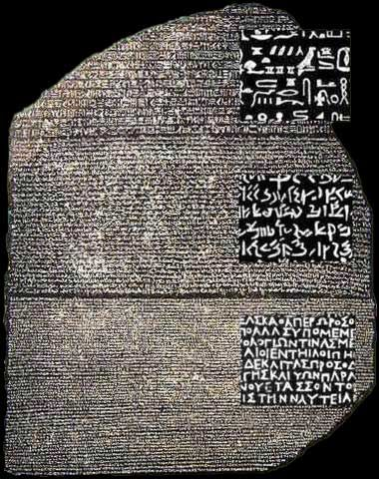
Then, in 1799, the Rosetta stone was discovered by French soldiers rebuilding a fort in a town called Rosetta
It features the same text written in Ancient Greek, demotic and
hieroglyphs.
We could read Greek but no one could break
the code when it came to the other languages.
Then a Frenchman, Jean-Francois Champollion
cracked the code in 1822.
He also discovered that the Pharaoh’s names were
written inside ovals called cartouches.

Slide 6
http://www.childrensuniversity.manchester.ac.uk/learning-activities/history/ancient-egypt/writing-in-hieroglyphs/

Slide 7
Hieroglyphs can be written in many different directions - from left to right, from right to left
and downwards in columns.
You can tell which way to read the writing by the way the hieroglyphs are facing.
Smaller hieroglyphs can be written under larger hieroglyphs to make it look neater.
Writing neatly and making carvings or writing look beautiful was very important to Ancient Egyptians.
Some hieroglyphs represent sounds, others represent meanings.
A traditional greeting would have been to say ‘iy’ - meaning hi or hello.
It would be traditional to say ‘wedja ib-ek’ if someone was sad, meaning ‘cheer up!’.
Their word for ‘hug’ translates literally as ‘being within two arms’.
The Egyptians gave people titles to explain their job in society.
With your talk partner:
These are statements of fact about the Egyptian language. Are they similar to English and other languages we speak, or different, why?

Slide 8
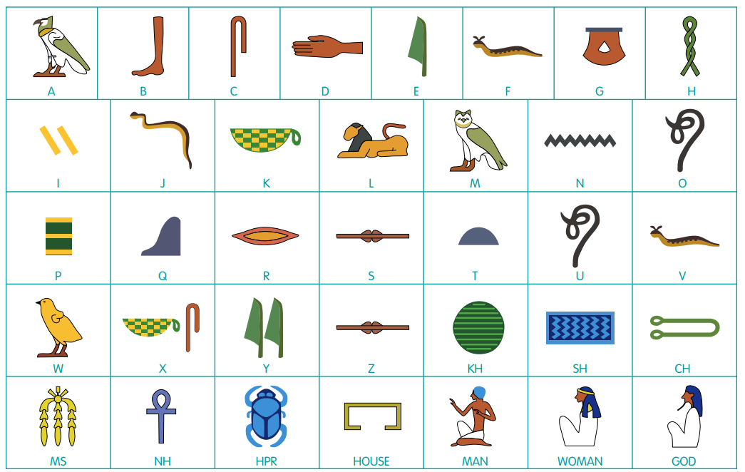
Vowels are approximations in translations of Egyptian writing because the Egyptians didn’t often write them. Write your name without any vowels. How easy do you think it would be to guess what vowels should go there if you didn’t know?
Egyptians wanted words to look neat, so they wouldn’t necessarily write them in a string, but rather put long flat ones on top of each other.
They could also add a ‘determinative’ symbol to give their name more meaning. This is kind of the equivalent of us saying Mr, Mrs, Doctor, Professor etc. This usually goes at the end of the name.

Slide 9
Can you write your name in hieroglyphs? Have a go in your book
Design your own determinative to go after it.
Remember, the Egyptians valued bright, beautiful, colourful writing. Can you make yours as attractive as possible?
Please then write an English translation below.
Extension:
Can you design a hieroglyph for the following words
Love
Hate
Jealousy
Can you think of some other words you could design a hieroglyph for?

