Slide 1
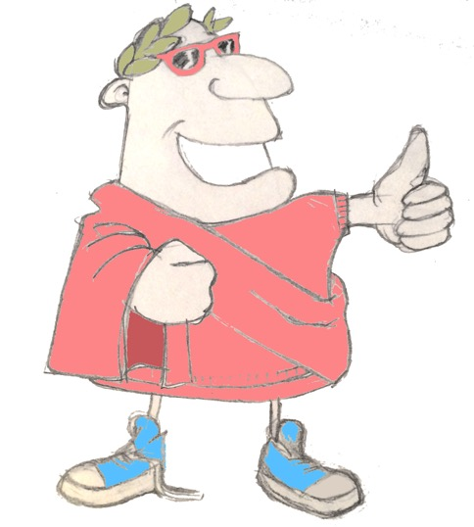
maximum Classics – 21
Even more epic!
Language L.O. to recap adjectival agreement in gender and number, and to introduce agreement as subject/object
Culture L.O. to continue stories and characters from Homer’s Iliad and Odyssey

Slide 2
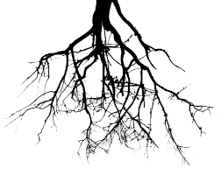
word roots challenge
primus/prima
first
bellus/bella
handsome/beautiful
frigidus/frigida
cold
bonus/bona
good
mirus/mira
amazing
iratus/irata
angry
secundus/secunda
second
malus/mala
bad

Slide 3
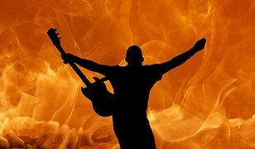
Verb endings

Slide 4
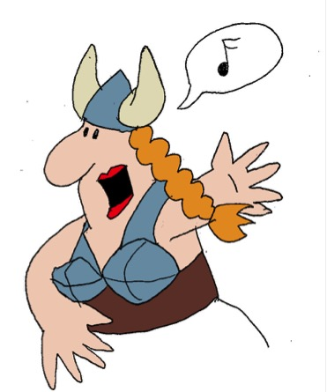
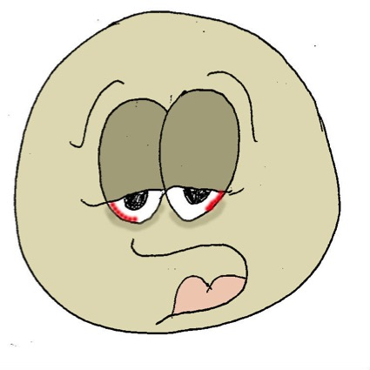
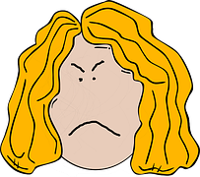
‘being’ verbs
sum
I am
es
you are
est
he/she/it is
sumus
we are
estis
y’all are
sunt
they are

Slide 5
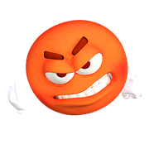
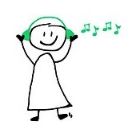
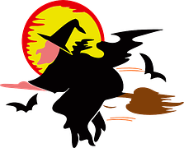
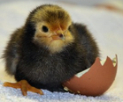
Quick on the draw
iratus/irata
mirus/mira
esse
videre
audire
maga
gladius
word class?
nouns
verbs
word class?
word class?
adjectives
maga
audit

Slide 6
Quick on the draw
iratus/irata
mirus/mira
esse
videre
audire
maga
gladius
verbs
nouns
word class?
adjectives
gladius
mirus
est

Slide 7
Quick on the draw
iratus/irata
mirus/mira
esse
videre
audire
maga
gladius
verbs
nouns
word class?
adjectives
magae iratae
gladios
vident

Slide 8
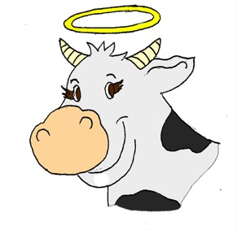
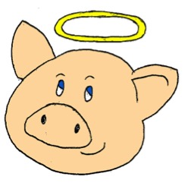
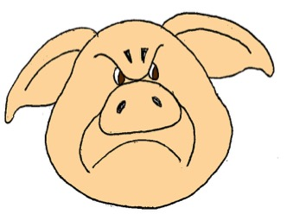
vacca
sordidus
iratus
porcus
porcus
iratus

Slide 9
vacca
sordidus
iratus
porcus
vacca
sordida

Slide 10
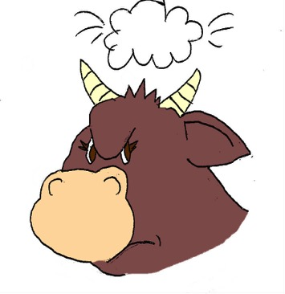
vacca
sordidus
iratus
porcus
vaccae
iratae

Slide 11
vacca
sordidus
iratus
porcus
porci
sordidi

Slide 12
vacca
sordidus
iratus
porcus
sordidum
vacca porcum ……………… videt

Slide 13
vacca
sordidus
iratus
porcus
!
iratas
porcus vaccas ………… videt

Slide 14
nouns & adjectives
Adjectives have to have the same ending as the nouns they’re describing in 3 ways:
feminine or masculine
singular or plural
subject or object
‘a’ noun endings | one (singular) | more than one (plural)
subject
object
‘us’ noun endings | one (singular) | more than one (plural)
subject
object
a
ae
us
i
am
as
um
os
Just remember to look for the rhyming endings!

Slide 15
Nouns & adjectives
Adjectives have to have the same ending as the nouns they’re describing in 3 ways:
(1) feminine or masculine, (2) singular or plural, (3) subject or object.
useful info
Exercise 1: Find the adjective
Can you find the right adjective from the word cloud below? Watch out, some of the words are there to fool you. The first sentence has been done to help you. Use you word lists if you are stuck on a word’s meaning.
‘us’ nouns (masculine) | singular | plural
subject | us | i
object | um | os
The queen praises the good doctor.
regina medicum …………… laudat.
bonum
bonum
mirae
‘a’ nouns (feminine) | singular | plural
subject | a | ae
object | am | as
2. I love cold water.
aquam …………… amo.
frigidus
prima
3. Do you all see the beautiful horses?
equos …………… videtis?
bellus
frigidam
miras
bellus/bella | handsome/beautiful
bonus/bona | good
frigidus/frigida | cold
mirus/mira | amazing
primus/prima | first
secundus/secunda | second
tertius/tertia | third
boni
4. The first queen has an amazing sword.
regina …………… gladium mirum habet.
primas
5. The stars are amazing.
stellae …………… sunt.
bellos
miri
6. The good horses praise the amazing stars.
equi…………… stellas …………… laudant.

Slide 16
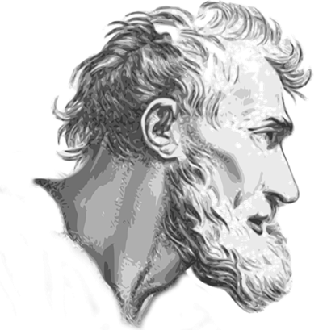
Epic recap
Re-read the Homeric epic extracts and see if you can answer the questions on the next slide

Slide 17
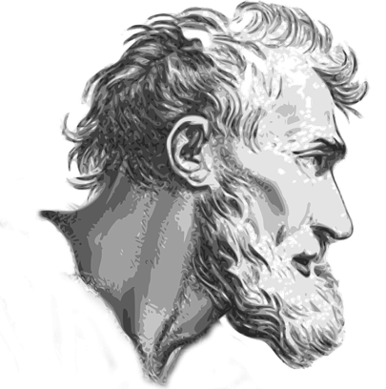
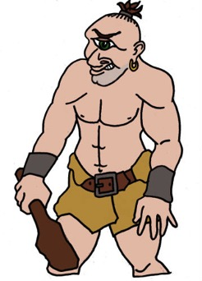
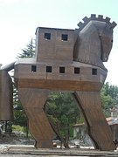
Epic quiz
Who wrote the famous Ancient Greek epic tales, the Iliad and the Odyssey?
When did Homer live?
What’s this?
And who’s this?!

Slide 18
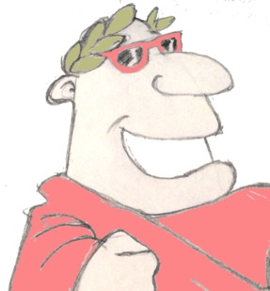
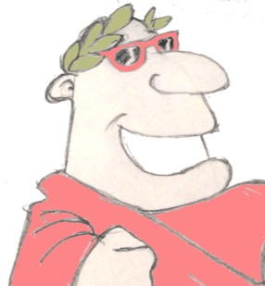
Plenary
Adjectives in Latin have to be the same as the noun they’re describing in three ways: what are they?
porci sordidi sunt?
What’s the main feature of a Cyclops?

