Slide 1
Animal Classifications

Slide 2
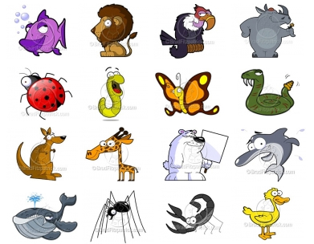
There are five different ways we can class animals...

Slide 3
1) Mammals
How can we tell an animal is a mammal?

Slide 4
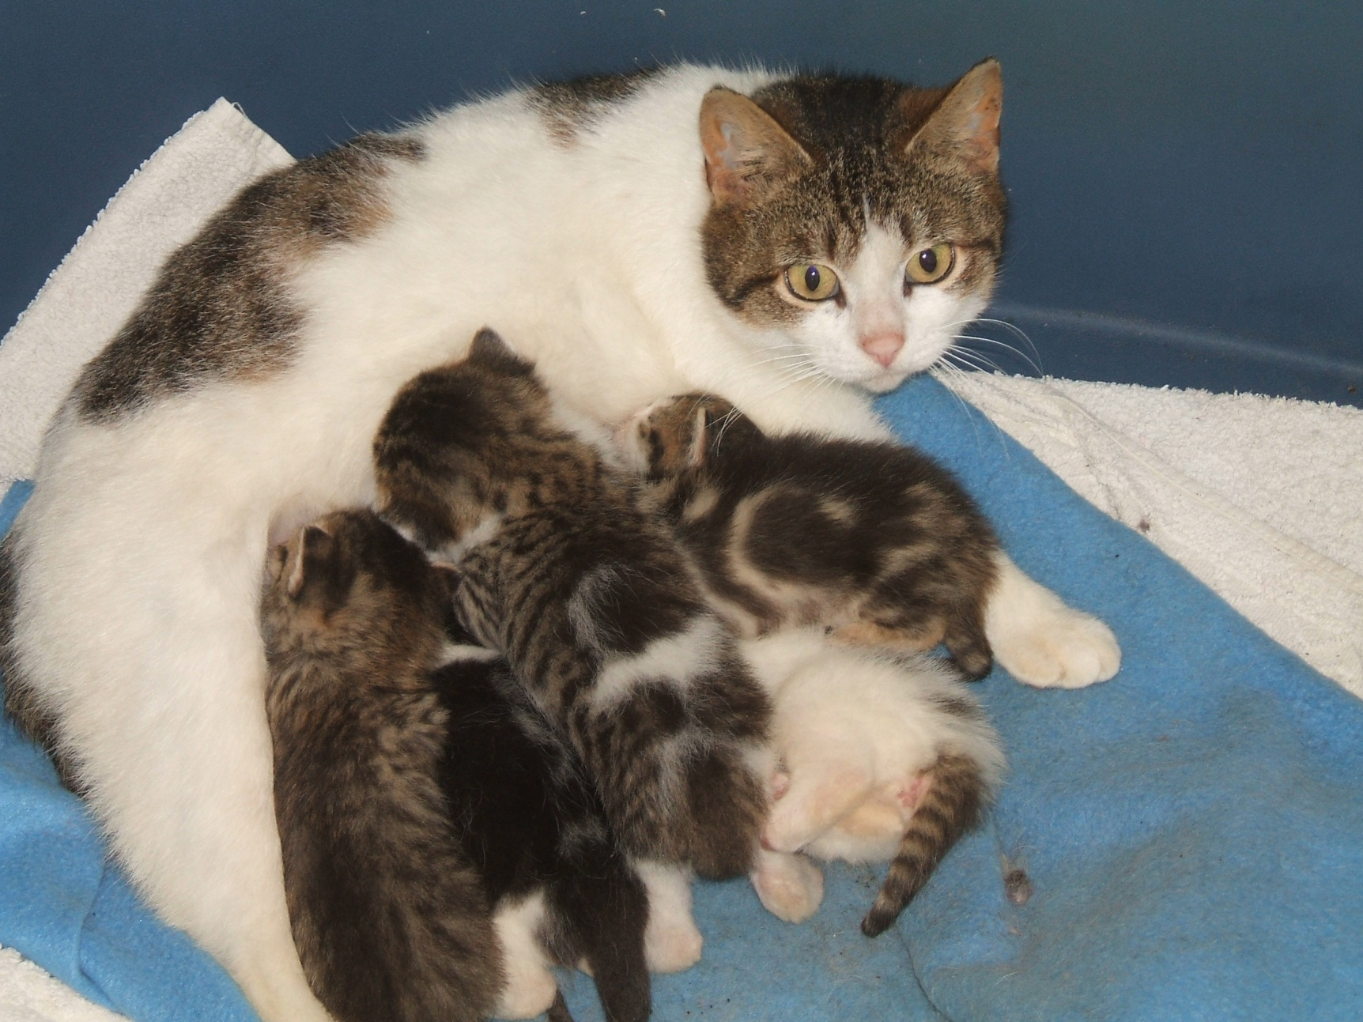
They give birth to live young...

Slide 5
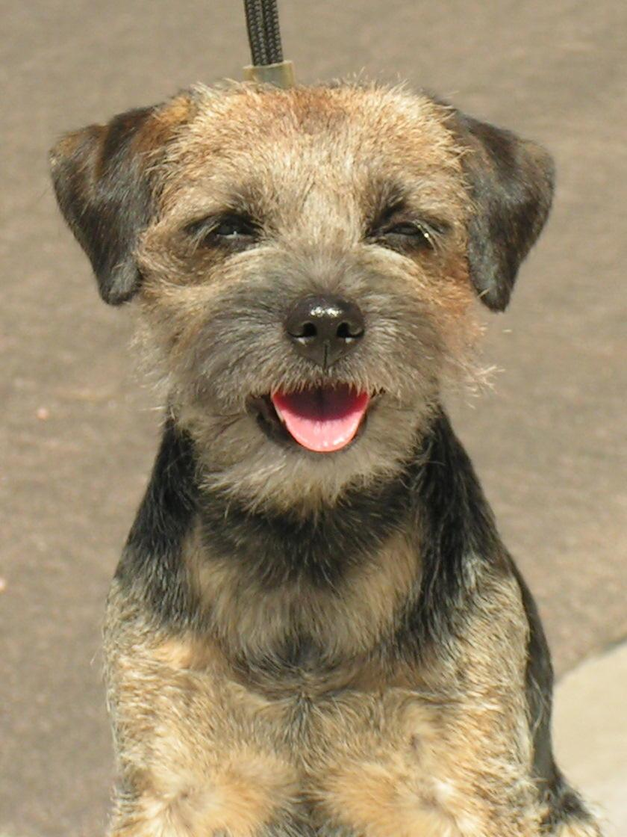
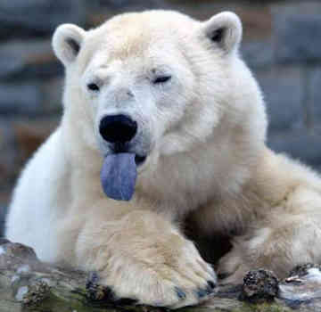
They have hair or fur...

Slide 6
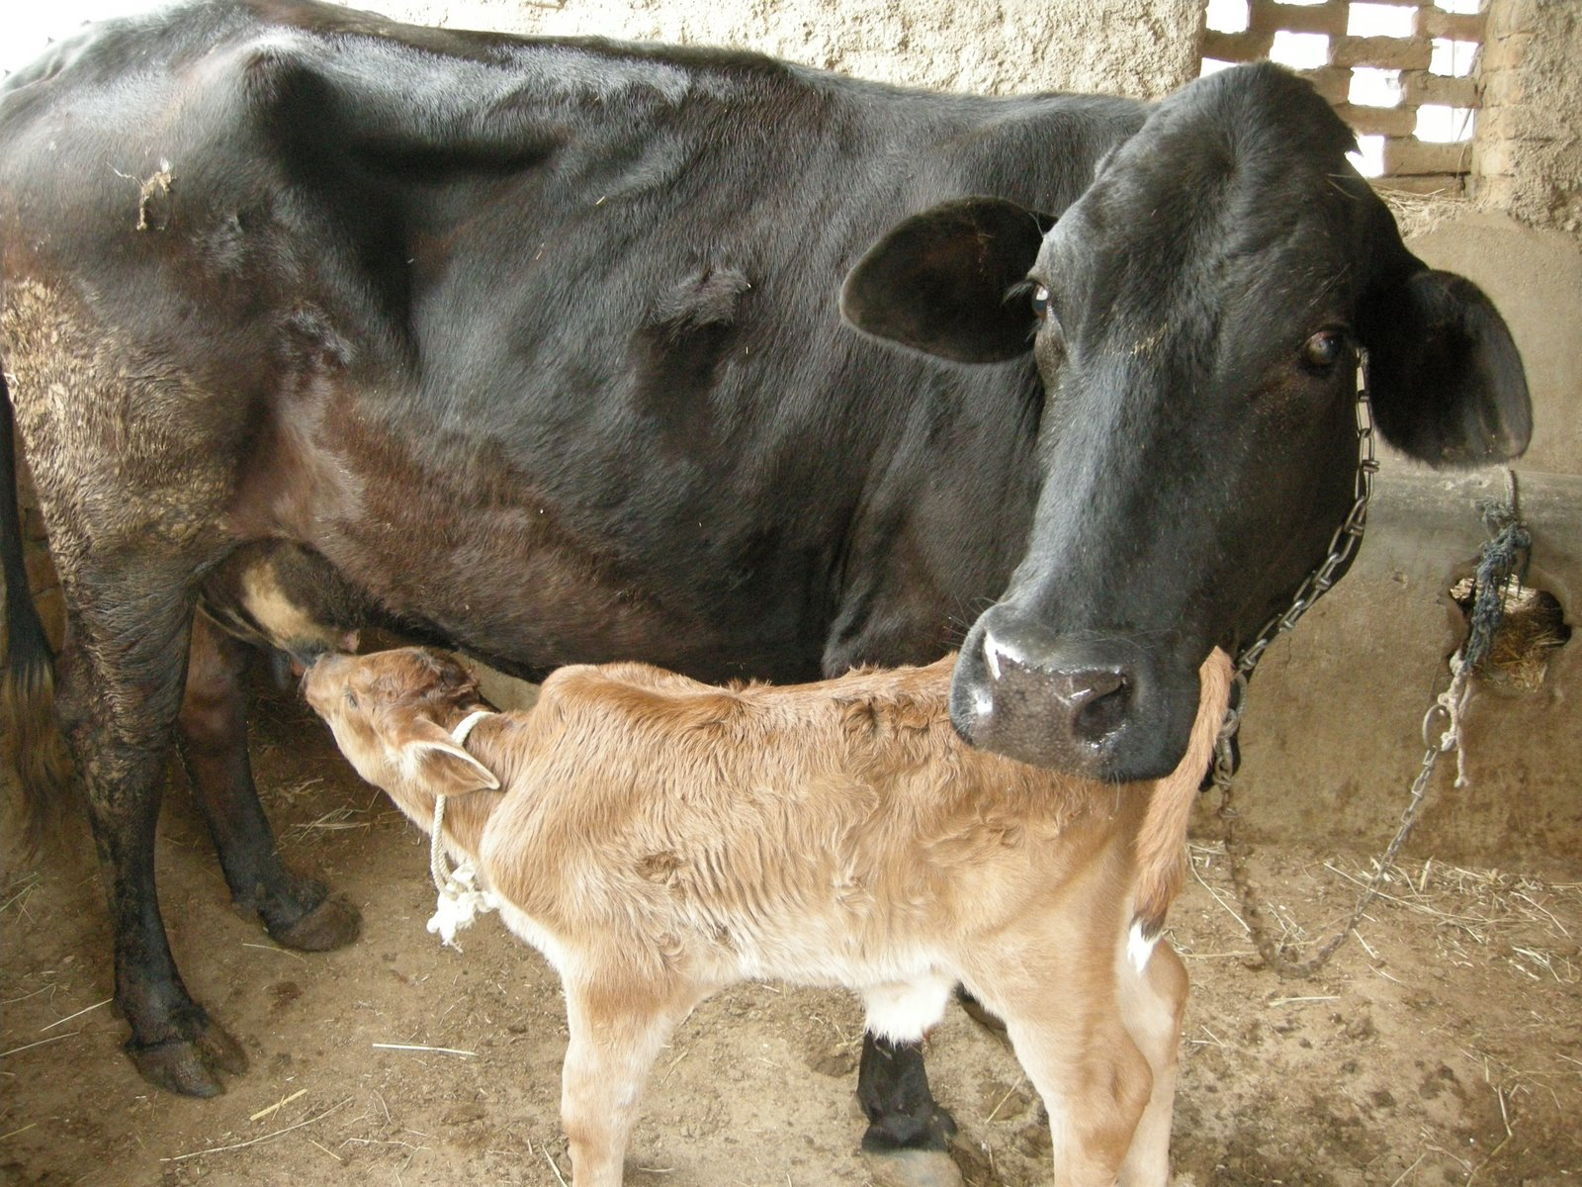
Mammal mothers feed their children with their own milk...

Slide 7
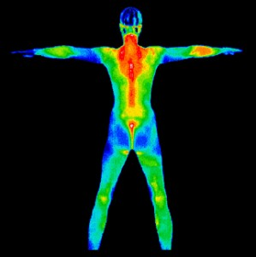
They are warm blooded...

Slide 8
2) Reptiles
How can we tell an animal is a reptile?

Slide 9
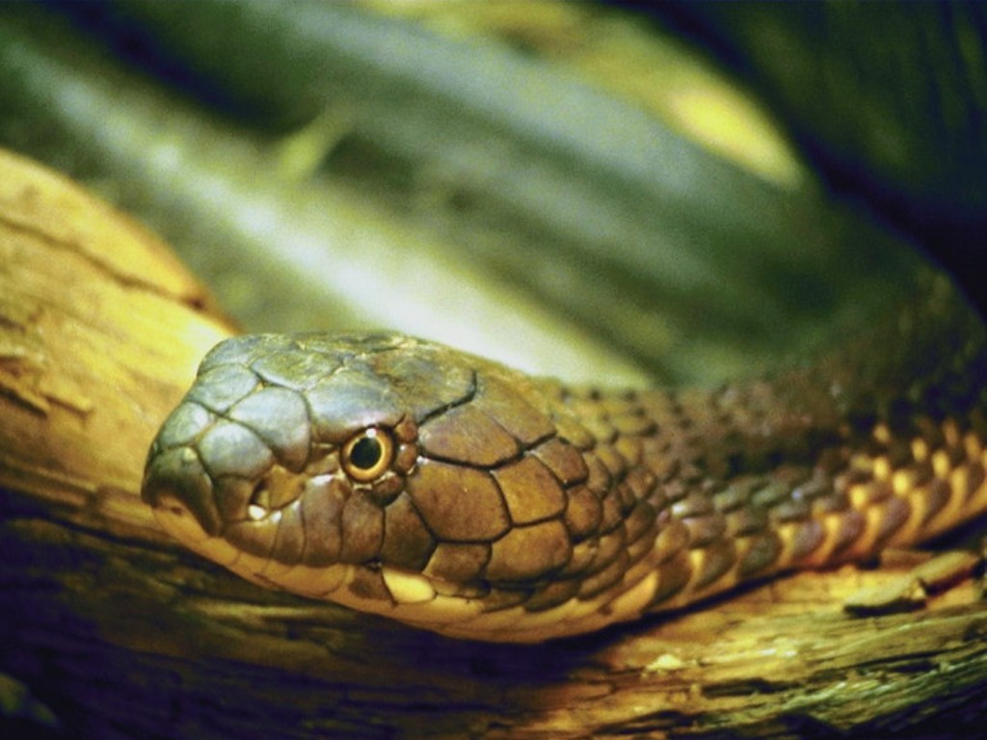
They have scales, not fur...

Slide 10
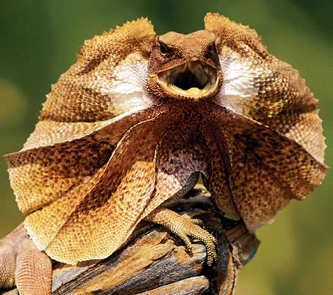
They have dry skin...

Slide 11
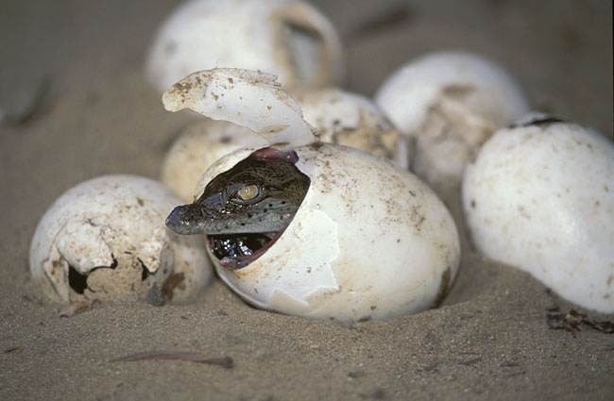
They usually lay eggs...

Slide 12
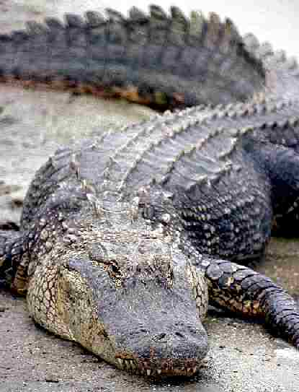
They are cold blooded...

Slide 13
3) Birds
How can we tell an animal is a bird?

Slide 14
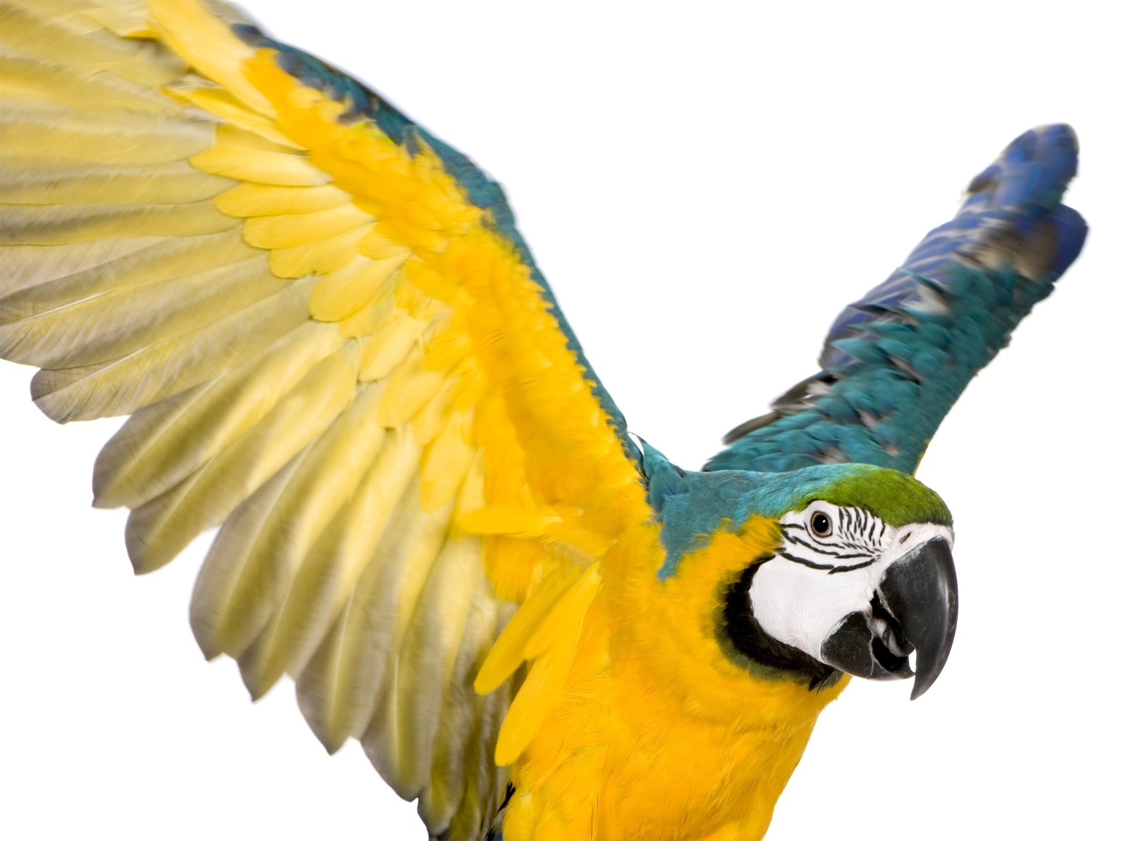
They have feathers and wings...

Slide 15
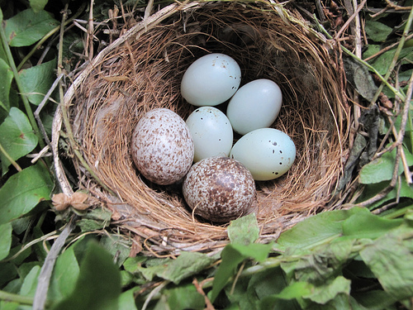
They lay eggs...

Slide 16
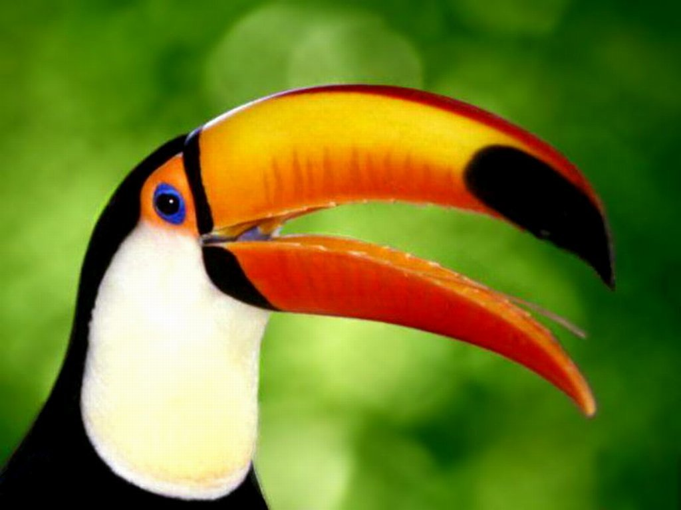
They are warm blooded...

Slide 17
4) Amphibians
How do we know if an animal is an amphibian?

Slide 18
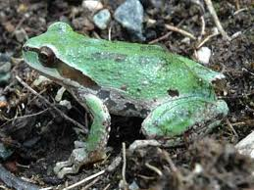
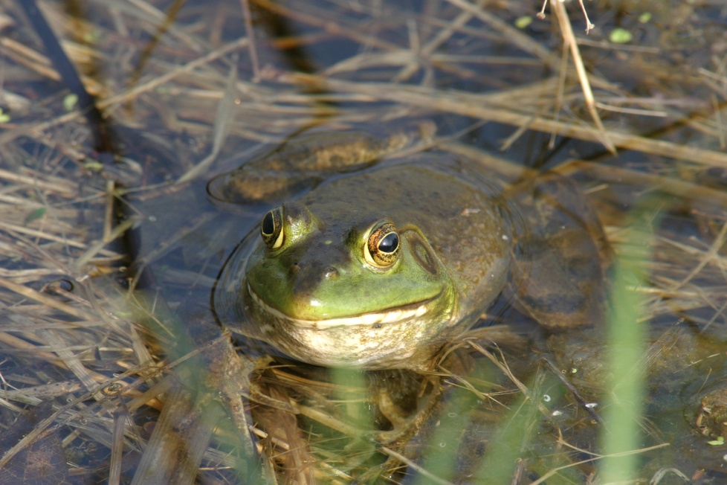
They live on land and water...

Slide 19
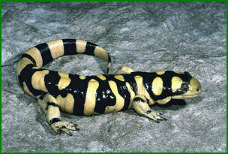
They are cold blooded...

Slide 20
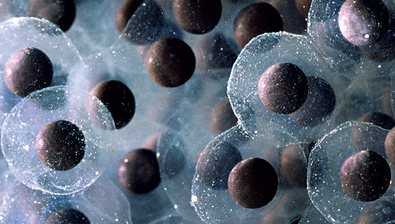
They lay eggs...

Slide 21
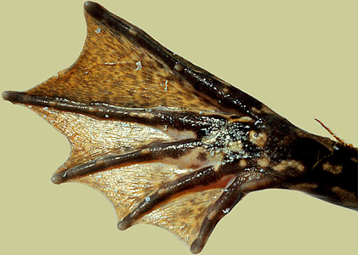
They have moist skin and webbed feet...

Slide 22
5) Fish
How do we know if an animal is a fish?

Slide 23
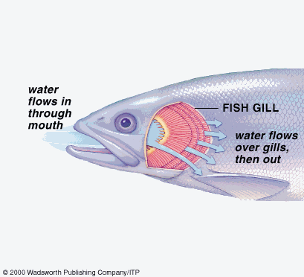
They breathe under water using gills...

Slide 24
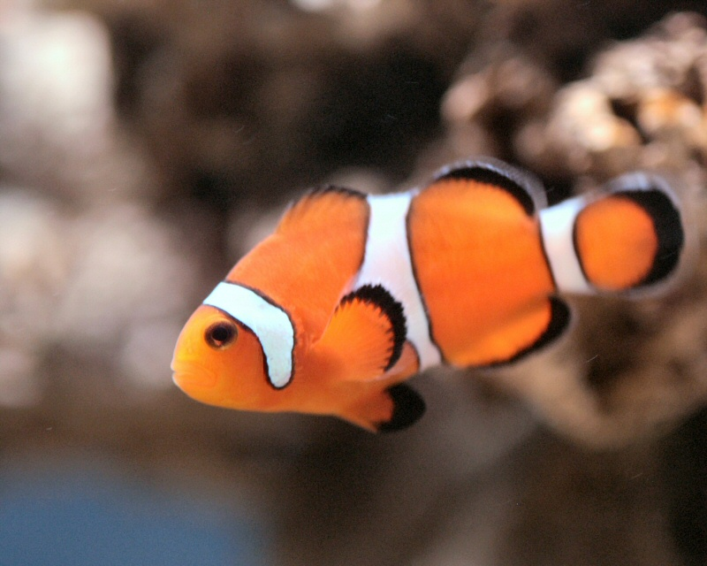
They have scales and fins...

Slide 25
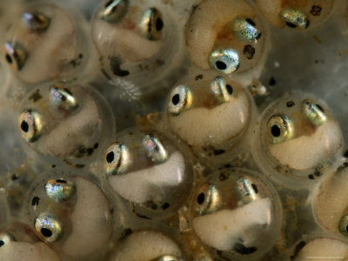
They lay eggs...

Slide 26
They are cold blooded...

Slide 27
What types of animals are these?...

Slide 28
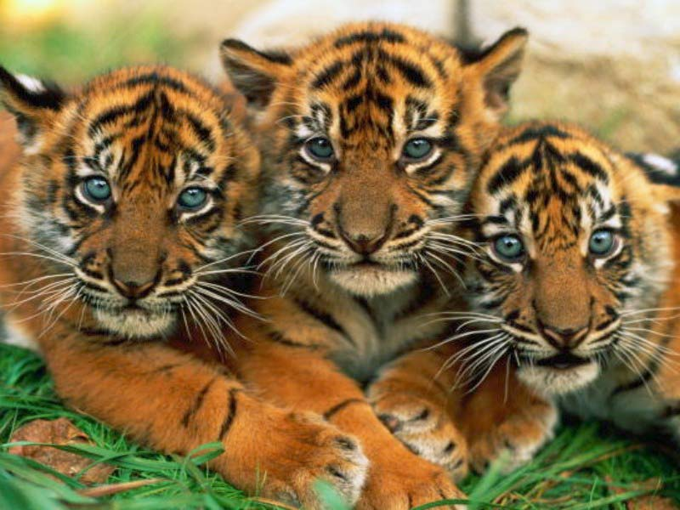

Slide 29
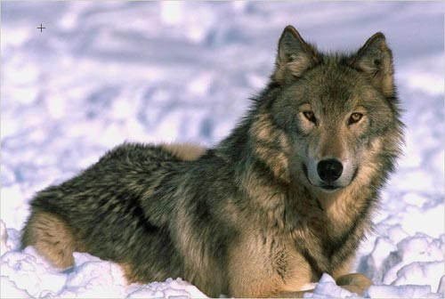

Slide 30
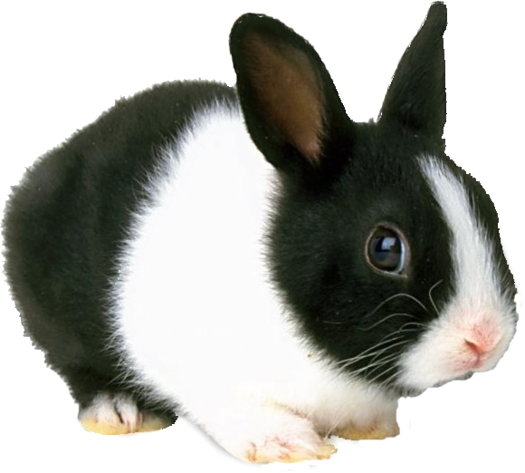

Slide 31
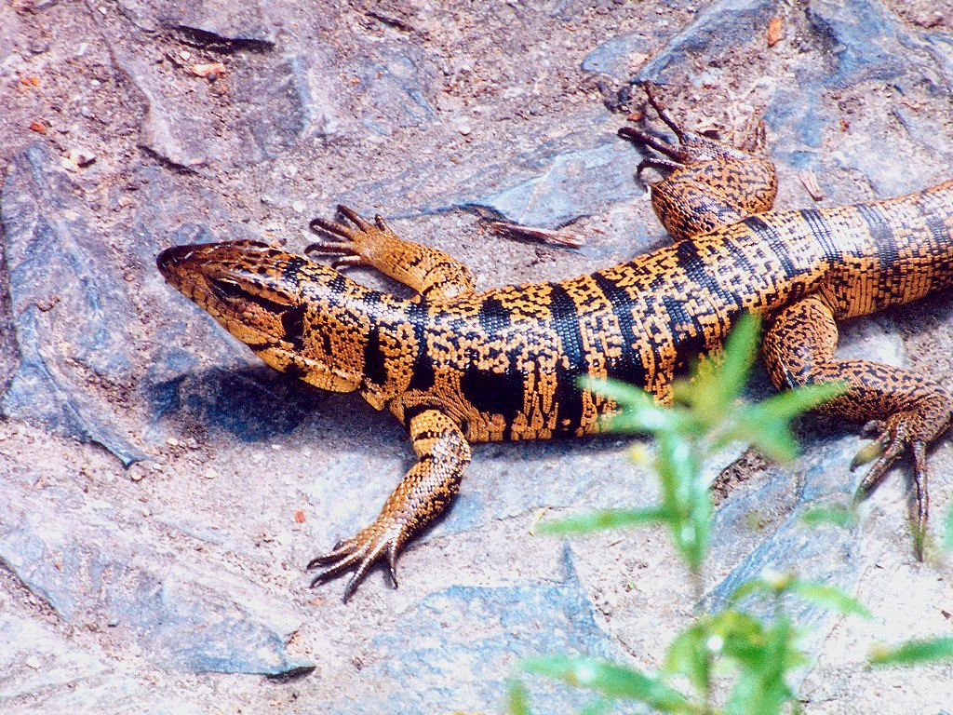

Slide 32
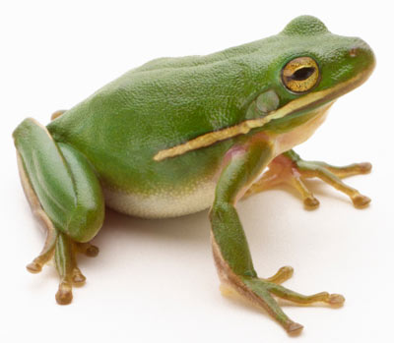

Slide 33
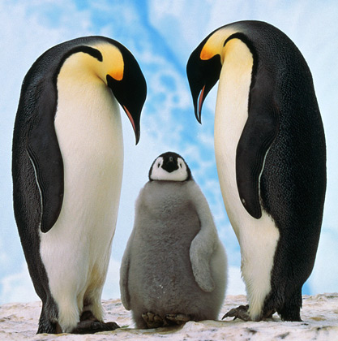

Slide 34
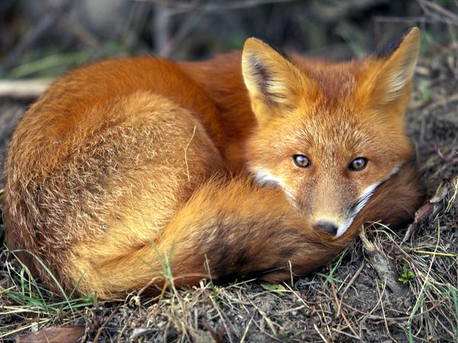

Slide 36
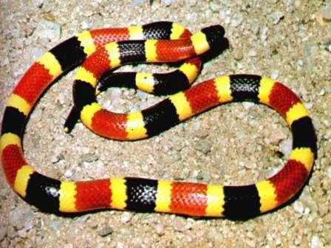

Slide 37
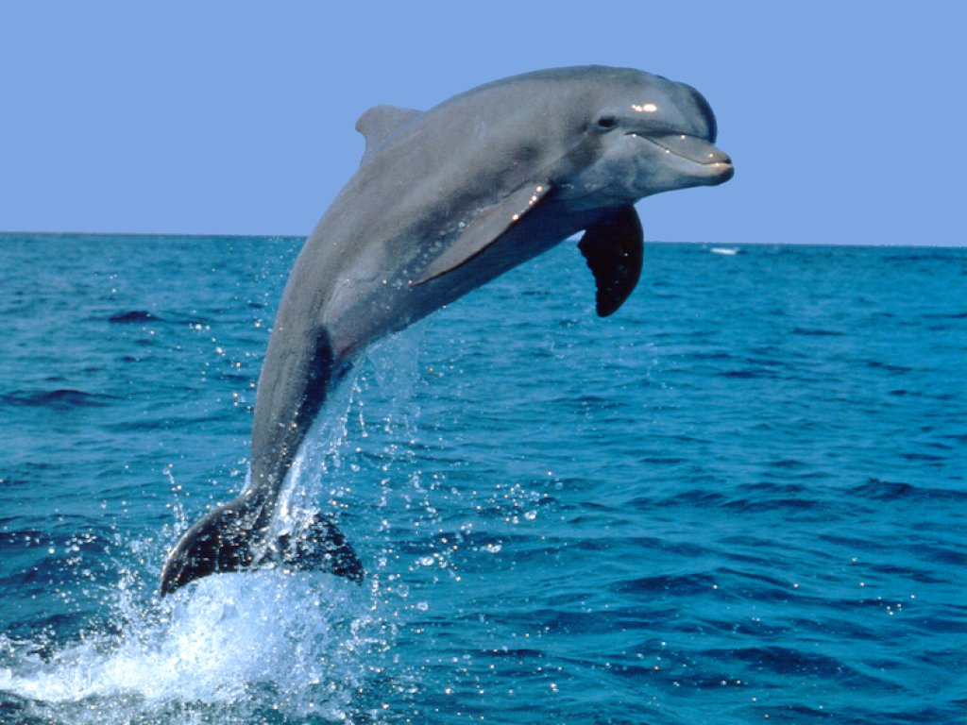

Slide 38
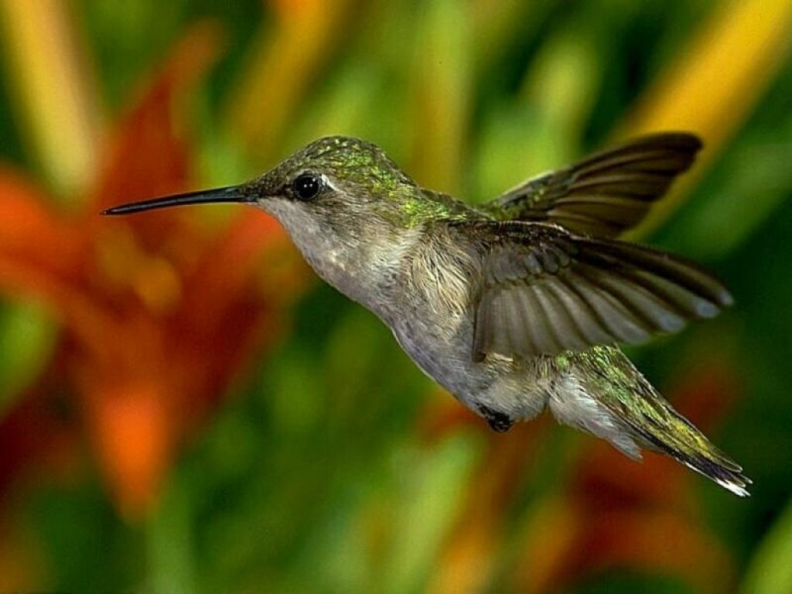

Slide 39
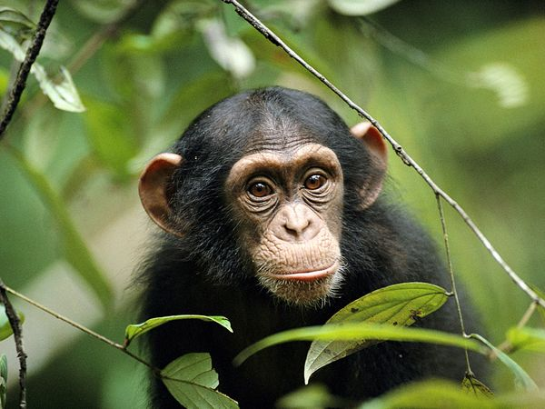

Slide 40
