Slide 2
Learning Objective
To identify and compare the mass of objects using balance scales.
Success Criteria
I can identify the mass of objects by counting uniform informal units.
I can compare the mass of objects using uniform informal units.

Slide 3
Mass
the same as
less than
heavier
heaviest
more than
lighter
lightest
equal to

Slide 4

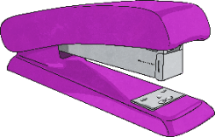
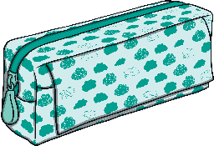

Find and compare the mass of the objects.
4
The pencil case weighs
marbles.
The stapler weighs marbles.
6
lighter
The stapler is than the pencil case.

Slide 5

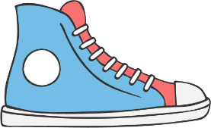
Find and compare the mass of the objects.
11
15
The shoe weighs marbles.
The book weighs marbles.
heavier
The book is than the shoe.

Slide 6


Find and compare the mass of the objects.
12
12
The bottle weighs marbles.
The mug weighs marbles.
the same as
The mug is the bottle.

Slide 7
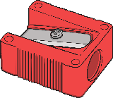

Find and compare the mass of the objects.
2
1
The eraser weighs marbles.
The sharpener weighs marble.
heavier
The eraser is than the sharpener.

Slide 8

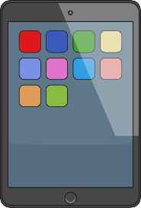
Find and compare the mass of the objects.
The paint tin weighs
marbles.
18
The tablet weighs marbles.
15
heavier
The tablet is than the paint tin.

Slide 9



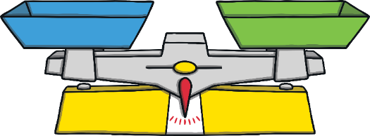
Find and compare the mass of the objects.
The stapler
weighs
marbles.
The laptop
weighs
marbles.
The lunch box weighs
marbles.
11
16
14
lightest
The stapler is the .
heaviest
The laptop is the .

