Slide 1
Subtracting
Fractions
LO: I can subtract fractions with the same denominator.

Slide 2
Subtracting Fractions
Subtracting fractions with the same denominator is really simple!
Write down your calculation.
Your answer will have the same denominator.
Find the difference between the numerators – you have you answer!
If you can, simplify the new fraction to its lowest form.
Numerator:
5
3
2
1
=
=
6
6
6
3
Denominator:

Slide 3
Subtracting Fractions
1111
3
4
1
4
2
4
1
2
-
=
or

Slide 4
Subtracting Fractions
3
4
1
4
2
4
1
2
-
=
or

Slide 5
Subtracting Fractions
4
5
3
5
1
5
-
=

Slide 6
Subtracting Fractions
4
5
3
5
1
5
-
=

Slide 7
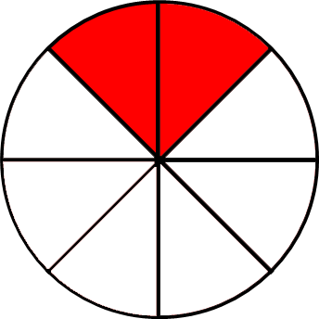
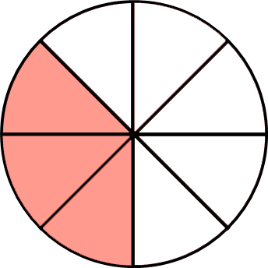
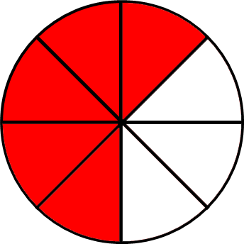
Subtracting Fractions
5
8
3
8
2
8
-
=

Slide 8

Subtracting Fractions
5
8
3
8
2
8
-
=

Slide 9
Subtracting Fractions
7
10
3
10
4
10
2
5
-
=
or

Slide 10
Subtracting Fractions
7
10
3
10
4
10
2
5
-
=
or

Slide 11
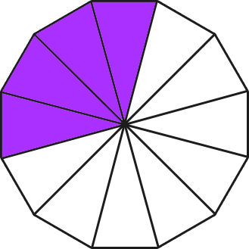
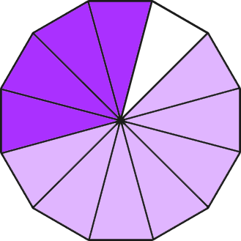
Subtracting Fractions
11
12
7
12
4
12
1
3
-
=
or

Slide 12
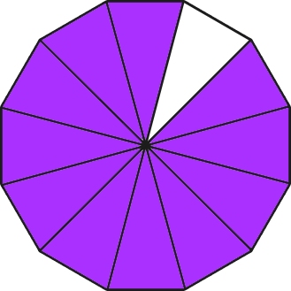
Subtracting Fractions
11
12
7
12
4
12
1
3
-
=
or

