Slide 1
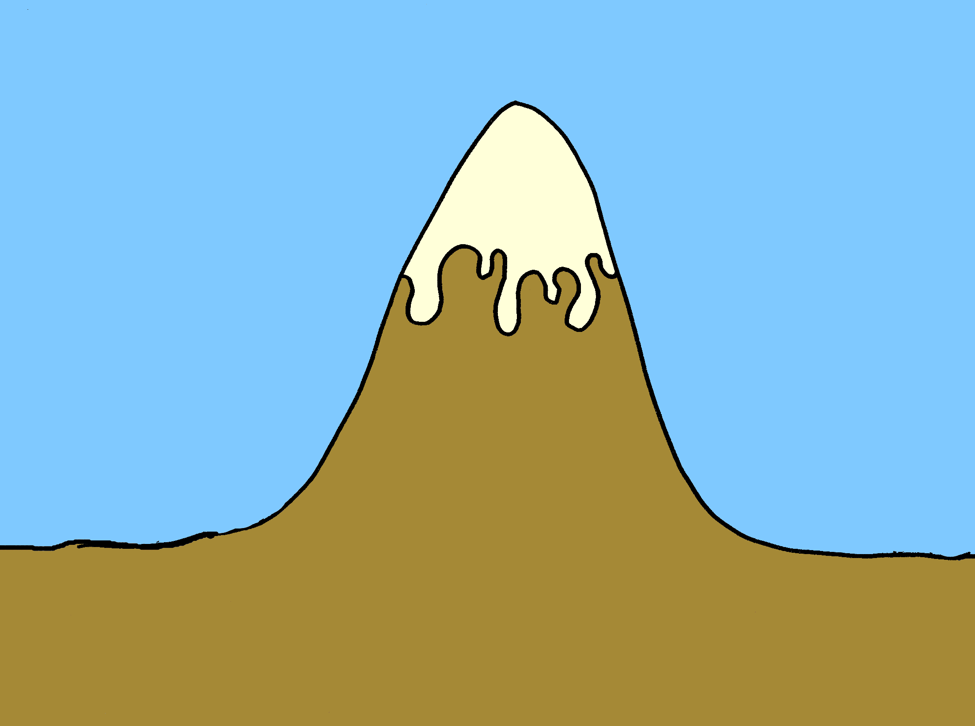
The Story Mountain

Slide 2
Introduction
The Story Mountain

Slide 3
Build up
Introduction
The Story Mountain

Slide 4
Problem!!
Build up
Introduction
The Story Mountain

Slide 5
Problem!!
Build up
Fix problem
Introduction
The Story Mountain

Slide 6
Problem!!
Build up
Fix problem
Introduction
Ending
The Story Mountain

