Slide 1
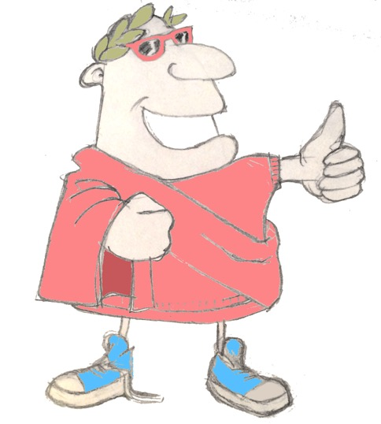
maximum Classics – 18
All about me
Language L.O. to encounter Latin adjectives and the concept of agreement

Slide 2
word roots challenge
How many English words can you find from these Latin words?
primus/prima
first
malus/mala
bad
bonus/bona
good
mirus/mira
amazing
secundus/secunda
!
frigidus/frigida
cold
tertius/tertia
third

Slide 3
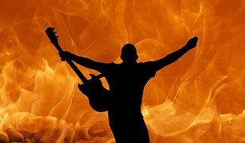
Verb endings

Slide 4
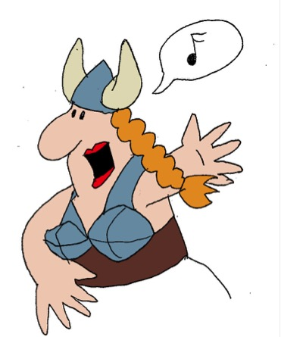
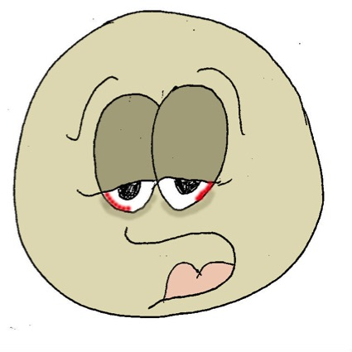
‘being’ verbs
sum
I am
es
you are
est
he/she/it is
sumus
we are
estis
y’all are
sunt
they are

Slide 5
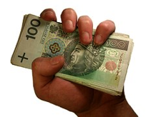
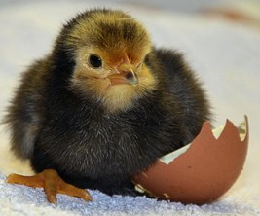
Quick fire verbs
habere
amare
esse
amo
sunt
habeo
amatis
sum
est
habes
habet

Slide 6
Spot the adjectives
he sings
horse
happy
disgusting
quickly
a dog
we saw
I am
you are going
yellow
enormous
terrific
strawberry jam
happiness
Paris
well-behaved

Slide 7
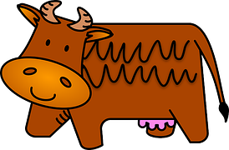
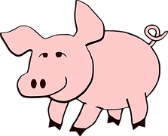
Latin adjectives
vacca prima est
equus tertius est
porcus secundus est

Slide 8
Latin adjectives
primus
equus ………… est
secunda
vacca ………… est
tertius
porcus ………… est

Slide 9
Latin adjectives
Latin adjectives have to match the noun they’re describing
masculine or feminine
us
a

Slide 10
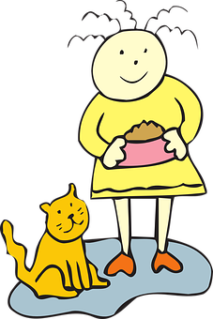
Describe yourself in Latin
Fill in the gaps, then translate the sentence. You’ll see a mixture of doing and being verbs being used, as well as some adjectives. Make sure you remember if you’re a boy or a girl when describing yourself!
1. mihi ………………….. nomen est.
translation: …………………………………………………………..
Carlotta
My name is Carlotta.
bonus/bona
malus/mala
2. ………………….. sum!
translation: …………………………………………………………..
bona
I am a good girl!
tertius/tertia
3. in familia mea ………………….. sum.
translation: …………………………………………………………..
primus/prima
prima
In my family I am the first/oldest.
secundus/secunda
4. capillos ………………….. habeo.
translation: …………………………………………………………..
brunos
brunos =brown
atros = black
flavos = blonde
rufos = red
I have brown hair.
5. oculos ………………….. habeo.
translation: …………………………………………………………..
brunos
I have brown eyes.
brunos =brown
caeruleos = blue
virides = green
ravos = grey
6. ………………….. amo.
translation: …………………………………………………………..
legere
I like to read.
♫
♬
pediludere
legere
cantare
pingere
currere
animalia curare

Slide 11
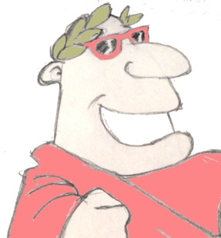
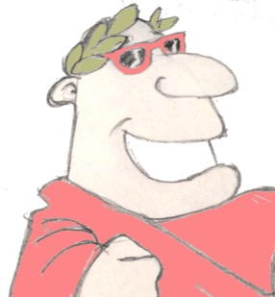
Plenary
What does ‘tertius’ mean in English?
Is a vacca ‘bona’ or ‘bonus’?
bonus es?

