Slide 1
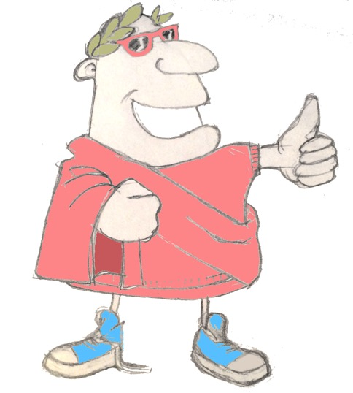
maximum Classics – 17
Olympic lies
Language L.O. to recap regular verbs, ‘being’ verbs and nouns in sentences

Slide 2



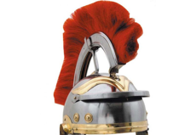





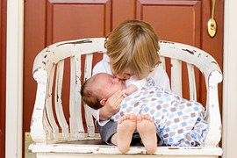
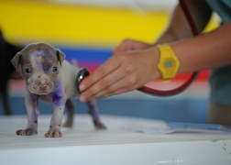
Ecce centurio!
(Can you remember what these Latin words mean?)
videre
ventus
bravo!
luna
laudare
audire
curare

Slide 3
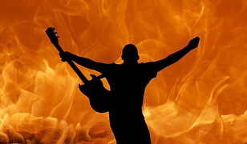
Verb endings

Slide 4
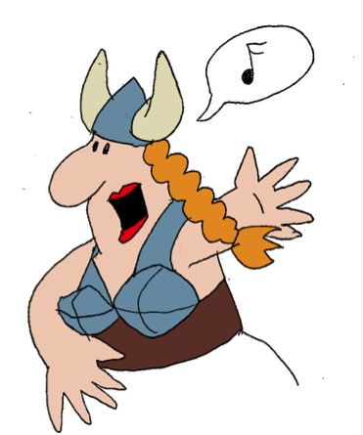
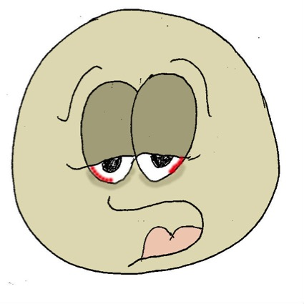



‘being’ verbs
sum
I am
es
you are
est
he/she/it is
sumus
we are
estis
y’all are
sunt
they are

Slide 5





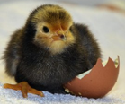
Quick on the draw
bravo!
esse
laudare
audire
stella
luna
medicus
ventus
(Try to test yourself by translating these sentences)
ventum
audimus

Slide 6
Quick on the draw
bravo!
esse
laudare
audire
stella
luna
medicus
ventus
stella
es

Slide 7
Quick on the draw
bravo!
esse
laudare
audire
stella
luna
medicus
ventus
stellas
medici
laudant

Slide 8
Quick on the draw
bravo!
esse
laudare
audire
stella
luna
medicus
ventus
lunam
laudatis

Slide 9
Quick on the draw
bravo!
esse
laudare
audire
stella
luna
medicus
ventus
in lunā
sunt
medici
clue
in = on

Slide 10
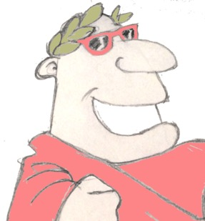
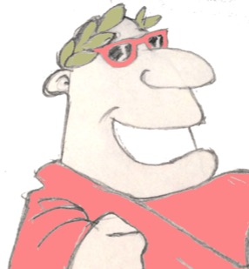
Plenary
What does ‘luna’ mean in English?
To whom were the Ancient Greek Olympics dedicated?
ventum audietis?

