Slide 1
Look…
Look at these pictures, and in your own words, describe how you think Egypt looks.

Slide 2
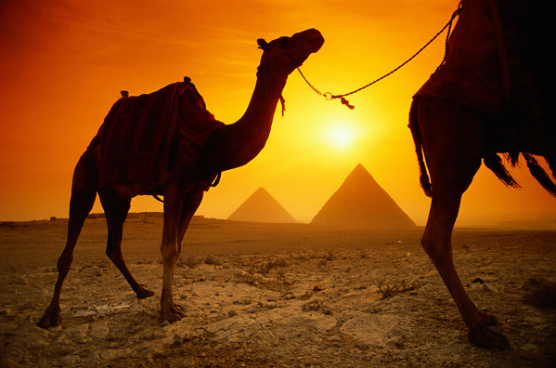
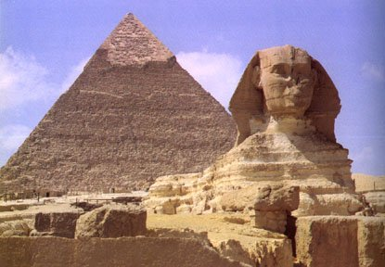
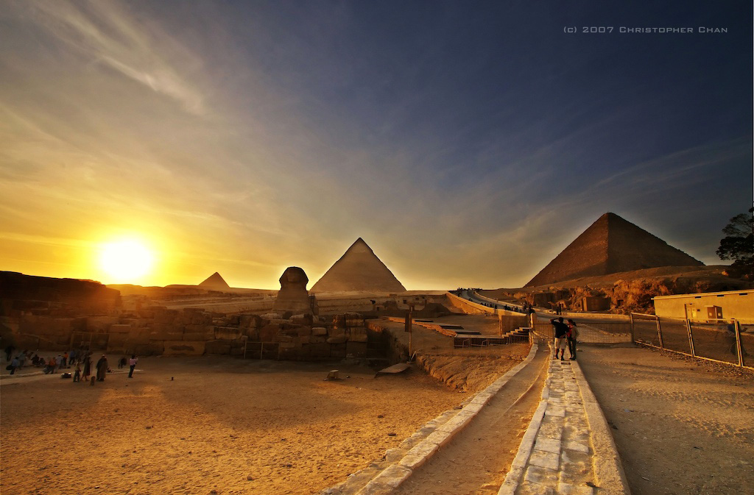
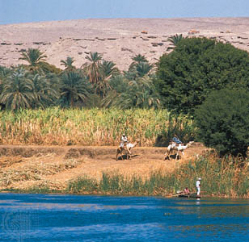

Slide 3
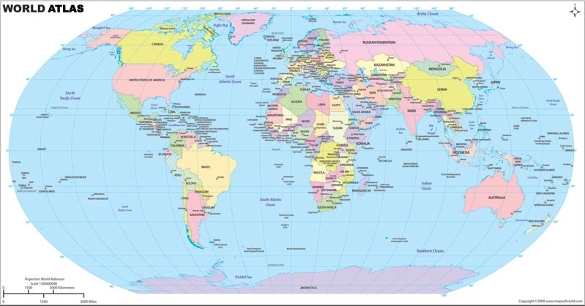
Where is Africa? Where is Egypt? Where is the River Nile?

Slide 4
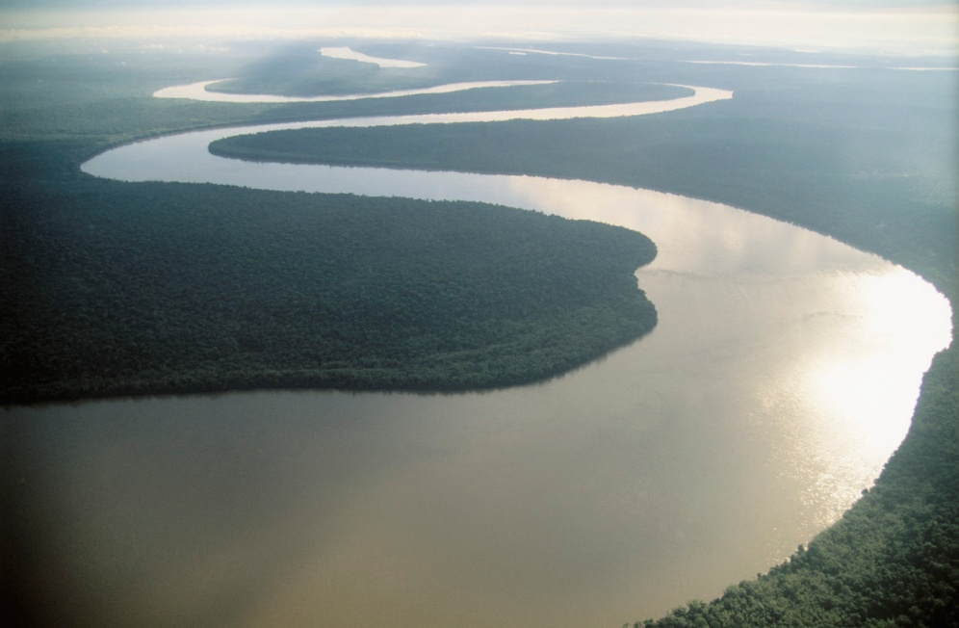
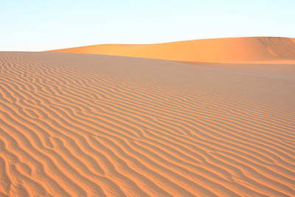
Gift of the Nile

Slide 5

Gift of the Nile
The Nile provided water
A useful ingredient for making houses
From here, villages were created

Slide 6
What is in a village?
There were 2 types of villagers homes:
Nobles homes
Pesasnt homes

Slide 7
Nobles
These houses were built near the river
They were big, beautiful and had many rooms
Most villas had up to 30 rooms! Including play room, bedrooms, storage rooms and even bathrooms!
Their homes were usually built off the ground to reduce sand and dirt

Slide 8
Peasant homes
These homes were considerably small
But still very nice
Each peasant family had their own home, some even had 2 stories
People usually slept on their roof as it was much cooler
Some house might be bigger, people didn’t care about the size of your house, just as long as you made it!

Slide 9
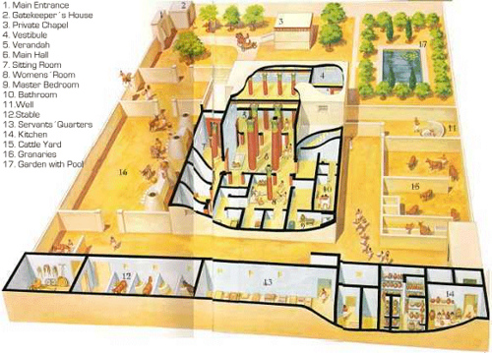

Slide 10
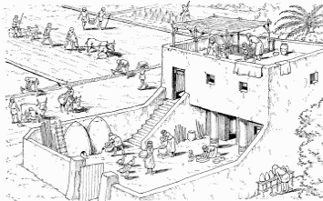

Slide 11
Jobs are roles around the village
There wasn’t any official ‘president’ role in the village
Was a common leader
Some, richer villages had Pharaohs and leaders

Slide 12
What is needed in a village?
If you lived in a village, what would you want?
Remember, you don't have much!
Here is what you have:
  Water
  Mud
  Basic tools
  Reeds (plants)
  Seeds
  Family

Slide 13
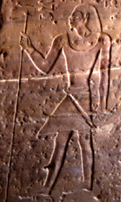
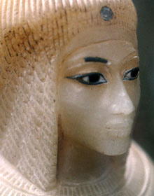
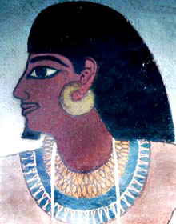
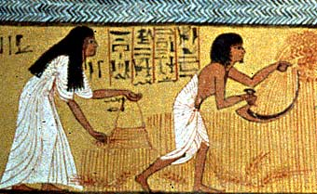
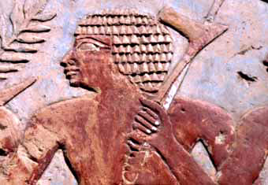
Describe these people:

