Slide 1
Democracy
As we look at these slides – think about what makes democracy a good thing.

Slide 2
What is Democracy?
Democracy is a system of government, where the whole population gets to vote for representatives to represent their area.
Equality and freedom are characteristics of democracy. In many countries, democracy is the most popular form of government.

Slide 3
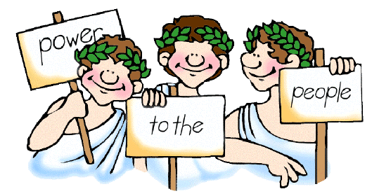
Athens, Ancient Greece
In Athens in Ancient Greece, one person couldn't just be a leader, government officials were elected by the citizens.
Democracy meant you couldn’t just be a dictator or tyrant.
People in Athens believed that citizens should choose rulers, and vote on matters themselves. Anyone could propose a new law.

Slide 4
What is the process of Democracy? (Ancient Greece)
There was two types of democracy in Ancient Athens:
The Assembly was made of male citizens, who made the laws of the land. The Assembly could exile unpopular or dishonest leaders. The Assembly was made up of 6000 citizens and attended meetings about new laws.
The Council was made up of 500 male citizens, chosen every year by lot - names drawn from all Athenian citizens. Members of the Council serve for one year; they prepared laws for the Assembly to consider.

Slide 5
Who could vote in Ancient Greece?
In Ancient Greece, only citizens could vote. Children & slaves were not considered citizens, so they could not vote.
Women were citizens, but without political rights, so they could not vote.
They believed all Greek men (except slaves), rich or poor, had the right to vote.

Slide 6
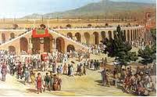
Why was democracy important in Ancient Greece?
Democracy in Ancient Greece was a fair way of choosing a leader. It gave a chance for poor men to lead in the government. All men had the right to speak for themselves, be fairly treated, take part in the decisions, and vote.
It caused fewer arguments about the laws being made and prevented Ancient Greece from having any bad leaders.

Slide 7
WALT: Understand democracy
What are the good things about democracy in Ancient Athens?
Is there anything you don’t agree with?
Word bank: fair, freedom, decision, vote, laws, leaders, dictator, tyrant, equality

Slide 8
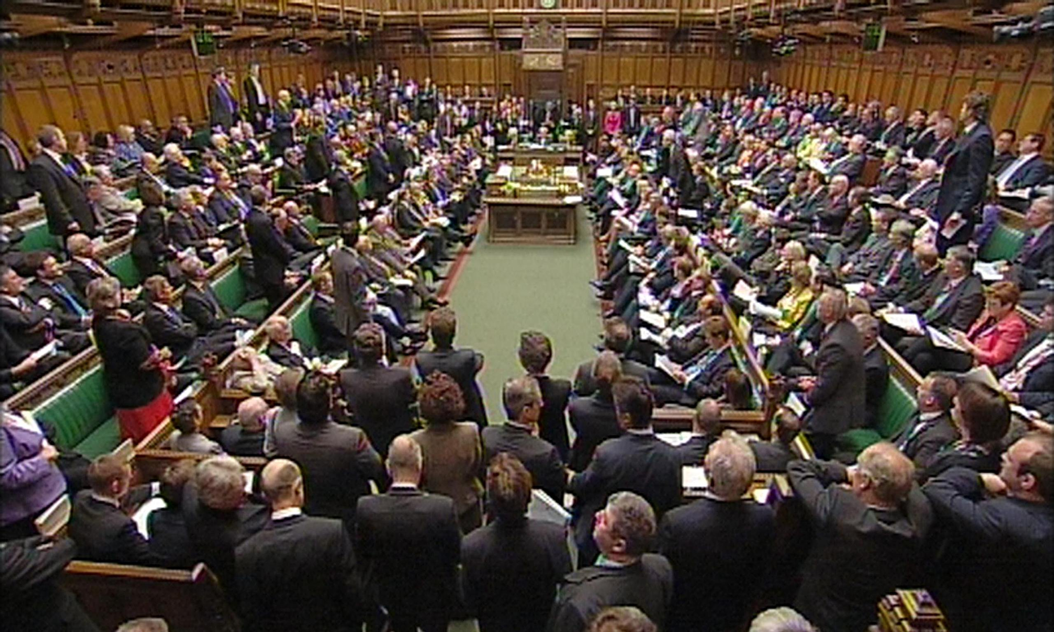
Democracy in Britain Today
© Original resource copyright Hamilton Trust, who give permission for it to be adapted as wished by individual users.
We refer you to our warning, at the foot of the block overview, about links to other websites.
Notes:
<Foliennummer>

Slide 9
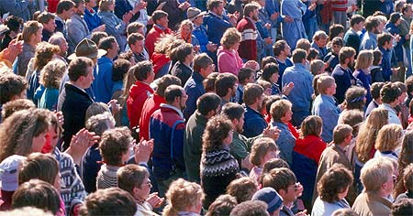
Today, democracy prevents people from just becoming a leader because of their family history.
Democracy also prevents there being any dictators.
It gives citizens the freedom to vote for who they want to be the leader.
It lets us vote for people who can represent us in a respectful way.

Slide 10
We hold an election to choose someone to represent us.

Slide 11
Most candidates who ‘stand’ for election belong to a political party.
Together people who belong to the party agree on the changes they will make if they are elected. These are called policies.
Can you name the three main political parties and their leaders?

Slide 12

Every citizen should listen to the views of the different parties and candidates, and then make his or her own decision on whom to support.

Slide 13
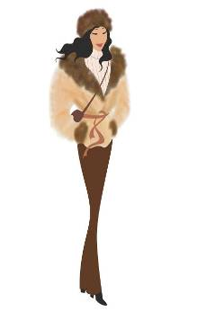
Each person (voter) votes (‘casts a ballot’) for the candidate of his or her choice. S/he does this by putting a cross X beside the person’s name on the ballot paper.
People cast their ballots in a booth so that no one can see who they are voting for. This is called a ‘secret ballot’.

Slide 14
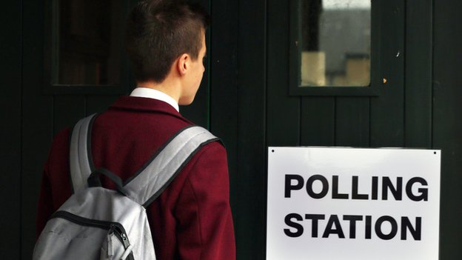
Democracy Today
All men and all women over 18 can vote!
Notes:
<Foliennummer>

Slide 15

At the end of the Election Day the votes are added up and the candidate with the highest number of votes (the majority) is declared the winner.
1st
2nd
3rd

Slide 16

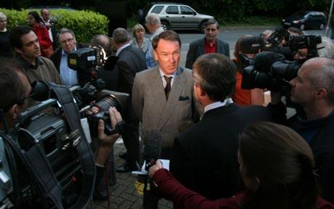
Democracy Today
The people we vote for are called Members of Parliament, or MPs for short.
They sit in Parliament and debate new laws. They also meet the people who voted for them to find out what they want.
Notes:
<Foliennummer>

